Slide 1


Dynamic Image Stacks
David E. Jacobs
Stanford University
Orazio Gallo Kari Pulli
NVIDIA Research
Notes:
Hello everyone, my name is David Jacobs. Today I’m going to be talking about some work I did with Orazio Gallo and Kari Pulli on a new interactive photo viewing experience we call dynamic image stacks.

Slide 2
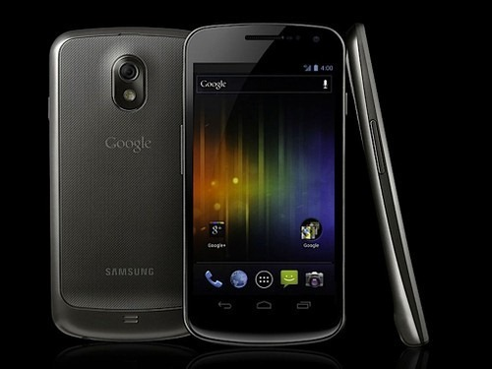
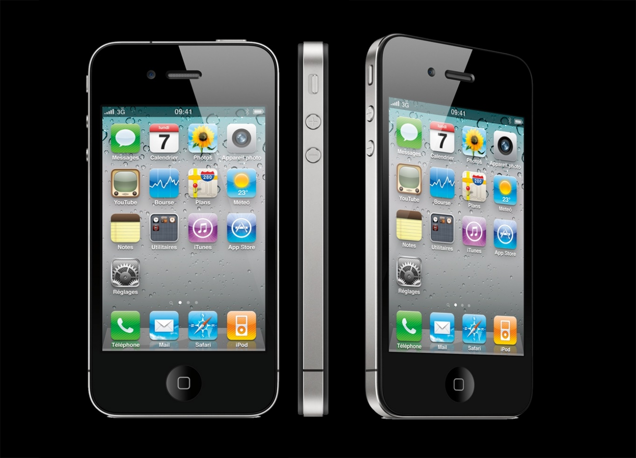
Cameras are everywhere
Notes:
In the last five years or so the rise of the smart phone has wildly changed the way people create and consume media.
One interesting consequence of this event is that now cameras are ubiquitous and attached to surprisingly powerful portable computers.
This is particularly exciting for researchers like myself as it’s finally possible to get computational photography out of the lab and into the hands of the general public.

Slide 3
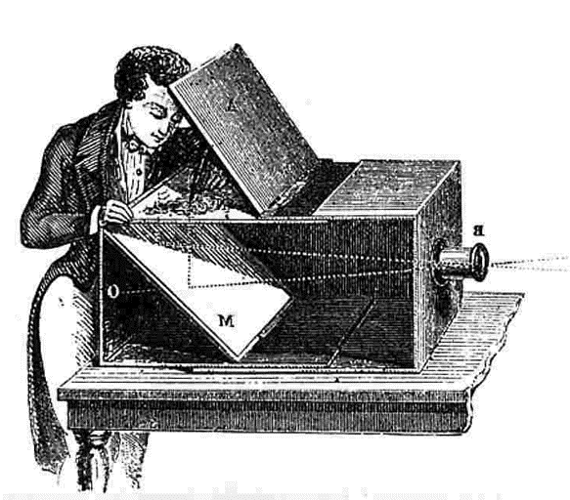
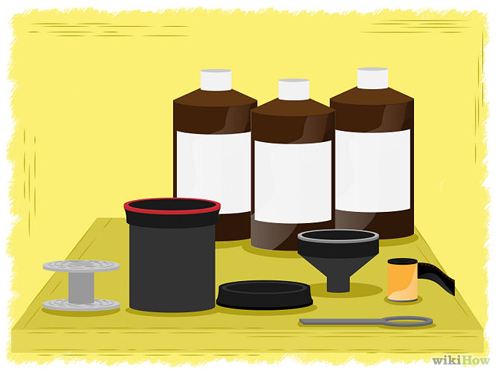
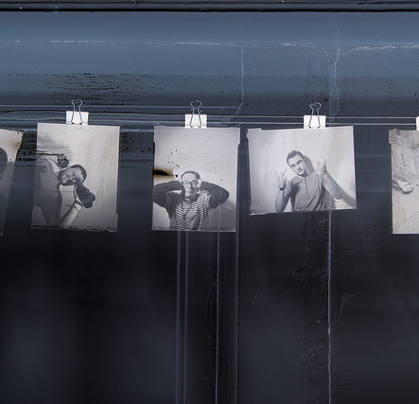
Photographic workflow
Capture
Develop
Print
Notes:
Computational photography has been around a lot longer than smart phones, however, so while many classic techniques make good use of the computing resources available on modern devices, they still stuck in the traditional photographic workflow…
You capture the light on film or a sensor, develop the image with chemicals or post processing algorithms, and then print the result to some photo paper or the modern equivalent, a JPEG file.
In this work, we argue that adhering to this traditional workflow amounts to a missed opportunity.

Slide 4
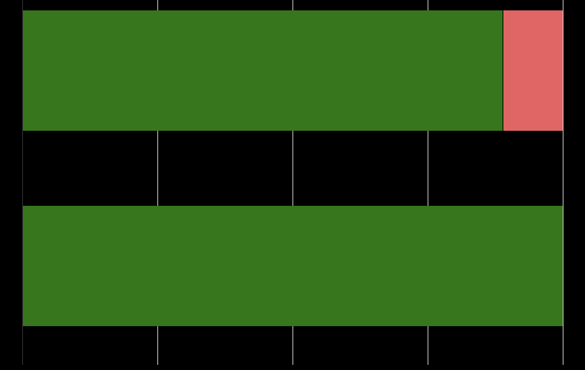
Printing photos is rare
Proportion of responses
Print ≤5% of nice photos
All respondents
(n = 153)
Print >5% of nice photos
89%
Cell phone photographers
(n = 22)
Notes:
Most photographers never print any of their photographs. In a survey of 153 people, 89% reported printing fewer than 5% of the photographs they considered worth saving and sharing with friends. If we limit ourselves to the 22 people who primarily take pictures with mobile devices, 100% of them reported almost never printing photographs.
If we don’t have to worry about being able to represent a capture session as a static 2D image, we can be much more flexible when it comes to designing our photographic workflow.

Slide 5
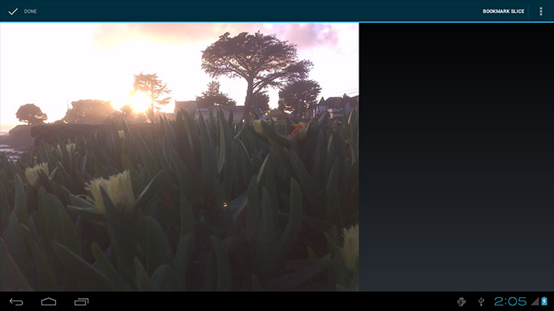
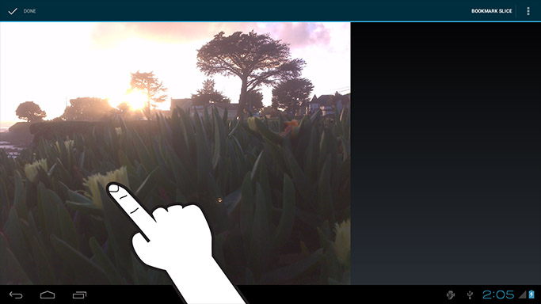
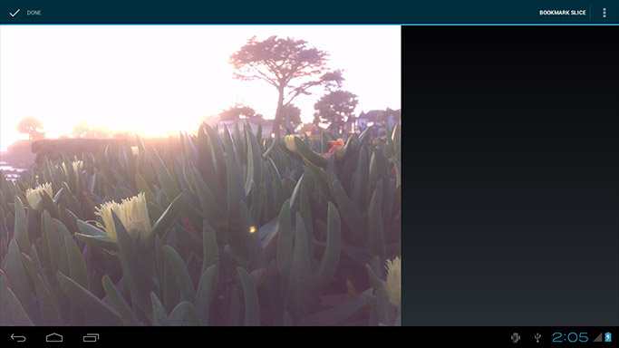
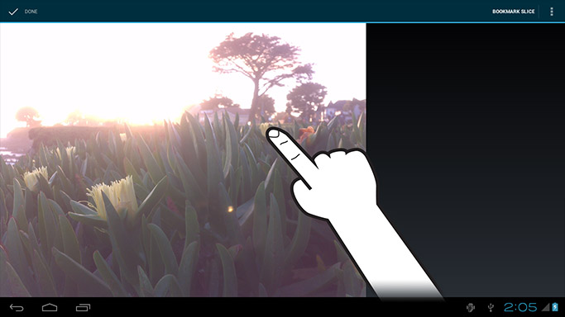

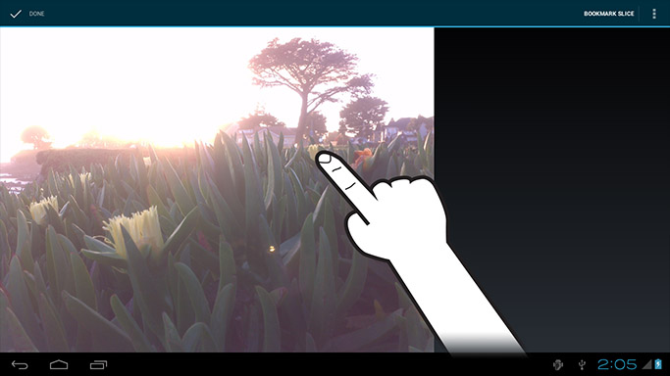
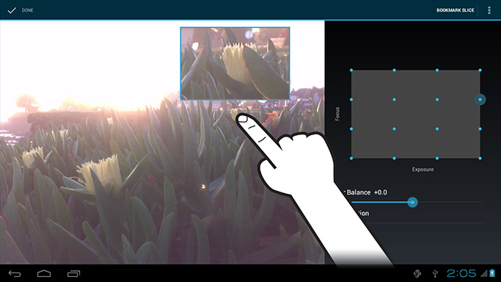
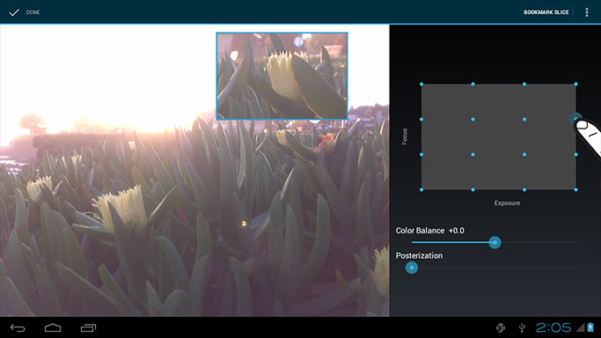
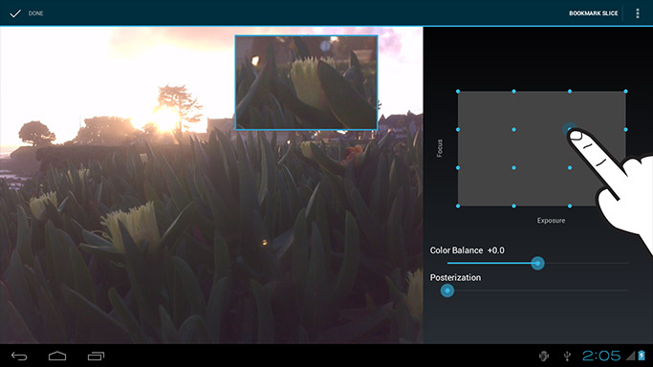
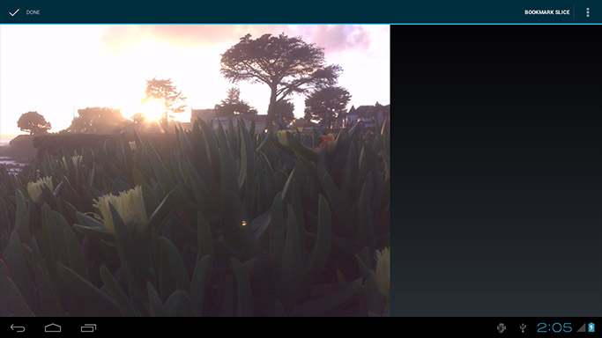
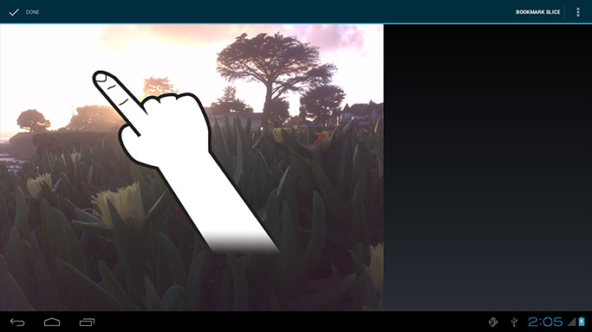
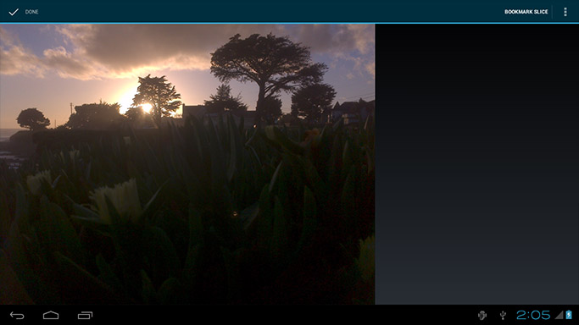
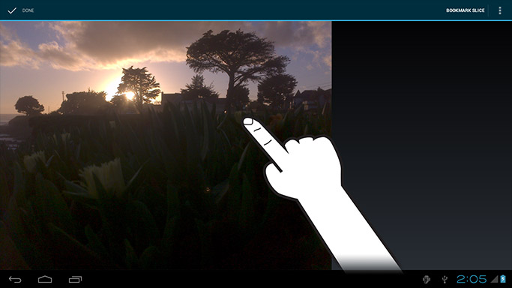
Notes:
To help demonstrate this, we developed dynamic image stacks, an alternative to the traditional workflow that encourages the viewer to actively explore a scene instead of passively observing it.
We try to mimic the human visual system, treating user touches as a proxy for eye fixations.
Tapping on the flower in the foreground, for instance, causes your view of the scene to adapt just like your eyes would, focusing on the flower and exposing it properly.
Tapping on the flower in the background similarly shifts the focus further away.
We don’t _have_ to try to mimic the eye though. Suppose there is a nicer view of that flower we’d rather see.
If I tap and hold on that flower, I can override the regular autofocus and auto exposure to choose a more artistic feel for that part of the scene.
The app will remember my preferences, so the next time I tap on that flower I’ll get this nice sunset silhouette view instead.
By allowing for a few simple taps and gestures, we can create a much richer viewing experience than any standard gallery app can provide.
As a secondary benefit, because we’re simply providing a nice interface for browsing the photos coming straight out of the camera, we don’t need to worry about introducing compositing artifacts or creating dull low contrast images. Instead, we get to take advantage of the built in the manufacturer-tuned post processing pipelines, which provide excellent quality individual images.

Slide 6
Outline
Introduction
Related work
Design and implementation
Discussion
Notes:
The remainder of the talk will be structured as follows.
First, I talk a little bit about related work, then I’ll our system and its inner workings in greater detail, and finally I’ll discuss an evaluation of our system and future work.

Slide 7
Outline
Introduction
Related work
Design and implementation
Discussion
Notes:
Okay, now let’s discuss a little bit about some earlier projects with similar goals.

Slide 8
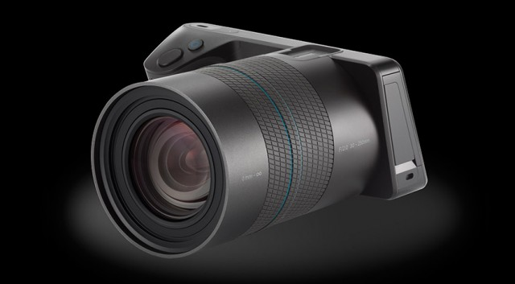
Related work
Lytro 2012
Notes:
We are not the first to propose a dynamic display technique.
Other companies and research groups have also been exploring novel interfaces for specialty image data.
I’ll mention a few of the notable projects here.
The Lytro lightfield camera captures a low resolution 4 dimensional lightfield, which is difficult to appreciate as a 2D image.
Instead, the lytro approach is to create what they call a living image, an interactively refocusable photograph controlled by taps or clicks.
So here we have the slice focused on the background.
If we tap on the midground, the focus shifts to the sprinkle donut.
And tapping the foreground puts the focus on this pink one.
Our work can emulate this same style of interaction, but we do not require any specialty hardware or make any sacrifices in spatial image resolution.

Slide 9
Related work
Lytro 2012
Mantiuk and Heidrich 2009
Notes:
As many of you probably know, it can be difficult to really reproduce the experience of viewing a high dynamic range environment with a single image.
Tonemapping tends to sacrifice global contrast in favor of higher local contrast.
In 2009, Mantiuk and Heidrich presented an interactive web browser based alternative to aggressive tonemapping.
Their HDR image viewer provided a simple slider interface for controlling which portion of the scene’s radiance to show onscreen.
It lets you drag around this blue rectangle to choose different virtual exposures for the image shown on screen.
Our method provides a slider interface in addition to our touch to expose modality, but does not require the creation of a radiance map, which can be particularly difficult for moving scenes.

Slide 10
Outline
Introduction
Related work
Design and implementation
Discussion
Notes:
Next I’ll talk about the specifics of our system and what it can do.

Slide 11
Capture
NVIDIA Tegra 3 Tablet
4 exposure values x 4 focus distances
FCam API (Adams et al. 2010)
Focus
Exposure
Notes:
The first step is to capture a stack of images.
We programmed an NVIDIA Tegra 3 tablet to capture a 4 by 4 focus exposure stack using the Fcam API.
As the photographer, you point the camera at the scene and hit the shutter button like you would any other camera app.
The only difference is that behind the scenes the camera captures 16 images over a second or two, depending on the exposure times required.

Slide 12
Exploration
Notes:
As soon as the capture is done, the stack is ready to be explored.
You’ve already seen most of the interaction, but this time we’ll go a little slower and spend some time talking about what’s going on under the hood for the different types of interaction.
First, let’s look at a basic tap.
Suppose that a user taps right here.
We can generally assume that action translates to “make this object look better”.
This is trickier than you might think at first, as the capture process allows time for movement in both the scene and camera between frames.
For example, in this scene, the flower blows in the wind and the camera itself moves substantially.
So if we were to just look at the pixels inside the red circle, we wouldn’t be able to do any fair comparisons to find the best picture of that flower.

Slide 13
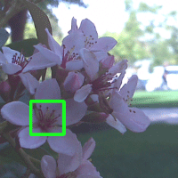
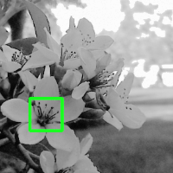
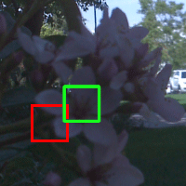
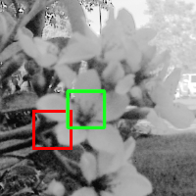
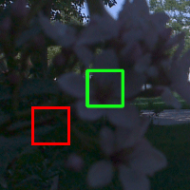
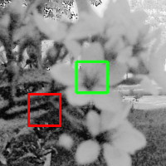
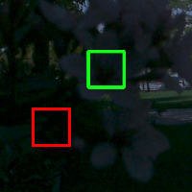
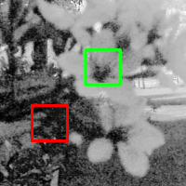
Registration
Notes:
Let’s zoom in a bit to see this closer up.
The originally selected patch is shown on the left most image.
The red squares in the other images show patches with the same pixel coordinates, while the green squares show patches with the same semantic meaning.
We need to find those green squares.
We do this in a two step process.
First, we normalize for the exposure of the images using a histogram normalization operation,
Then, we perform a brute force window search. Basically, we look at every patch in a small radius around the red square, subtract them from the query patch, and trying to find the patch with the smallest total difference.
This simple registration algorithm won’t yield pixel perfect correspondences, but for our purposes we don’t actually care.
Recall that we aren’t trying to do any compositing, we just want to make sure we are doing a fair comparison.
So long as the registration is accurate to within the radius of the user’s finger, she won’t be able to tell the difference anyway.

Slide 14
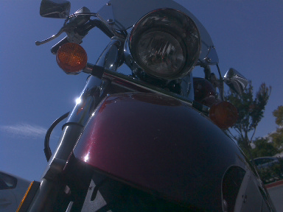
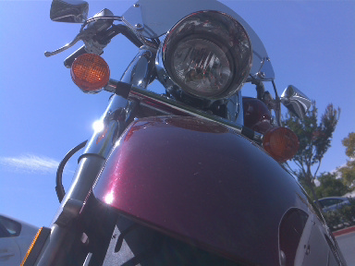
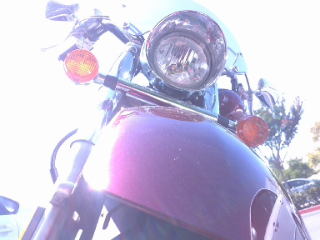
Autoexposure
Full Frame
Sky Patch
Fender Patch
Notes:
Now that we have comparable patches to look at, we need to figure out which one is the best for showing the object of interest.
Let’s start with figuring out the best exposure value.
Typically, an auto-exposure algorithm will work by looking at the histogram of the image, and try to find an exposure level which pushes the average gray level of the image towards 50%.
The intention is to try to get as much of the image as possible into the regime in which the camera sensor works best.
The middle of the range is best because low gray levels are dominated by noise, while pixel values near saturation suffer from sensor non-linearities.
In these histograms I’ve shown the mean pixel luminance as a red line, so this simple algorithm would say the middle picture is best exposed.
As a photographer, I would agree.
This scene isn’t particularly high dynamic range, so we can get good detail everywhere in a single picture: the sky is nice and bright without saturating, the fender has some nice color to it and isn’t obscured by glare.
So this works pretty well for full images, but let’s see what happens when we try the same approach on small patch of sky.
You’ll notice that the histogram of a small patch is very different from a full image, blindly applying the same algorithm would result in picking the left image, which underexposes the sky.
Similarly, comparing the histograms of a fender image patch overexposes that part of the scene.
We solve this problem by estimating the correct gray level of an image patch to be closer to the histogram normalized gray level. So if an patch is really bright or dark compared to the rest of the scene, it will stay that way when autoexposed.
In this case, our algorithm would choose the center image for both image patches.

Slide 15




Autofocus
∑
11460
11372
10552
8054
Notes:
Once we’ve found the best exposure, we need to select the best focused image with that exposure value.
In order to evaluate focus, we just filter the patches with a Laplacian kernel to get contrast images, then simply sum up the patches to get contrast scores.
More contrast means better focus, pretty simple.
Once we’ve chosen our patch, we update the screen and wait for the next interaction.

Slide 16
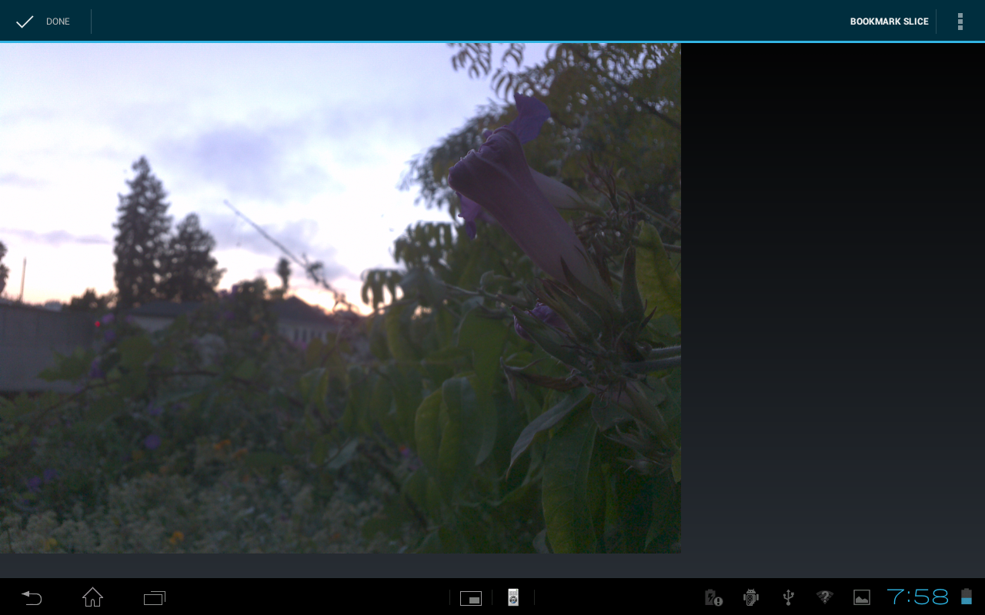
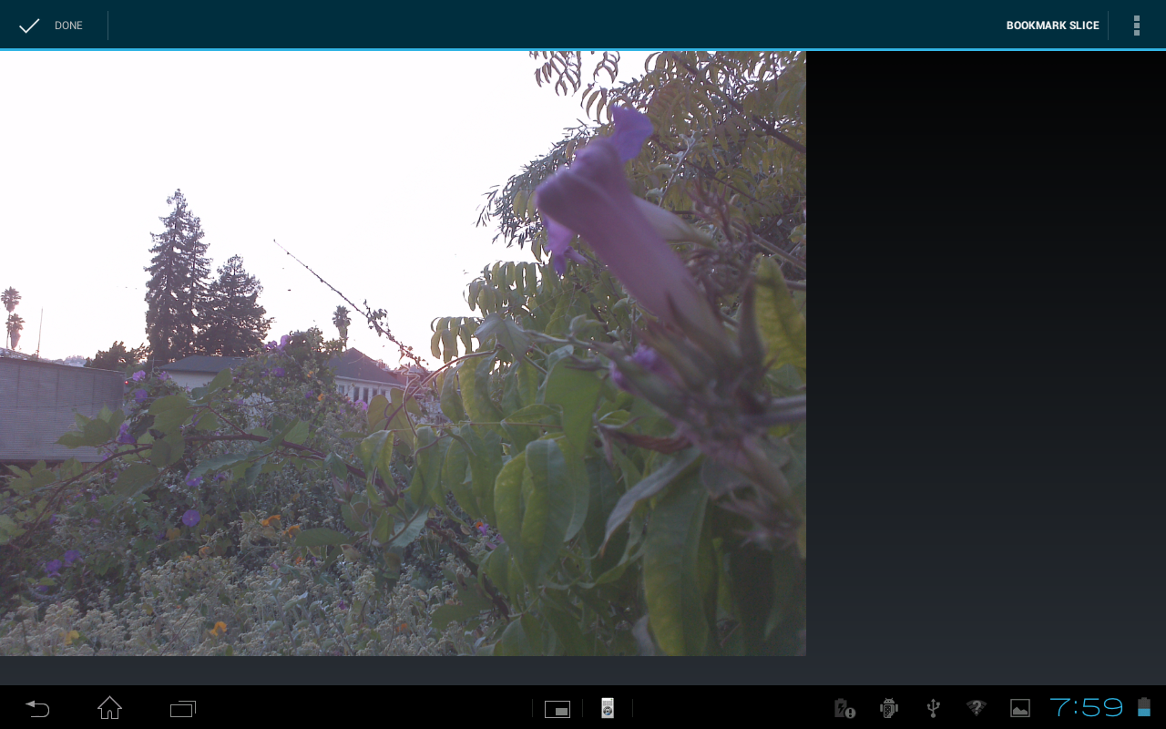
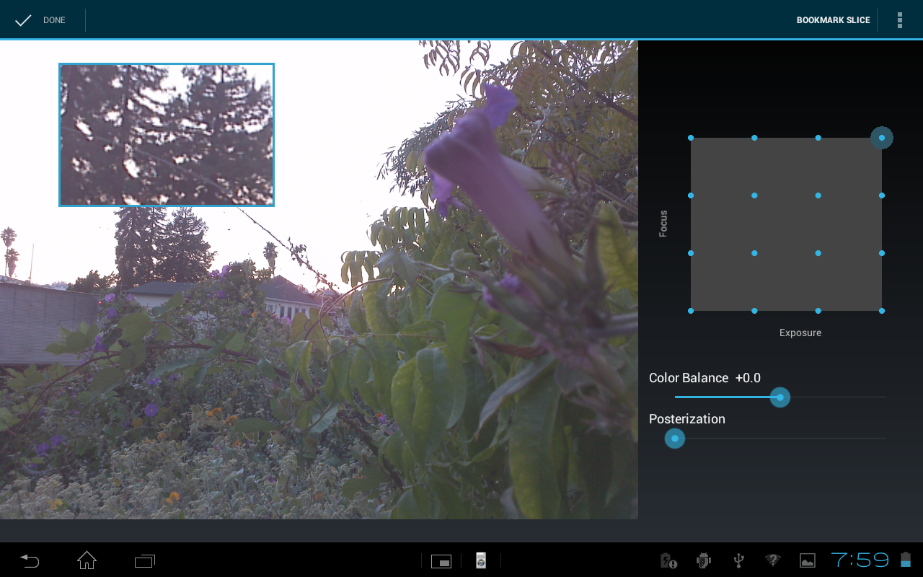
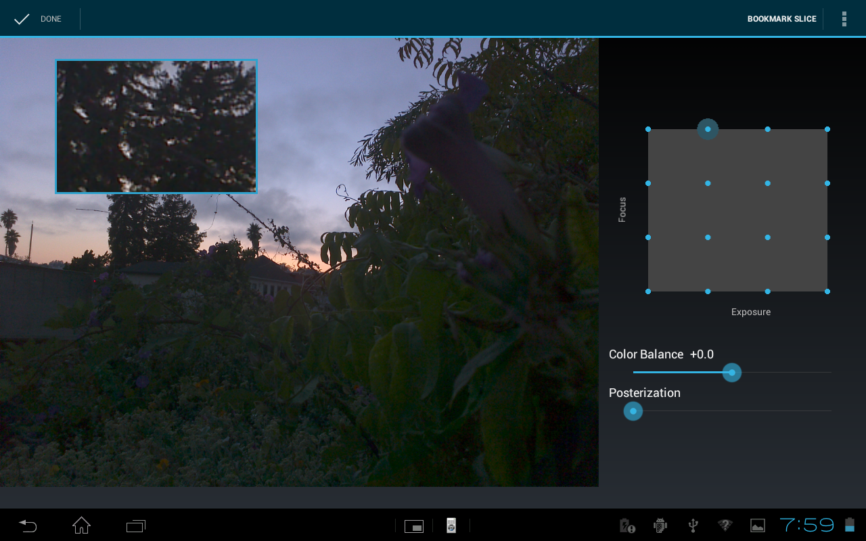
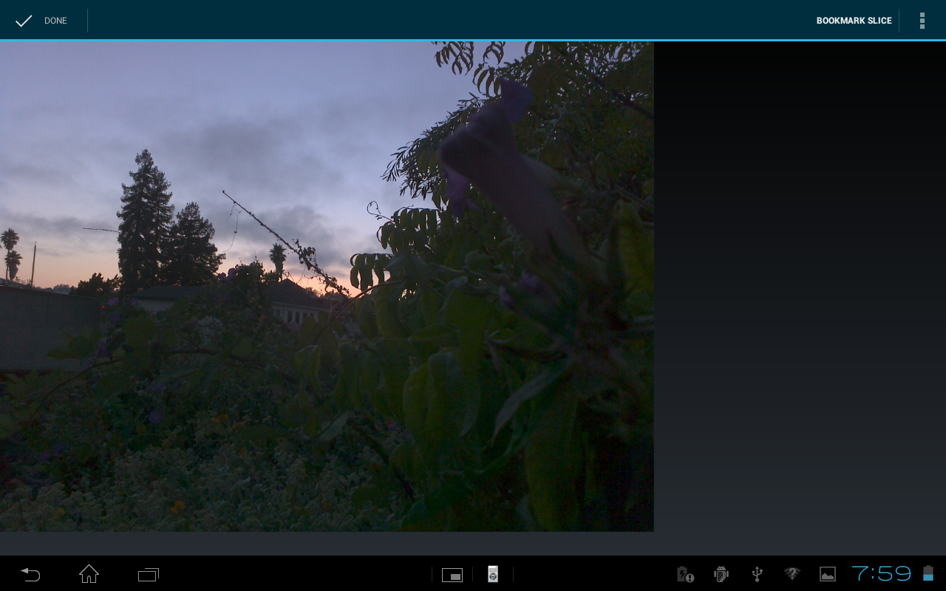
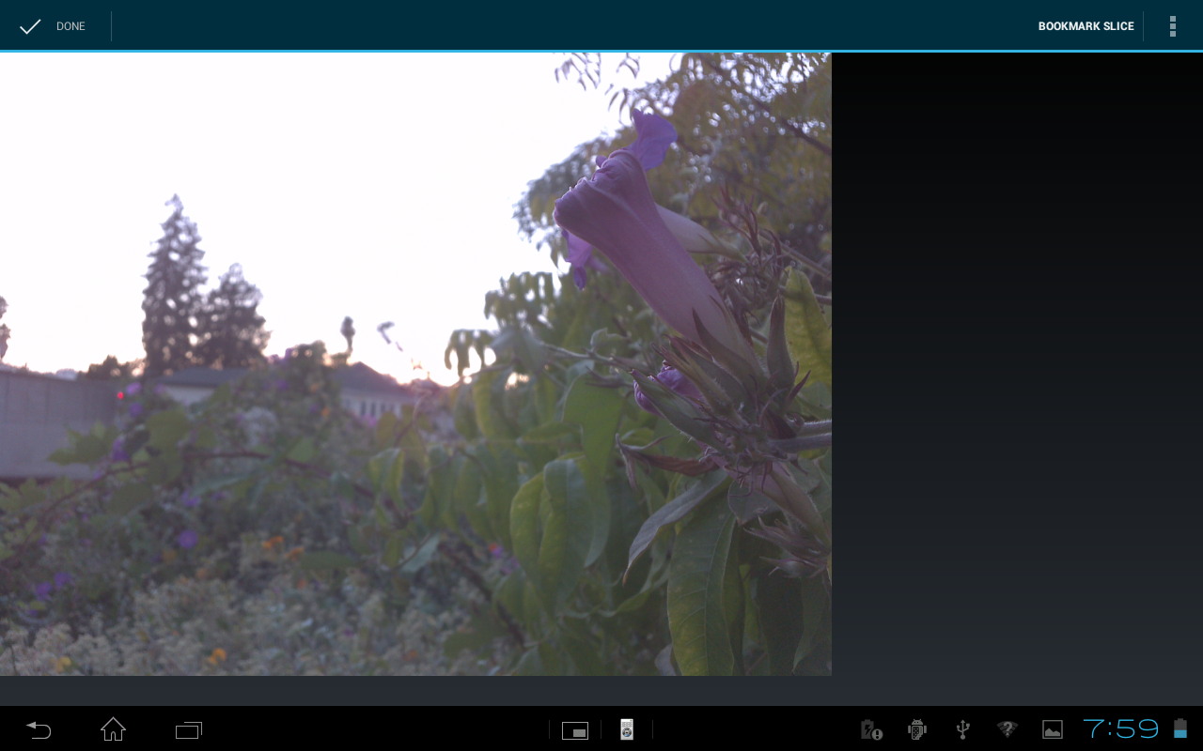
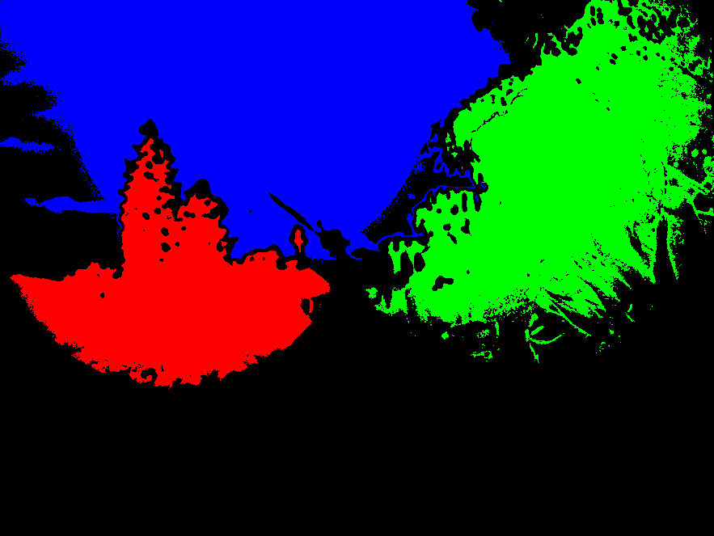
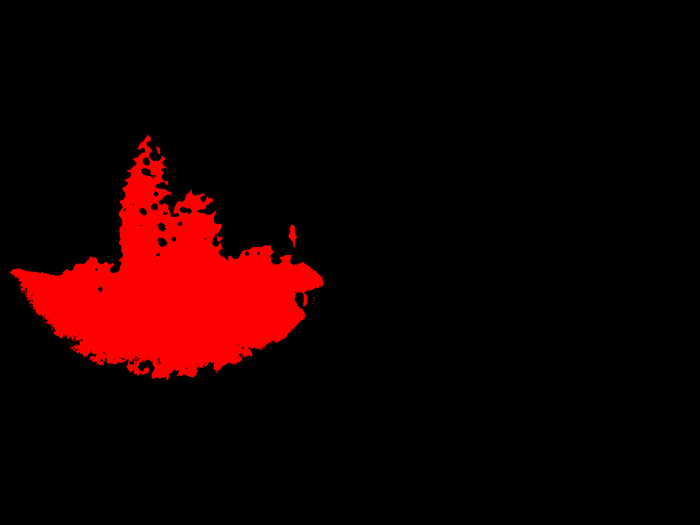

Overriding heuristics
Notes:
For example, let’s say you tap on these trees in the background.
It focuses them properly, and exposes them reasonably well.
The sky doesn’t look very good, and there isn’t much detail in the trees anyway, so let’s make this a silhouette instead.
We do a long tap to bring up the detailed controls,
Then change the exposure setting.
This creates a control point, which has an bilateral area of influence around it, which means anything nearby with a similar color to the control point.
In this case, everything in red is close enough to the control point that we’ll borrow the parameters that were set there.
If we tap somewhere in the black, like the flower over on the right side, we’ll just default to the normal heuristics.
But, when we tap back to where we were before, the app remembers the old settings and keeps the sunset well exposed.
Using these kinds of interactions, an artist can create many control points to completely determine the viewing experience for herself or for others.

Slide 17
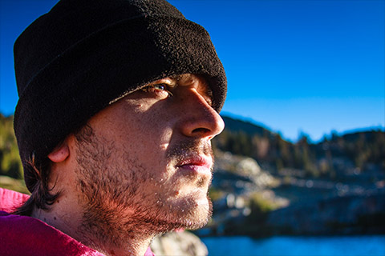
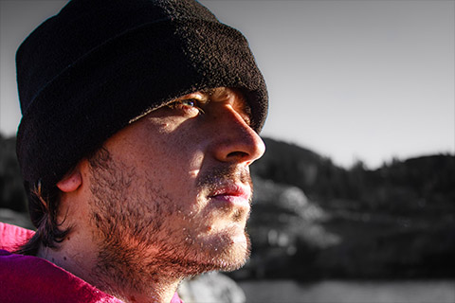
Passive display
Notes:
This last point actually brings up another aspect of our system.
While providing a means to interactively explore a scene is exciting for viewers, there are situations in which interaction is not possible or wholly desirable.
For instance, a photographer may have a specific feeling or aesthetic in mind when he or she created the photograph and would not want the viewer to deviate too far from that vision.
In these situations, we can treat our system as a tool for creating what we call a dynamic stack tour of a scene, a short animation that guides the viewer through the parameter space of the stack.
In this respect, all of the demonstrations you’ve seen in this presentation can be considered to be a form of dynamic tour.
We can apply a similar principle to single images as well to create a dynamic print.
Here we show a dynamic print constructed from a modified version of our app where the stack images are multiple interpretations of a single RAW image file.
In this print, the artist wanted to draw attention to the subject’s face by desaturating the background and boosting the contrast.

Slide 18
Outline
Introduction
Related work
Design and implementation
Discussion

Slide 19
Evaluation
User study with tablet application
14 participants with novices and professional photographers
All generally considered interaction fun and engaging
Veteran photographers worried about the loss of creative control
Notes:
To evaluate our system, we performed an informal user study with our tablet application.
We had 14 participants ranging in experience from novices to professional photographers.
In general, the responses were positive, but the more experienced photographers were reluctant to let their viewers choose the way they experienced the photograph. They did, however, seem to like the idea of dynamic prints and more carefully guided tours through the stacks.

Slide 20
Limitations and future work
Inter-frame motion
Resistance to change
Gaze-directed interface
Notes:
Before we wrap up, I’d like to take a moment to talk about the limitations of our work and where we think it can go in the future.
Since we capture our images sequentially, the potential for scene or camera movement is high, especially for active subjects like athletes or toddlers.
In practice, however, this doesn’t seem to be a concern for most users. Among those who participated in our study, only a few even mentioned the inter-frame motion without prompting, and none said it was objectionable.
This implies our decision to trade off temporal resolution for better single image quality was a good one.
One unexpected challenge we encountered was a cultural one.
Many of the people we showed our system to had trouble understanding that the interaction itself was the final product, rather than being a tool for selecting the “best” photograph.
Going forward, we need to figure out how to teach people to think about photography in a fundamentally different way.
Luckily, we’re not alone here.
Companies like Lytro and now Google with it’s synthetic refocusing feature are starting to introduce dynamic photoviewing to the general public and are being received well.
Lastly, going forward we would like to further explore a gaze-directed version of dynamic stacks. We’ve experimented with this a little bit on a desktop version of our app and an off the shelf gaze-tracker. It behaves more or less like you would expect: as you look around the scene adapts to your gaze. One difficulty here is what is often called the midas touch problem. It’s easy to accidentally trigger transitions between interpretations of the scene, since we’re not really used to being disciplined about controlling where we look. Getting around this midas touch problem, maybe with a combination of touch and gaze gestures, will make for interesting future work.

Slide 21
Questions?
The authors would like to thank following people for their help in bringing this work to fruition
Our study participants
Doug Lanman and the NVIDIA Mobile Visual Computing group
The anonymous reviewers
If you would like to see a demo, come say hi during a break

Slide 22
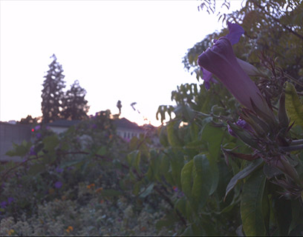
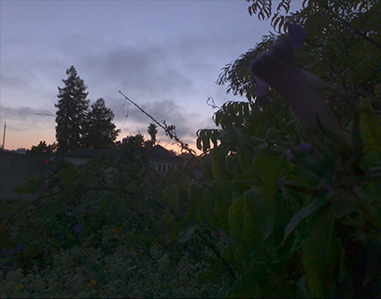
Computational photography - HDR
Notes:
One computational photography technique that’s become quite popular on mobile devices is high dynamic range imaging.
The dynamic range of a scene is the ratio between the luminances of its brightest and darkest parts.
For many scenes, this ratio is too large to be captured in a single photograph.
For example, in this scene, I can tell the camera to take a long exposure, so the flower in the foreground can be seen clearly, but contains no useful information where the sky gets saturated.
If I instead try to get the sky well exposed, I end up with the foreground too dark to see clearly.

Slide 23
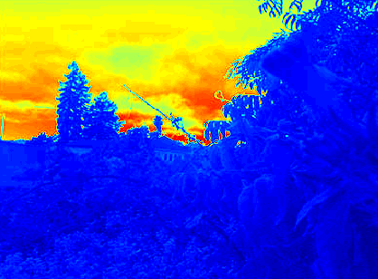
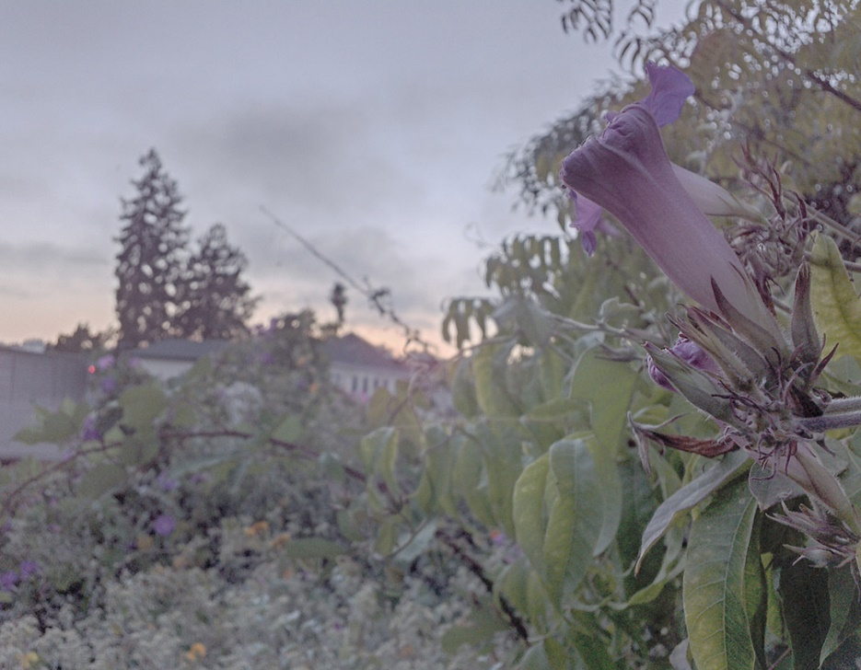
Computational photography - HDR
Notes:
The typical computational photography solution to this problem is to capture two or more pictures at different exposure levels and then try to combine the information from the low bit-depth pictures to create a high bit-depth radiance map.
So now we have a representation of the scene with good information across all illumination levels.
The catch is that the high bit depth image can’t be displayed directly on a low bit depth LCD display or by a photo printer.
Before we can do that, we need to squeeze the 16- or however many bits of the radiance map down into a regular 8-bit image.
This process is called tonemapping, and usually involves sacrificing some global contrast, resulting in an image with detail everywhere, somewhat obscured by a grey haze.
**Which tonemapper is this?

Slide 24
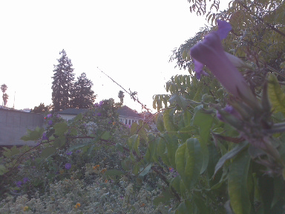
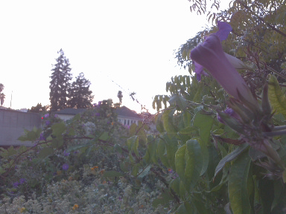
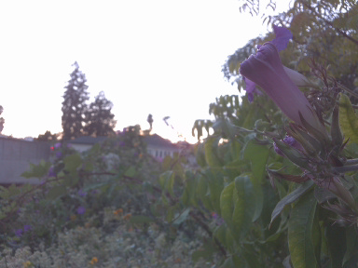
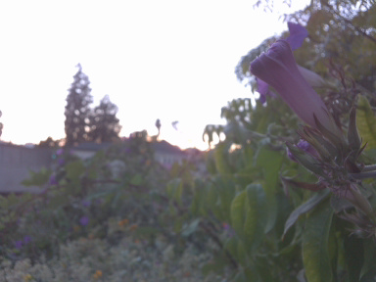
Computational photography – focal stacking
Notes:
Another popular technique takes the same basic idea and instead applies it to the focus dimension instead of exposure.
You take a stack of images with the camera focused different distances, then combine them all to create a single picture with everything in focus.

Slide 25
Computational photography – focal stacking
Notes:
Another popular technique takes the same basic idea and instead applies it to the focus dimension instead of exposure.
You take a stack of images with the camera focused different distances, then combine them all to create a single picture with everything in focus.

Slide 26
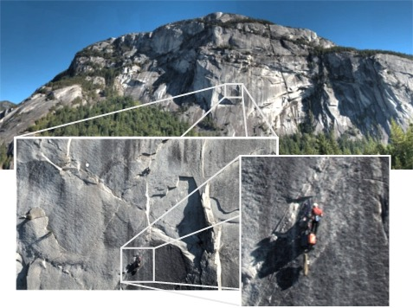
Related work
Lytro 2012
Mantiuk and Heidrich 2009
Kopf et al. 2007
Notes:
Finally, I’ll mention the gigapixel image viewer by Kopf et al. in 2007. In this case, showing the entirety of the image is impractical due to the huge? scale of the image data involved.
Their viewer is designed to produce the best image it can for a given region of interest.
The common theme here is that certain kinds of image content benefit greatly from dynamic, interactive viewing interfaces. Our work continues in this same vein, specializing in exploring focus-exposure stacks.

Slide 27
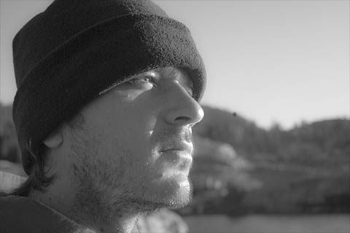


Passive display
Notes:
This last point actually brings up another aspect of our system.
While providing a means to interactively explore a scene is exciting for viewers, there are situations in which interaction is not possible or wholly desirable.
For instance, a photographer may have a specific feeling or aesthetic in mind when he or she created the photograph and would not want the viewer to deviate too far from that vision.
In these situations, we can treat our system as a tool for creating what we call a dynamic stack tour of a scene, a short animation that guides the viewer through the parameter space of the stack.
In this respect, all of the demonstrations you’ve seen in this presentation can be considered to be a form of dynamic tour.
We can apply a similar principle to single images as well to create a dynamic print.
Here we show a dynamic print constructed from a modified version of our app where the stack images are multiple interpretations of a single RAW image file.
In this print, the artist wanted to convey a sense of growth.

