Slide 1
Comparing Controlflow and Dataflow for Tensor Calculus: Speed, Power, Complexity, and MTBF
Milos Kotlar¹ (kotlar.milos@gmail.com)
Veljko Milutinovic^{2,3,4} (vm@etf.rs)
¹School of Electrical Engineering, University of Belgrade
²Academia Europaea, London, UK
³Department of Computer Science, University of Indiana, Bloomington, Indiana, USA
⁴Mathematical Institute of the Serbian Academy of Arts and Sciences, Belgrade, Serbia
28/06/2018
ExaComm 2018, Frankfurt

Slide 2
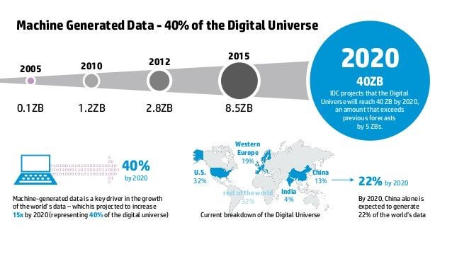
Data is growing faster than ever before
By the year 2020, volume of big data will increase from 10 zettabytes, to roughly 40 zettabyte

Slide 3
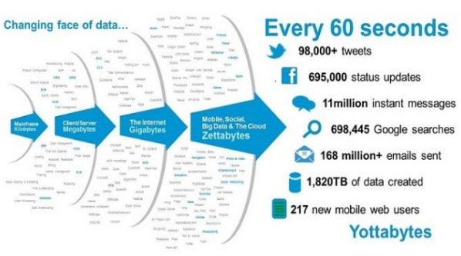
Data is growing faster than ever before
More data has been created in a past few years, than in the entire previous digital history

Slide 4
The big data analysis
The big analysis mostly involves machine learning algorithms, which extract important information from data
The big data applications are taking effort to break the zetta-scale barrier (10²¹)
The main challenge is finding a way to process such big quantities of data

Slide 5

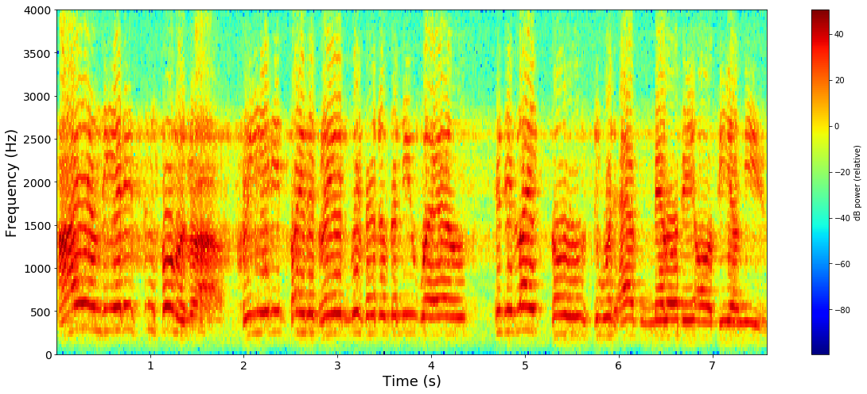
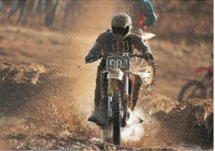
Machine learning algorithms
Image recognition
Speech recognition
Text recognition
Image captioning
Elephant
Which place to visit in Frankfurt?
My name is Milos
Mein Name ist Milos
“A person riding a motorcycle on a dirt road”

Slide 6
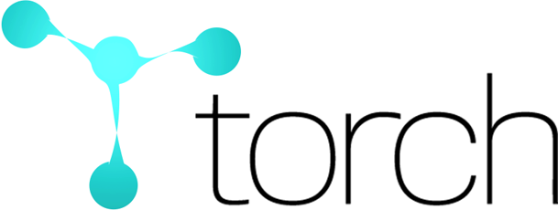





Most of machine learning algorithms are based on the tensor calculus

Slide 7
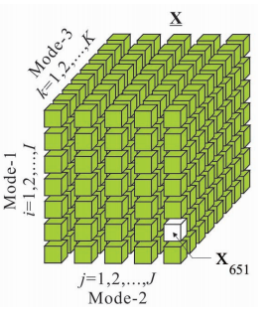
Tensors Calculus
Tensors are a multi-dimensional objects
Following natural sciences have found interest in tensor calculus:
Civil engineering
Physics
Chemistry
Software engineering

Slide 8
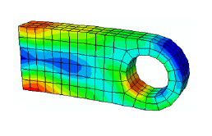
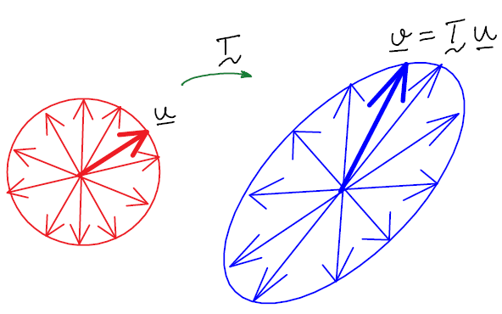
Tensors in civil engineering
Tensor is an object that operates on a vector to produce another vector
0th order tensor is scalar 1st order tensor is vector (3x1) 2nd order tensor (3x3) 3rd order tensor (3x3x3)

Slide 9
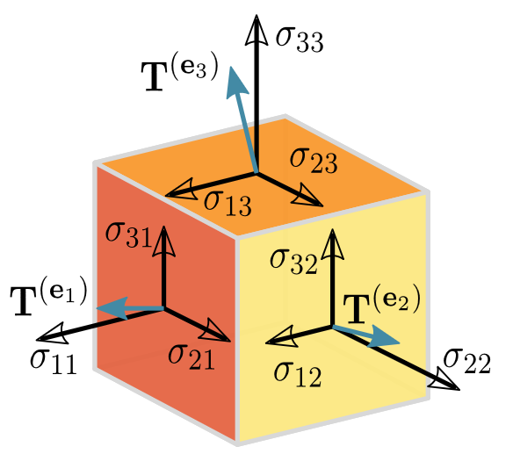
Tensors in physics
Deformation tensors - deformation may be caused by external loads, body forces, chemical reactions, or changes in temperature
Stress
Strain
Moment of inertia
Identity

Slide 10
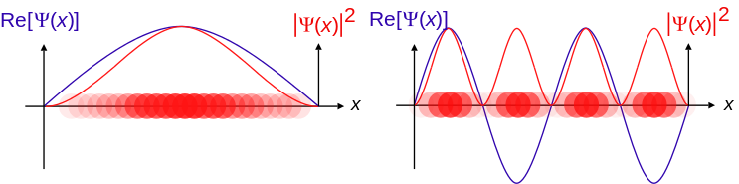
Tensors in chemistry
Used in quantum-mechanical observables of molecular systems
Real-space electronic structure calculation
Computing a wave functions

Slide 11
Tensors in software engineering
Tensors are high dimensional generalizations of matrices
Machine learning uses tensors in a many algorithms, such as:
Neural networks - for describing relations between neurons in a network
Computer vision - for storing valuable data and correlations between
Natural language processing - for estimating parameters of latent variable models

Slide 12
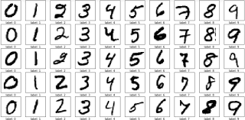
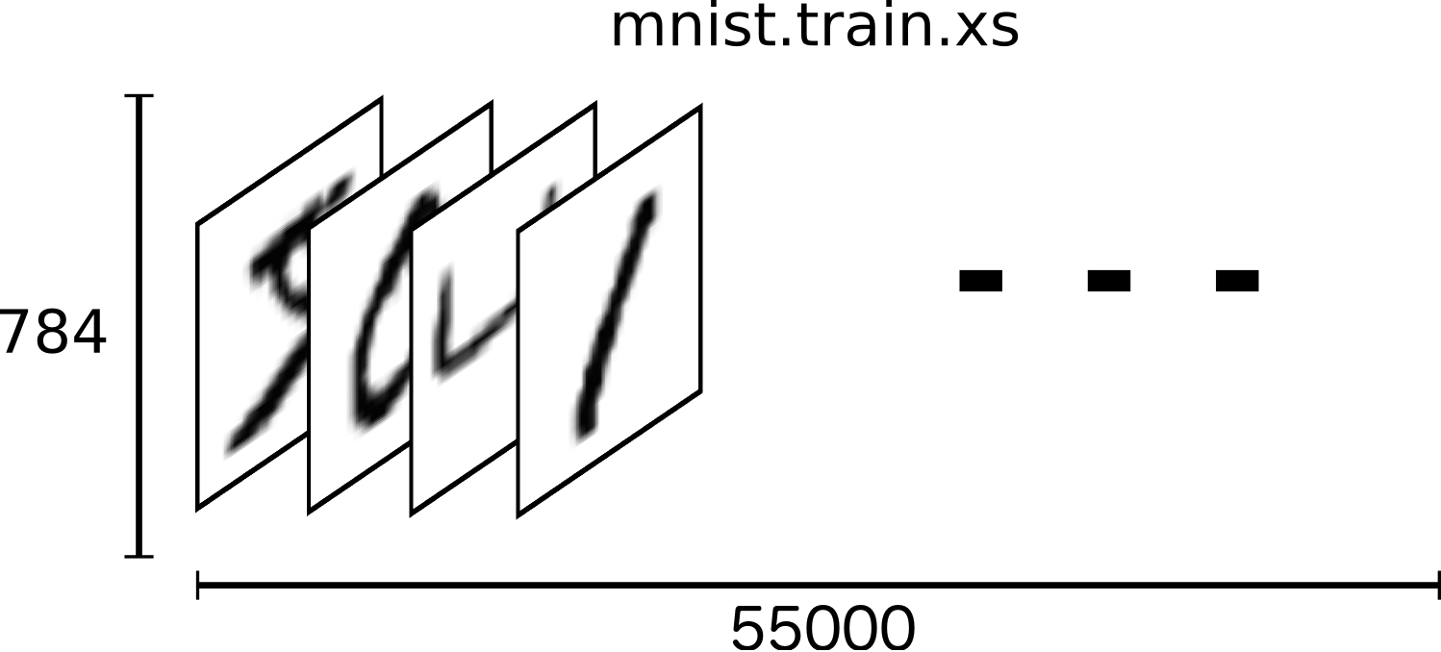
Image is a 3rd order tensor

Slide 13
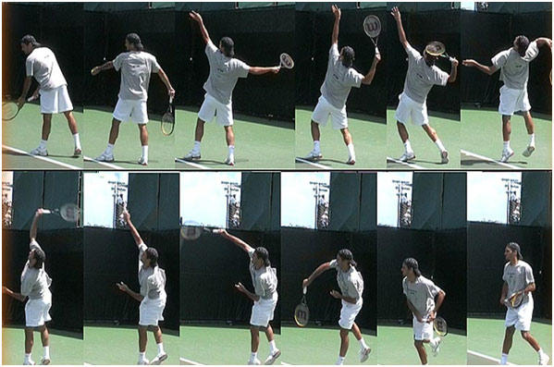
Video is a 4th order tensor

Slide 14
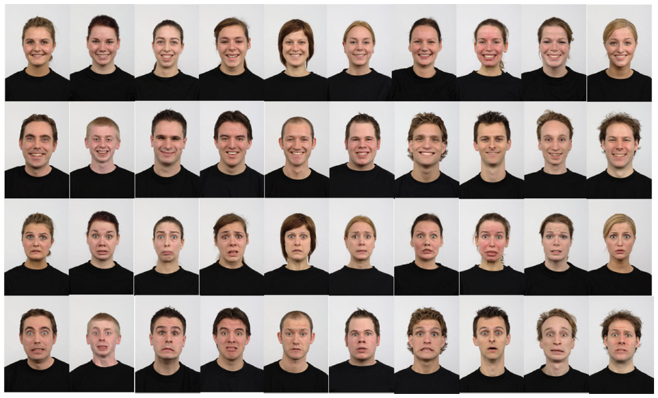
Facial images database is a 6th order tensor

Slide 15
The big data analysis
The ratio of data volume increase is higher than the ratio of processing power increase
Most of the existing approaches are dissipating enormous amount of electrical power, by solving big data problems
Conventional microprocessor technology based on the control-flow paradigm has been increasing the clock rate aligned with the Moore's Law, and thus, the processing power has been improved

Slide 16
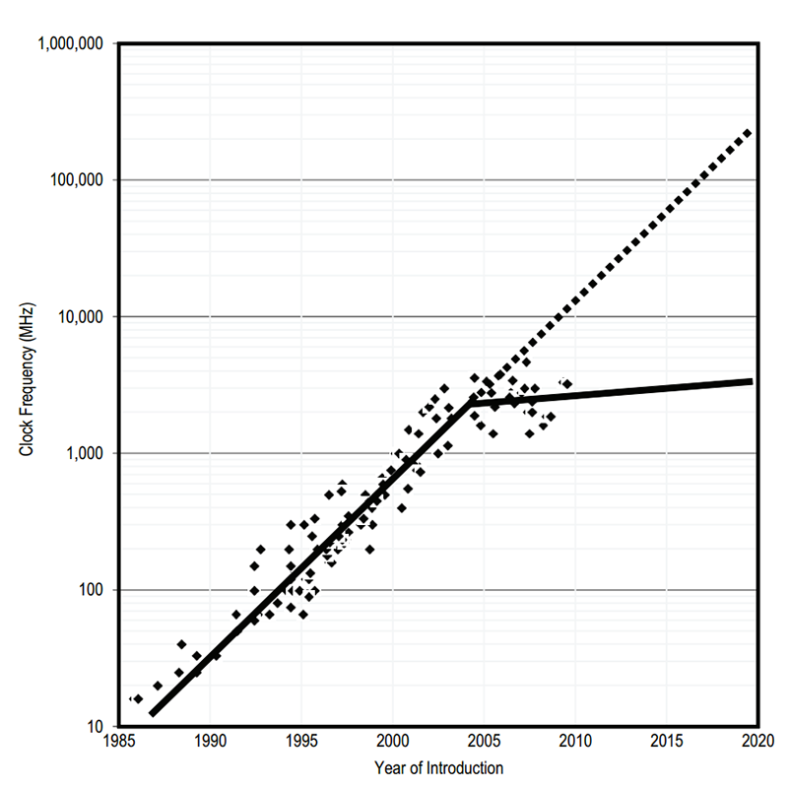
Moore’s Law
The silicon technology hit a wall, since power dissipation of silicon technology reached its technological limits
According to Moore’s Law, the standard microprocessor technology has hit the wall

Slide 17
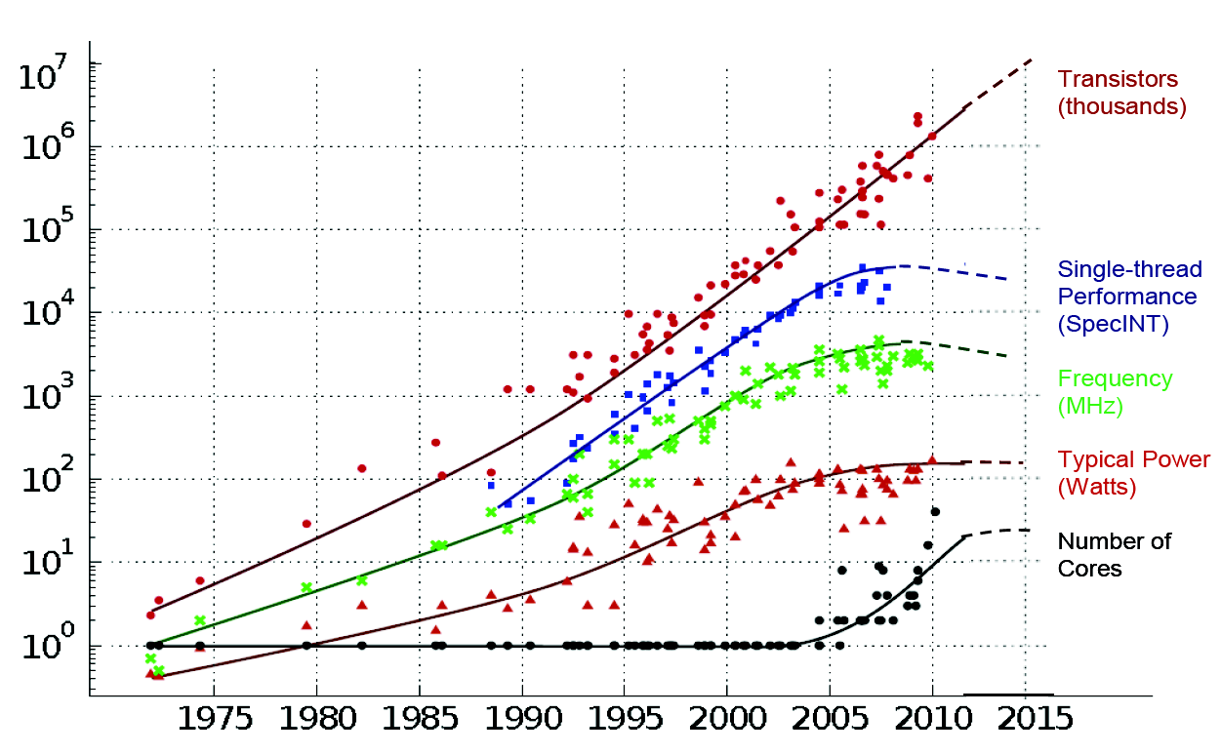
40 years of microprocessor trend data

Slide 18
High-performance computing
The end of Moore's Law leads to the several approaches for solving this problem
The development of high-performance computing systems utilizes other alternative architectural principles, such as the dataflow paradigm

Slide 19
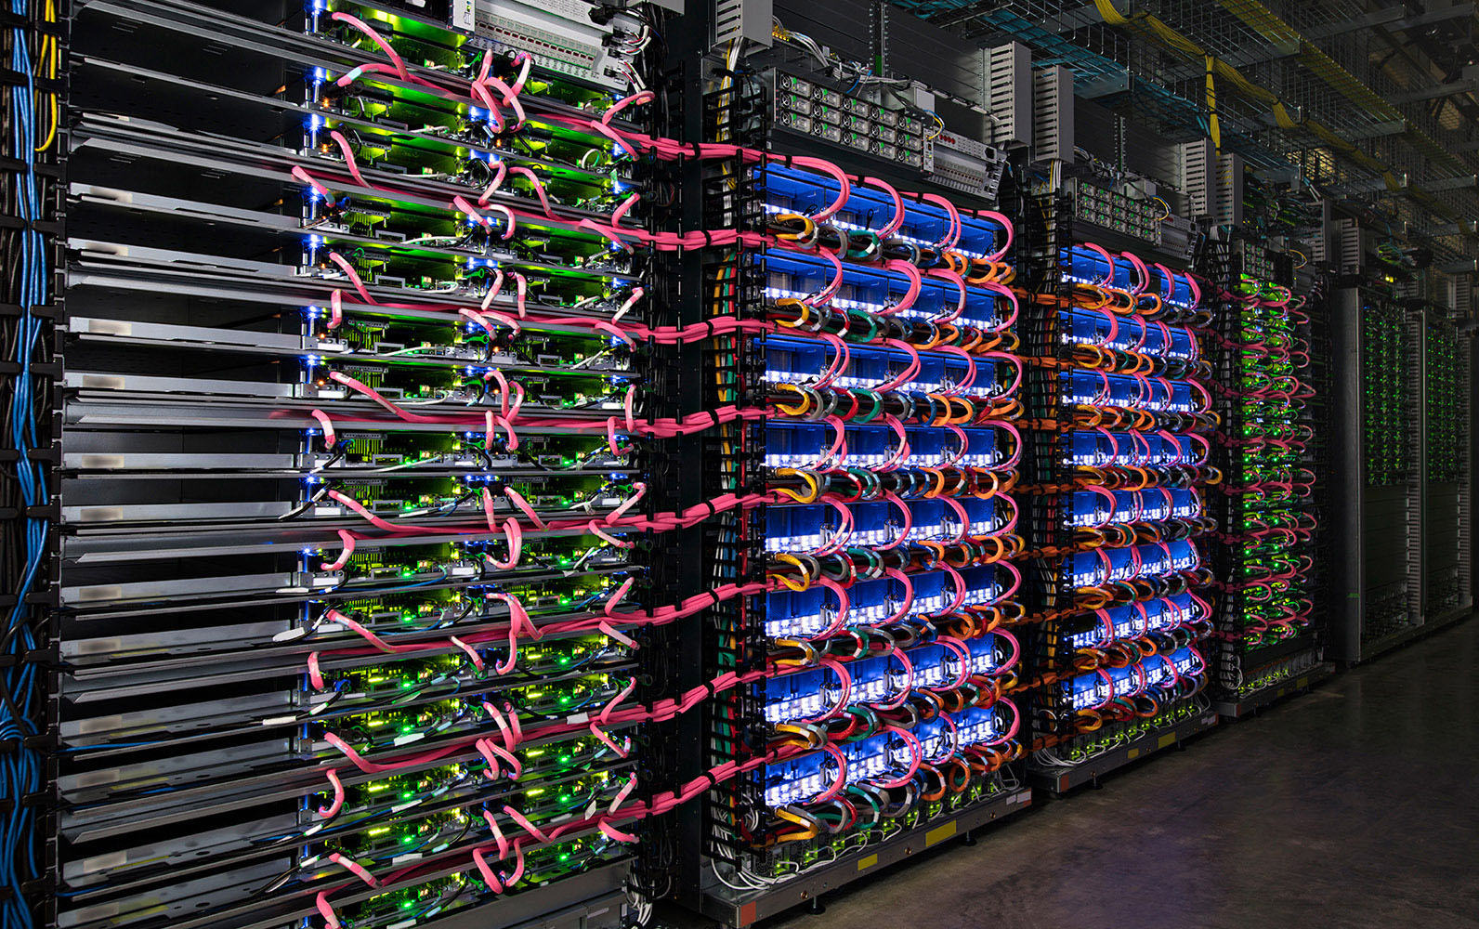
Google TPU Dataflow

Slide 20
The dataflow paradigm
The dataflow paradigm introduces computing in space where computations are placed dimensionally on a chip
Such an approach perfectly fits when execution time is not a prime concern, to save space and energy, and with limited space and/or power resources
For big data algorithms, the dataflow paradigm can achieve acceleration consuming much less electrical power

Slide 21
Conditions for the dataflow paradigm
Over 95% of the algorithm run-time has to be in loops
Acceleration depends on level of data reusability inside the loops
Suitable for data streaming
Latency before the first result is computed
Presents a new programming model
Requires programming effort to accelerate an algorithm

Slide 22
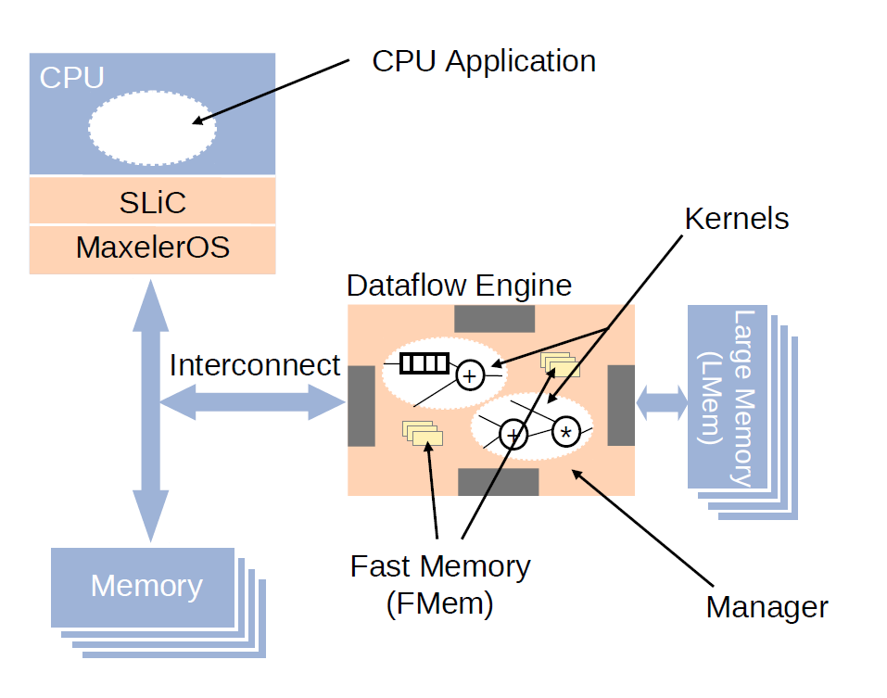
Maxeler dataflow architecture

Slide 23
Controlflow vs. dataflow
Controlfow:
Computing in time
Number of transistors: ~ 1B (1,000,000,000)
Clock rate: ~4GHz
Dataflow:
Computing in space
Number of transistors: ~ 100M (100,000,000)
Clock rate: ~200MHz

Slide 24
Why is dataflow so much faster?
MultiCore/ManyCore
DataFlow
Machine Level Code
Gate Transfer Level

Slide 25
Why are electricity bills so small?
controlflow
dataflow

Slide 26
Why is the transistor count so small?
controlflow
dataflow
Data Processing
Data Processing
Process Control
Process Control

Slide 27
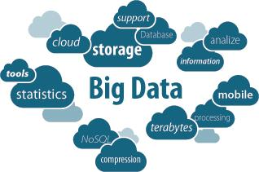
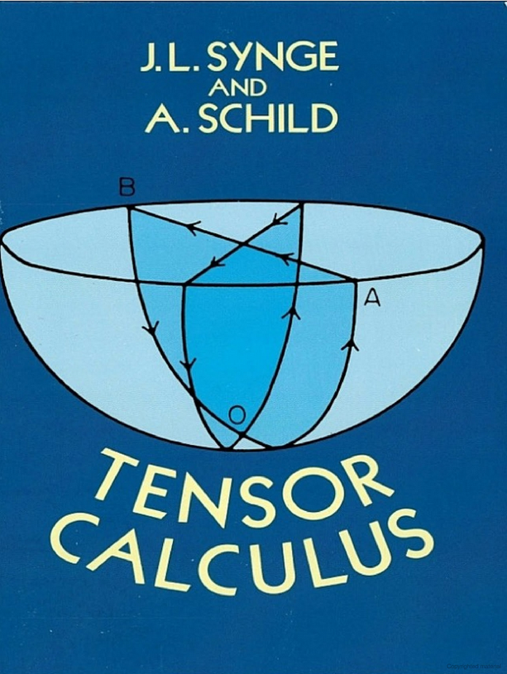

CPU
Tensors

Slide 28
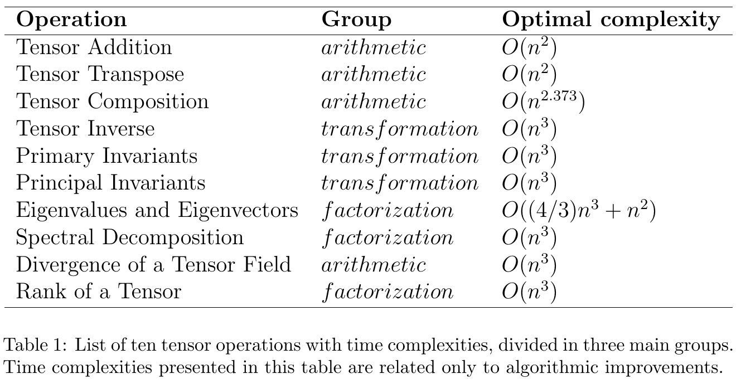
Tensor operations

Slide 29
Tensor operations on the dataflow paradigm
Arithmetic changes
Modifying input data choreography
Utilizing internal pipelines
Utilizing on-chip/off-chip memory
Low precision computations
Data serialization (rowwise/columnwise)

Slide 30
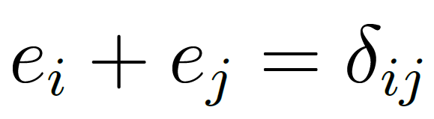
Tensor addition
An operation of adding two tensors, by adding the corresponding elements:
As 99% of the execution time is spent in loops, the entire algorithm could be migrated to the accelerator

Slide 31
Tensor addition
The host program sends tensors in row-wise order to the dataflow engine (DFE), and waits for the result
Control-flow loops are unrolled in the execution graph
Elements of tensors flow through pipelines and compute entire row of a new tensor simultaneously

Slide 32
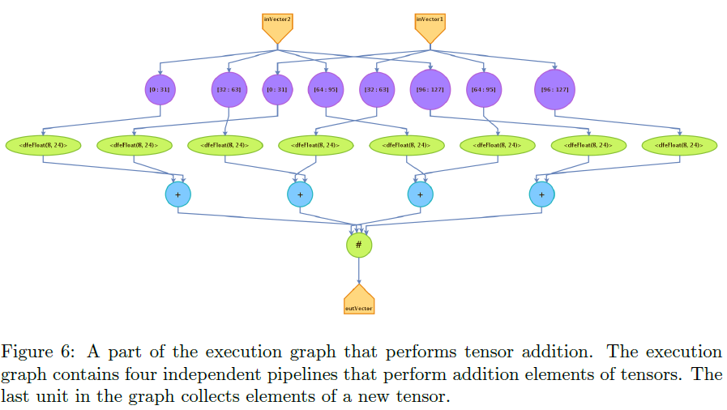
Tensor addition

Slide 33
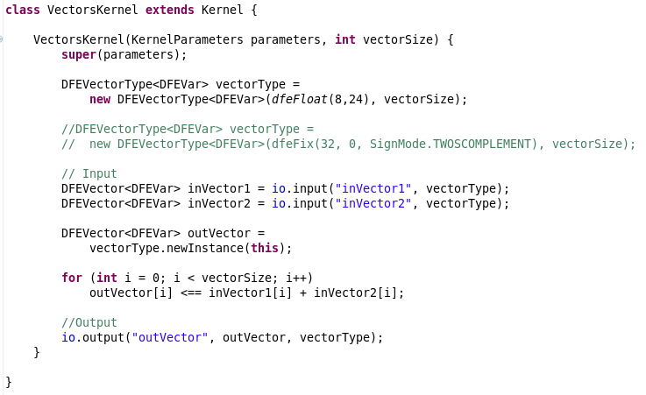
Tensor addition

Slide 34
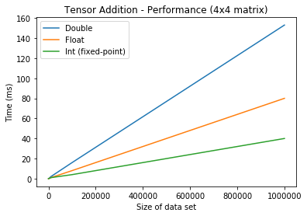
Low precision computation
The dataflow architecture efficiently computes bitwise operations

Slide 35
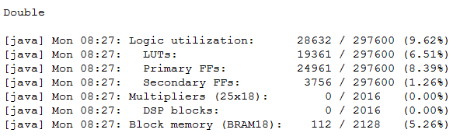
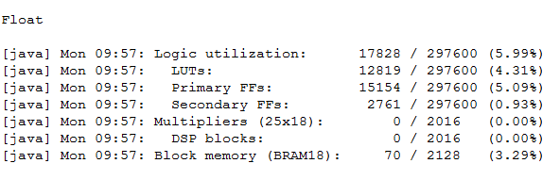
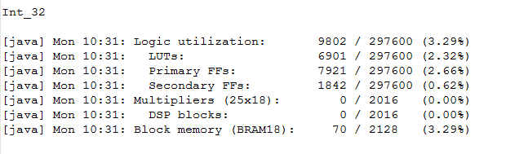
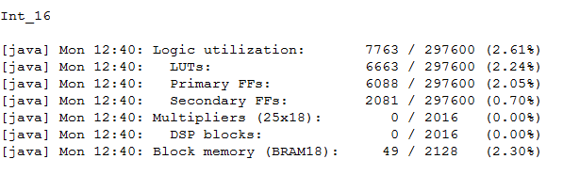
Resource allocation

Slide 36
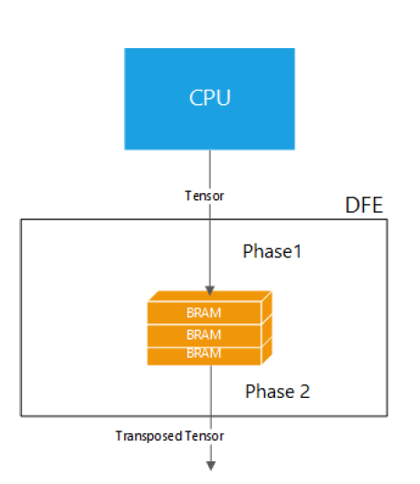
Tensor transpose
An operator which flips a tensor over its diagonal
Elements in a tensor have its own pipelines placed in the transposed order, without any arithmetic units
If the host sends chunks of a tensor to the DFE, or a tensor is too big for streaming, the on-chip memory could be used

Slide 37
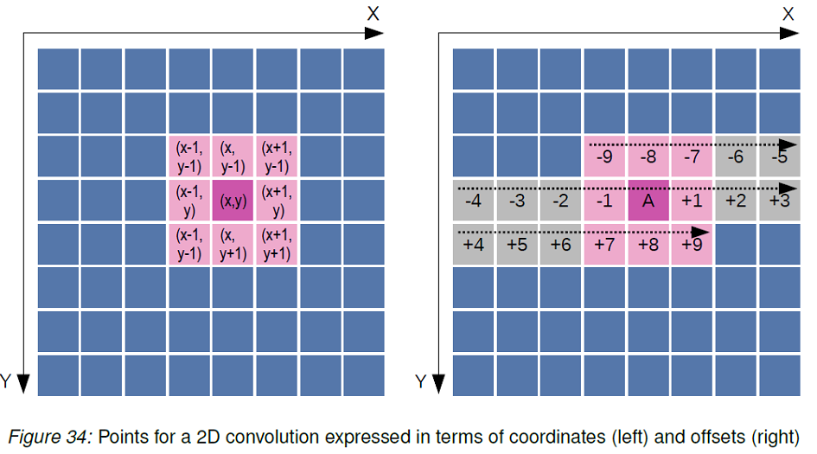
Stream offset

Slide 38
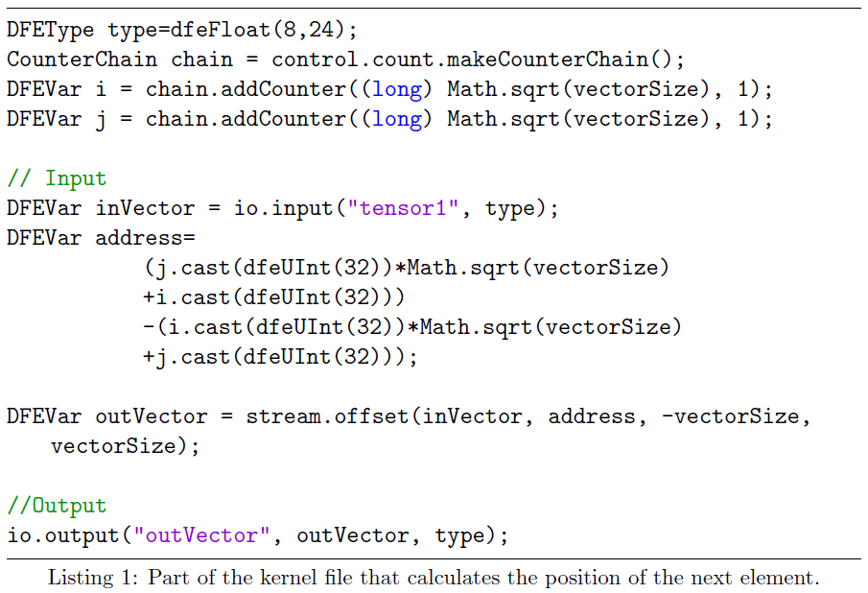
Tensor transpose
Using the stream offsets, the DFE dynamically calculates the position of the next element

Slide 39
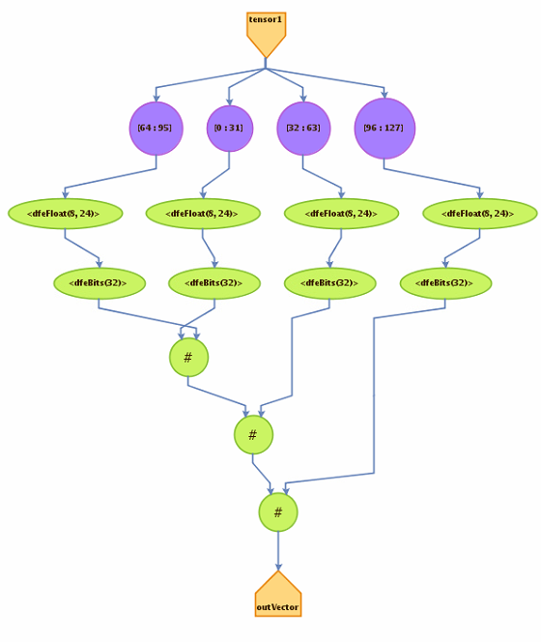
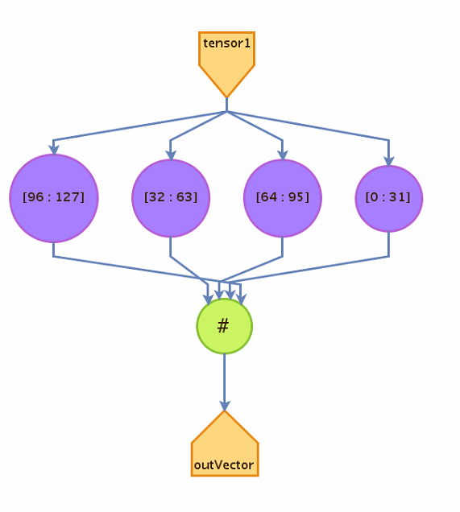
Tree reduction
Tree reduction
Original graph
Final graph

Slide 40

Tensor composition
Tensor composition is a basic operation in linear algebra, and as such has numerous applications in many areas of mathematics, physics, and engineering
The DFE receives entire tensors and produces a new tensor simultaneously

Slide 41
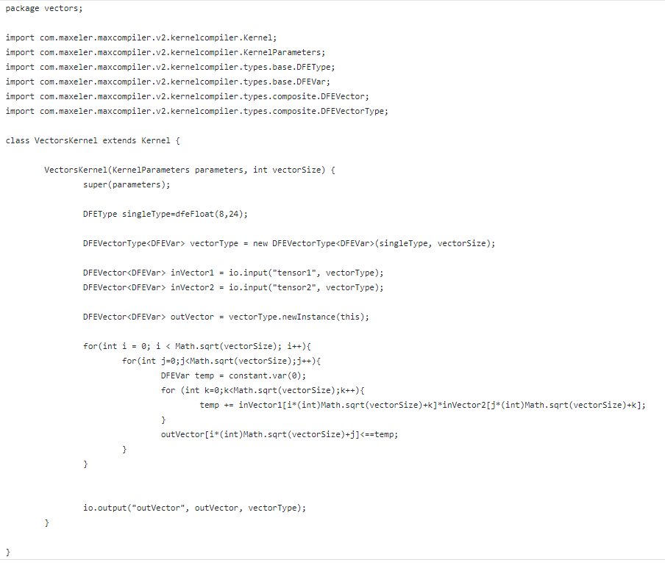
Tensor composition

Slide 42
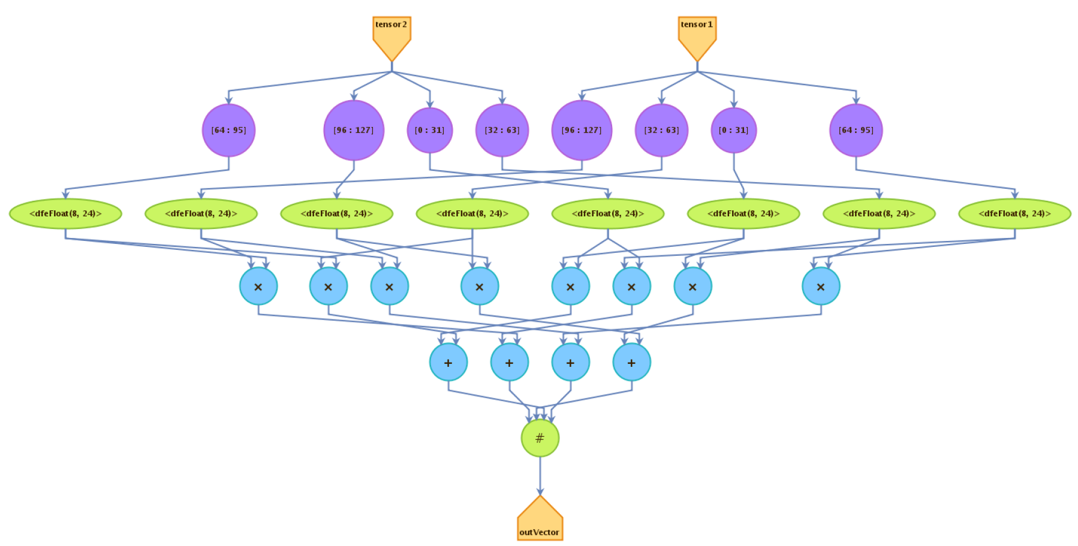
Tensor composition

Slide 43

Tensor inverse
Algorithms used for calculating inversion of a tensor:
LU decomposition
Cholesky decomposition
The LU decomposition refers to the factorization of a tensor, with proper row and column permutations, into two factors, a lower triangular tensor L and an upper triangular tensor U

Slide 44
Tensor inverse
The dataflow implementation could be divided in two phases:
LU/Cholesky decomposition
Computing the inverse of a tensor
When the first phase is done, a new tensor arrives at the beginning of the first phase
Switching to low precision computations, the performance could be improved

Slide 45
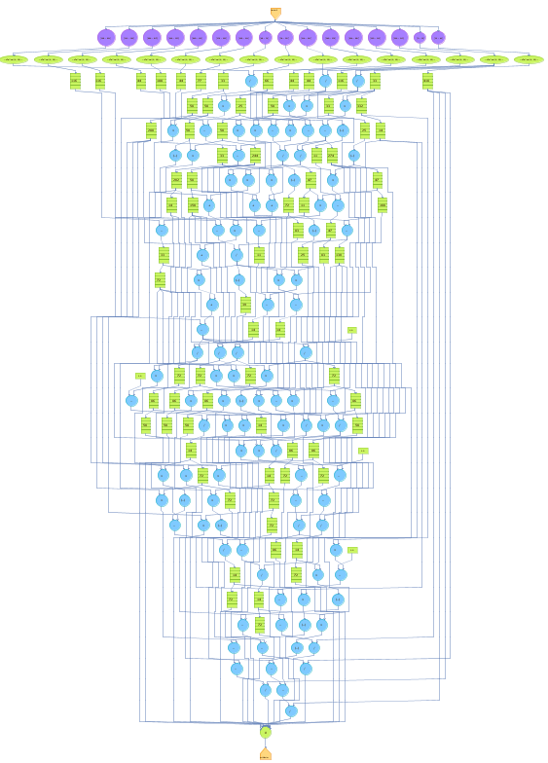
Tensor inverse

Slide 46
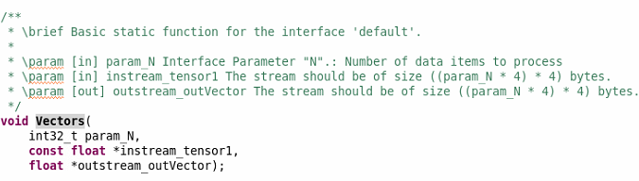
Example of SLiC interface

Slide 47


Primary and principal invariants
Invariants of a tensor are coefficients of the characteristic polynomial of a tensor:
Trace is sum of the diagonal components:
How to find determinant of a tensor?
How to find characteristic polynomial coefficients?

Slide 48
Primary and principal invariants
The best approach for finding determinant of a tensor is an factorization method that can iterates fast, such as LU decomposition
The Power iteration algorithm is an eigenvalue algorithm that computes the greatest eigenvalue and corresponding eigenvector, which represent coefficients

Slide 49
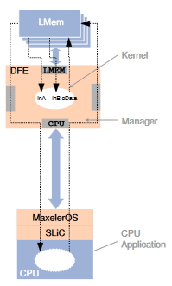
Primary and principal invariants
The dataflow implementation exploits advantage of the off-chip memory
The dataflow manager orchestrates data movements between DFE, off-chip memory, and the host
In each iteration, the algorithm computes a new eigenvalue

Slide 50
Eigenvalues and eigenvectors
Computing eigenvalues and eigenvectors is not a trivial problem
The dataflow implementation for calculating eigenvalues and eigenvectors is based on the QR decomposition
The proposed dataflow solution implements the QR decomposition using two different methods:
Gram-Schmidt method
Householder method

Slide 51
Gram-Schmidt method
The Gram-Schmidt is an iterative process that is suitable for the dataflow architecture
The algorithm utilizes advantages of the off-chip memory
The data dependency is acyclic, which means that internal pipelines are fully utilized without data buffering

Slide 52
Householder method
Algorithm could be expressed as a transformation that takes a vector and reflects it about some plane or hyperplane
The algorithm performs in-place computations, which utilizes on-chip memory
The DFE receives entire tensor, where each element has its own pipeline

Slide 53
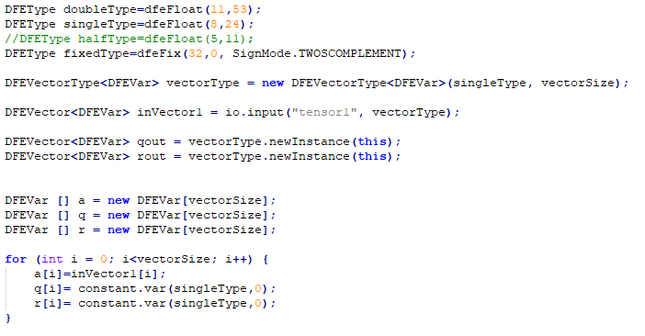
Householder method

Slide 54
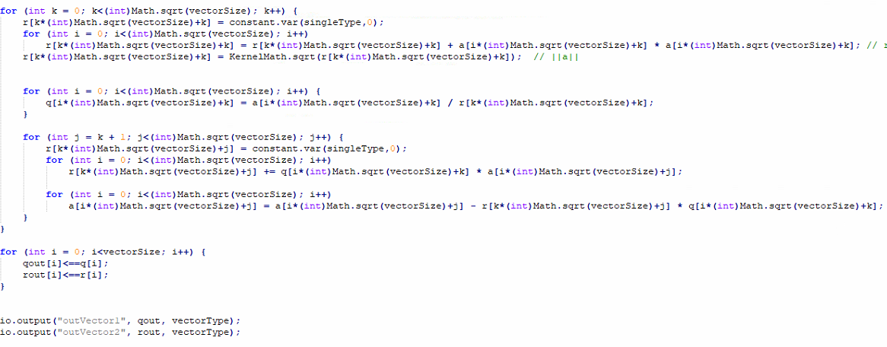
Householder method

Slide 55
Spectral decomposition
Spectral decomposition, or sometimes eigendecomposition is a factorization of a tensor into a canonical form
The dataflow implementation of the Jacobi eigen algorithm
The Jacobi eigen algorithm is an iterative method that is based on rotations and could be applied only for real symmetric tensors

Slide 56
Spectral decomposition
The dataflow implementation streams data to the off-chip memory
In each iteration, data are retrieved from the off-chip memory, the rotations are computed, and data are streamed back to the memory
When an eigenvector is computed the result is transferred from the off-chip memory the host

Slide 57
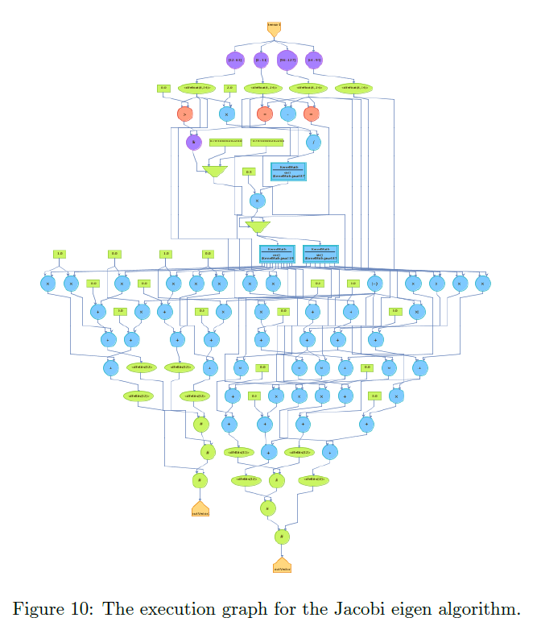
Spectral decomposition

Slide 58
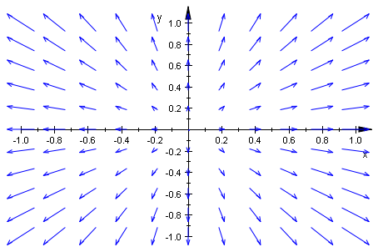
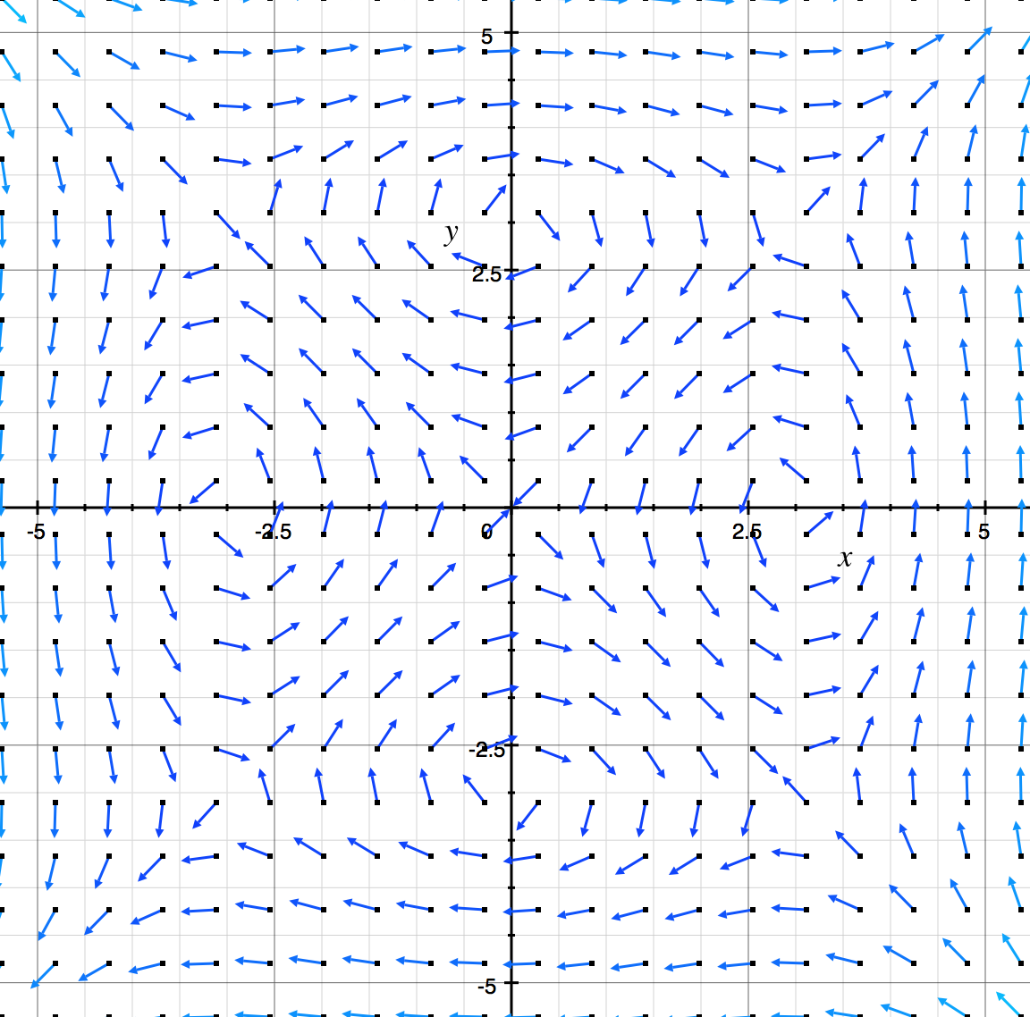
Divergence of a tensor field
Volume density of the outward flux of a vector field from an infinitesimal volume around a given point

Slide 59
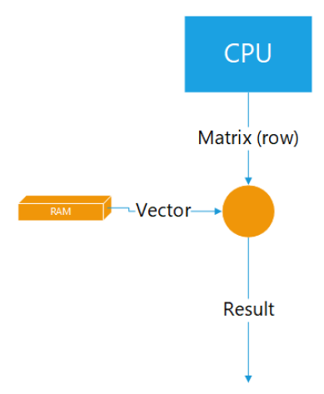
Divergence of a tensor field
A set of tensors are stored in the on-chip memory
In each iteration new tensor is computed, by utilizing parallel internal pipelines

Slide 60
Tensor rank
Gaussian elimination is an algorithm for solving systems of linear equations
Could be used for calculating rank of a tensor using echelon form
In memory row swapping are performed using hardware variables, which flow through parallel pipelines
The performance depends on size of a tensor

Slide 61
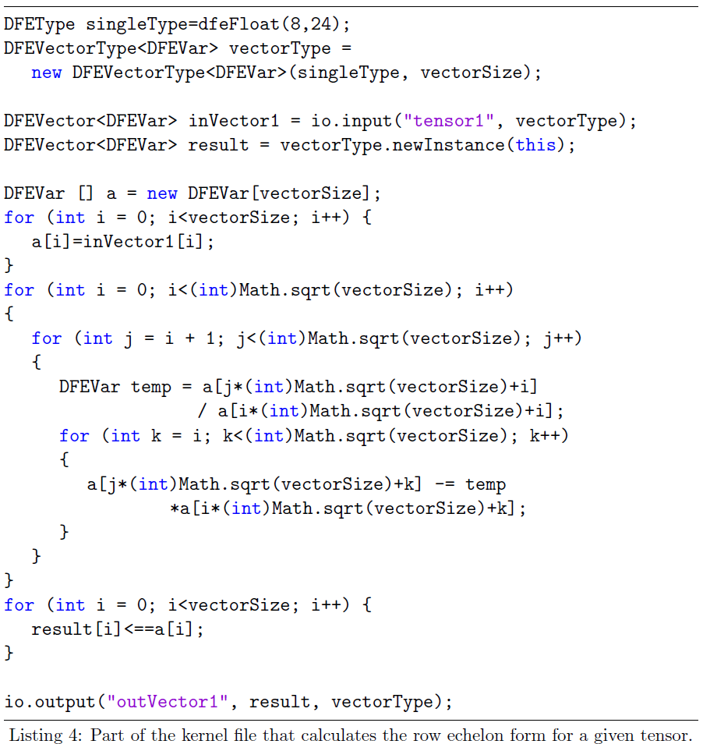
Tensor rank

Slide 62
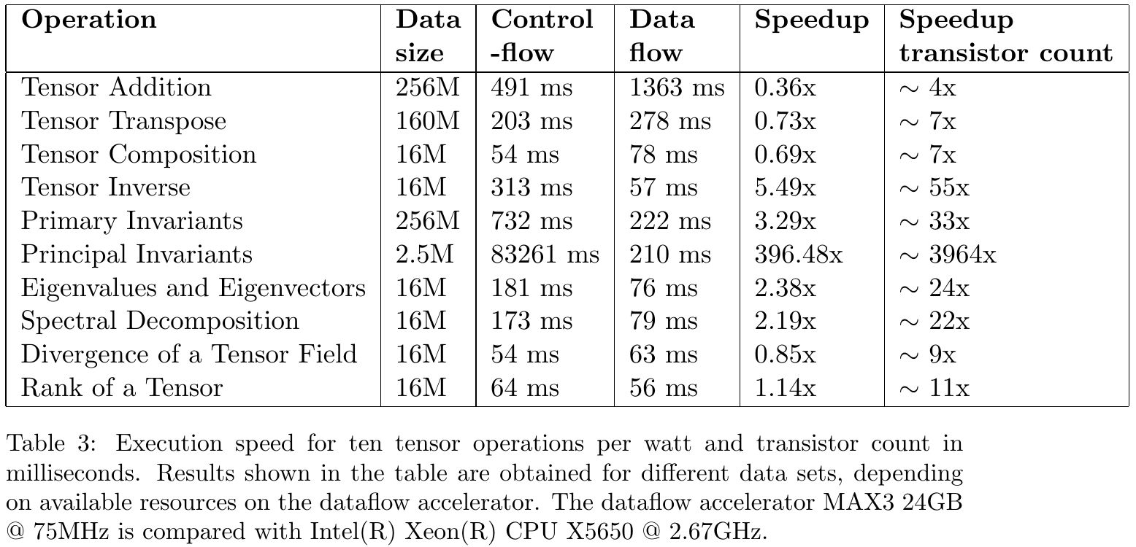
Performance evaluation

Slide 63
Performance evaluation
Performance evaluation is based on the speedup per watt and transistor count, which is more suitable for a theoretical study (contrary to speedup per watt and cubic foot, of interest for empirical studies)
Complex operations, such as tensor decompositions, are suitable for big data and achieve significant performance, compared against the conventional controlflow implementations

Slide 64
Performance evaluation
Power dissipation depends on the clock frequency and the number of transistors
Complexity of two paradigms is expressed by the transistor count
The MTBF domain depends a lot on the transistor count, the power dissipation, and the presence of components prone to failure, to name a few

Slide 65
Source code
https://github.com/kotlarmilos/tensorcalculus
Thank you!
kotlar.milos@gmail.com
https://www.youtube.com/watch?v=Axw07_Ixhhs

