Slide 1
Exploratory learning
Semi-supervised Learning
in the presence of unanticipated classes
Bhavana Dalvi, William W. Cohen, Jamie Callan
School of Computer Science,
Carnegie Mellon University

Slide 2
Motivation

Slide 3
Positioning in the problem space
Semi-supervised Learning
  All classes are known : e.g. Country, State
  Few seed examples for each class :
  e.g. (Country: USA, Japan, India…) (State: CA, PA, MN etc.)
  Model learns to propagate labels from labeled to unlabeled points
  Makes use of existing knowledge
  Assumes all classes are known
Unsupervised Learning
  Works without any training data
  Doesn’t make use of existing knowledge
Exploratory Learning
Makes use of existing knowledge
Discovers unknown classes
City, Animals etc…

Slide 4
Semi-supervised EM
Initialize the model with few seeds per class
Iterate till convergence
E step: Predict labels for unlabeled points
You might start with ``fruits’’ and end up in all sorts of ``food’’ items or even ``trees’’.
M step: Recompute model parameters using seeds + predicted labels for unlabeled points
Semantic Drift
Unlabeled points might not belong to any of the existing classes

Slide 5
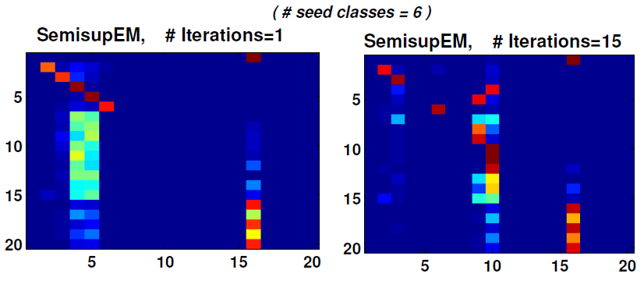

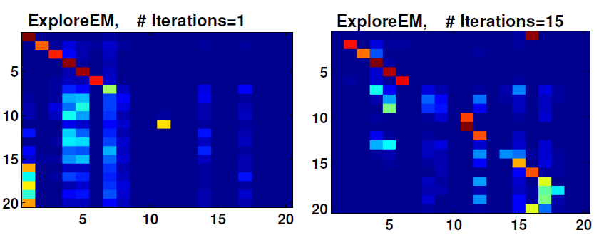
Example : Semantic Drift
(20-Newsgroups dataset)
Existing
Proposed

Slide 6
Problem definition

Slide 7
Problem Definition
Input
  Large set of data-points : X1 .... Xn
  Some known classes : C1 .... Ck
  Small number of seeds per known class
  |seeds| << n
Output
  Labels for all data-points Xi
  Discover new classes from data: Ck+1 … Ck+m
  (k+m) << n

Slide 8
Solution
Can we extend the Semi-supervised EM algorithm for this purpose ?

Slide 9
Exploratory EM Algorithm
Initialize model with few seeds per class
Iterate till convergence (Data likelihood and # classes)
    E step: Predict labels for unlabeled points
    For i = 1 to n
    If P(Cj | Xi) is nearly-uniform for a data-point Xi, j=1 to k
        Create a new class Ck+1, assign Xi to it
      Else
        Assign Xi to argmax { P(Ci | x) }
        Ci
    M step: Re-compute model parameters using seeds and predicted labels for unlabeled points
      Number of classes might increase in each iteration
    Check if model selection criterion is satisfied
    If not, revert to model in Iteration `t-1’

Slide 10
Nearly uniform?
Jensen-Shannon Divergence criterion
Data-point: x, current #classes= k
P(C1 | x), P(C2 | x), ... P(Ck | x)
Uniform = [ 1/k 1/k .... 1/k]
Div = Jensen-Shannon-divergence(P(Ci|x), Uniform)
If (Div < 1/k)
  Create new class Ck+1
Else
  Assign x to argmax { P(Ci | x) }
  Ci

Slide 11
Nearly uniform?
MinMax criterion
Data-point: x, current #classes= k
P(C1 | x), P(C2 | x), ... P(Ck | x)
MaxProb = max{ P(C1 | x) … P(Ck | x)}
MinProb = min{ P(C1 | x) … P(Ck | x)}
If (MaxProb / MinProb) < 2
  Create new class Ck+1
Else
  Assign x to argmax { P(Ci | x) }
  Ci

Slide 12
What are we trying to optimize?
Objective Function :
Maximize { Log Data Likelihood – Model Penalty }
Params{1..m},
m:#clusters
Computed using
Model selection criterion

Slide 13
Model Selection Criterion
Extended Akaike information criterion (AICc)
Log-Data Model
Likelihood Complexity
AICc(g) = - {2*L(g) } + { 2*v + 2*v*(v+1)/(n-v-1) }
Where,
g: model being evaluated,
L(g): log-likelihood of data given g,
v: number of free parameters of the model,
n: number of data points
( Lower values are preferred. )

Slide 14
Extending existing SSL methods
Semi-supervised Naïve Bayes
Seeded K-Means
Seeded Von-Mises Fisher

Slide 15
Naïve Bayes
Semi-supervised Naïve Bayes
Exploratory Naïve Bayes
Multinomial model
label(Xi)=argmax(Cj|Xi)
  Cj=1..k
if (P(Cj | Xi) is nearly uniform)
  label(Xi) = Ck+1
Else
label(Xi) = argmax P(Cj|Xi)
  Cj=1..k

Slide 16
K-Means
Semi-supervised K-Means
Exploratory K-Means
Features: L1 normalized TFIDF vectors
Similarity: Dot Product (centroid, data-point)
Assign Xi to closest centroid Cj
If (Xi is nearly equidistant from all centroids)
  Create new cluster Ck+1 and put Xi in it
Else
Assign Xi to closest centroid

Slide 17
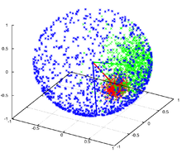
Von-Mises Fisher
VMF : data distributed on the unit hypersphere
Blue: Kappa = 1
Green: Kappa = 10
Red: Kappa = 100
Mu: mean direction
shown with arrows
Banerjee et al. 2005 : Hard-EM based generative cluster models based on vMF distr.
Extension similar to Naïve Bayes based on near-uniformity
of P (Cj | Xi)

Slide 18
Exploratory EM Algorithm
Choose classification/
clustering algorithm
KMeans, NBayes, VMF …
Initialize model with few seeds per class
Iterate till convergence (Data likelihood and # classes)
    E step: Predict labels for unlabeled points
    If P(Cj | Xi) is nearly-uniform for a data-point Xi, j=1 to k
      Create a new class Ck+1, assign Xi to it
    M step: Recompute model parameters using seeds + predicted labels for unlabeled points
      Number of classes might increase in each iteration
    Check if model selection criterion is satisfied
    If not, revert to model in Iteration `t-1’
Choose class creation criterion
MinMax/ JS / trained classifier …
Generic
Applicable to any
Clustering / Classification
tasks
Your choice of Model Selection
AIC/BIC/AICc …

Slide 19
Semi-supervised Gibbs Sampling
+ Chinese Restaurant Process
Initialize the model using seed data
for (epoch in 1 to numEpochs) {
    for (item in unlabeled data) {
      Decrement data counts for item and label[epoch-1, item]
      Sample a label from P(label | item)
      Create a new class using CRP
      Increment data counts for item and register label[epoch , item]
    }
}
(Taken from Bob Carpenter's LingPipe Blog)
Inherently Exploratory Baseline

Slide 20
Experiments

Slide 21
Datasets
Dataset | # Documents | # Features | # Classes
Delicious_Sports | 282 | 721 | 26
20-Newsgroups | 18.7K | 61.2K | 20
Reuters | 8.3K | 18.9K | 65

Slide 22
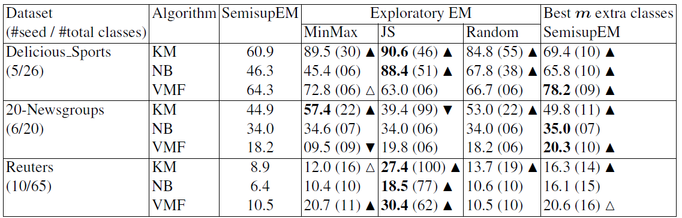
Exploratory vs. Semi-supervised EM
Comparison in terms of macro averaged seed class F1
Baseline
Best case performance of improved baseline
Proposed Method

Slide 23
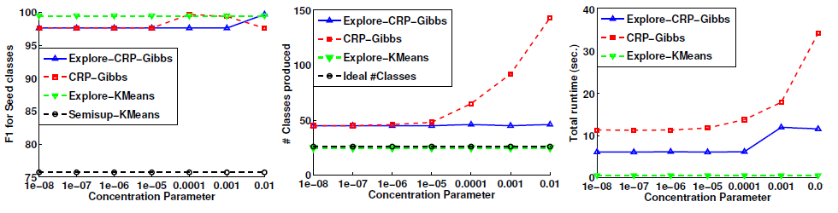
Findings
Algorithm:
Exploratory EM ≥ Semi-sup EM with
‘m’ extra classes
New Class creation criterion:
Near Uniformity ≥ Random
Existing exploratory method: Chinese Restaurant Process
Exploratory EM ≥ Gibbs + CRP
- Seed class F1
- Runtime
- # classes produced
- No need to tune concentration parameter

Slide 24
Conclusions
And Future Work …..

Slide 25
Summary
Advantages
Limitations
Dynamically creating new classes reduces semantic drift of known classes.
Simple heuristics for near-uniformity work.
Extends SSL methods
NBayes, K-Means, VMF
Exploratory EM version proves to be more effective than “Gibbs Sampling with CRP”
Limited to EM setting
Experimentally converges, theoretical proof is needed
No-more parallelizable
Evaluating newly created clusters is a challenge
Experiments are limited to cases where each datapoint belongs to only one class/cluster.

Slide 26
Future Work….
Evaluation:
  Are the new clusters meaningful?
  Can we name newly created clusters/classes?
  Can we parallelize it?
Applications:
  Scatter gather tool for information retrieval
  Hierarchical classification e.g. populating knowledge bases
  Multiple view datasets

Slide 27
Thank You
Questions?

Slide 28
Extra Slides

Slide 29
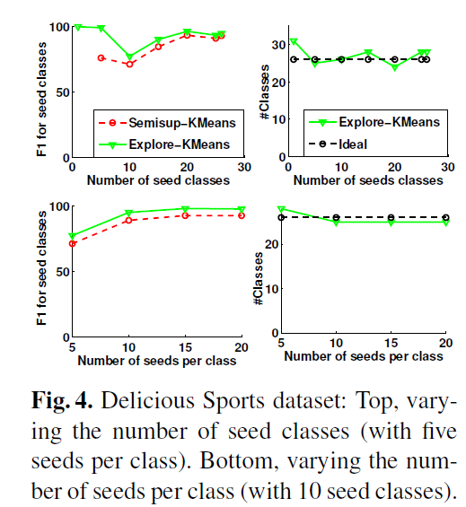

Slide 30
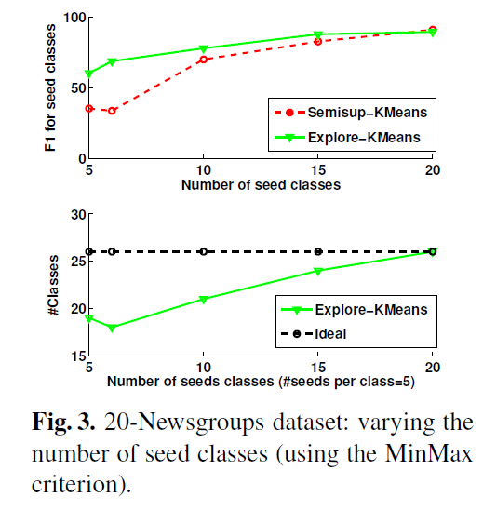

Slide 31
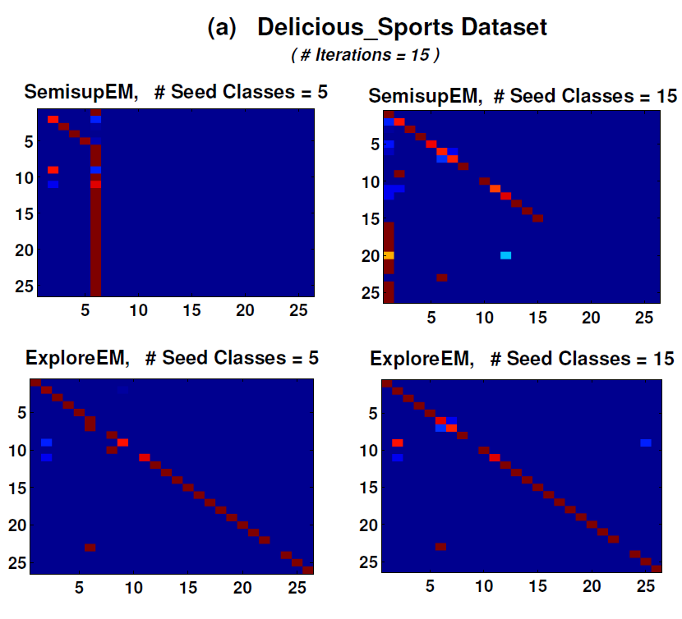

Slide 32
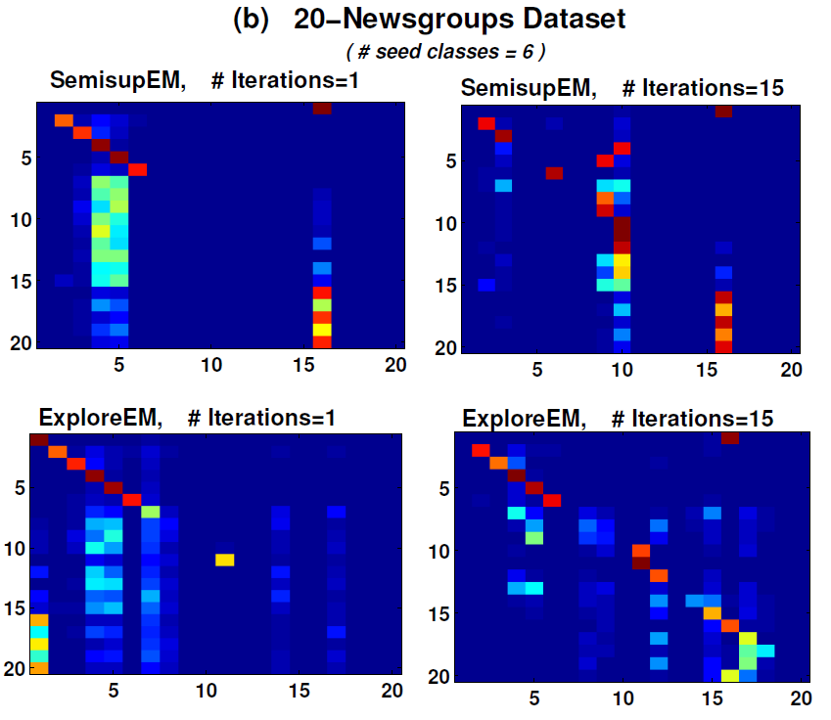

Slide 33
ExploreEM is better than Gibbs+CRP
Explore-CRP-Gibbs
Prob of creating a new class extended to depend on
- near-uniformity of P(old classes | x)
Improvements in terms of
F1 on seed classes
#classes produced
Total runtime
No need to tune concentration parameter

Slide 34
Explore-CRP-Gibbs
Prob of creating a new class depends on
- fixed prior: concentration parameter (Pnew)
e.g. 10⁻⁴
Can be extended to depend on
- near-uniformity of P(known classes | x)
P(new class) = Pnew / (k * d)
where k: current number of classes,
d: JS- divergence (uniform, P(Cj | Xi))

