Slide 1
Don’t Use Computer Vision
For Web Security
Florian Tramèr
CV-COPS
August 28th 2020
Notes:
This title is intentionally provocative.
Hope to convince you that using CV for web security today is quite the can of worms

Slide 2
Computer Vision For Web Security
(Most) users ingest web content visually
Detection of undesirable content
can (partially) be framed as a computer vision problem
Anti Phishing
Content takedown
Ad-blocking
“Does this webpage look similar to Google.com?”
“Is this a video of a terrorist attack”
“Is this image an ad?”
Notes:
Let’s start by asking the obvious question: why would you use CV for web security in the first place
Simple observation: most humans navigate the web visually
And for anyone who’s ever been on the Web, you’ll know there’s a lot of things there that we’d prefer not to see. This could be ads, phishing websites, illegal content, etc.
Detecting such content is, at the core, a vision problem. Once we know what things users shouldn’t see, all we need to do is recognize them and remove them.
Examples include using computer vision for ad-blocking. Or for detecting phishing websites, that look like legitimate websites and try to trick you into entering your credentials. Another example is content takedown: so last year there was a terror attack in New Zealand, and many social media platforms were trying to prevent users from uploading a video filmed by the terrorist.
But traditionally, these problems haven’t been tackled with computer vision techniques, simply because existing techniques just didn’t work well enough.
With recent advances in deep learning, there’s a lot of hope that CV techniques could help make the web more secure.

Slide 3
Act I
Don’t Use Computer Vision For
Client-Side Web Security
ML model is run on the user’s machine
Notes:
The thesis of this talk is that this is not the case, and that computer vision won’t help computer security, and in some cases makes things worse.
In a first part, I’ll talk about why executing computer vision models on the client-side is not going to be very helpful from a security perspective.
Here by client-side, I mean the the ML model is shipped to every user who then executes the model locally.

Slide 4
An illustrative example: Ad-Blocking
“AdVersarial: Perceptual Ad Blocking meets Adversarial Machine Learning”
(with Pascal Dupré, Gili Rusak, Giancarlo Pellegrino and Dan Boneh)
ACM CCS 2019, https://arxiv.org/abs/1811.03194
Notes:
Aa driving example, I’ll be using ad block software. The results here are mainly taken from this CCS paper with Pascal, Gili, Giancarlo and Dan

Slide 5

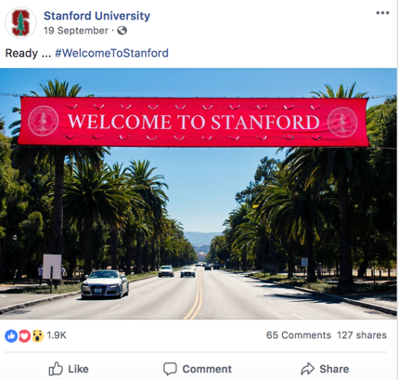


Why use CV for Ad-Blocking?
Humans should be able to recognize ads
Notes:
So why would one use computer vision for ad-blocking?
Consider Facebook. A few years, they restructured their page so that Ads and non-ads look essentially identical from a structural perspective.
The HTML code is nearly the same in both cases, the data is loaded from the same URLs, etc. So all these signals, that ad-blockers traditionally relied on, are no longer useful.
In fact, the only difference between ads and non-ads on FB is their visual content, as well as a small ad-disclosure in the top left corner.
And such visual ad-disclosures have become quite common in the industry.

Slide 6
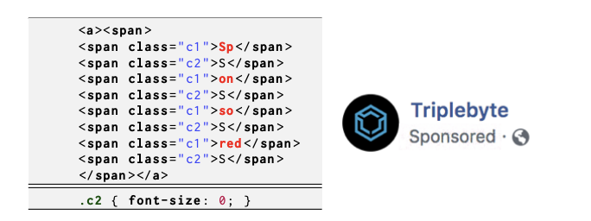
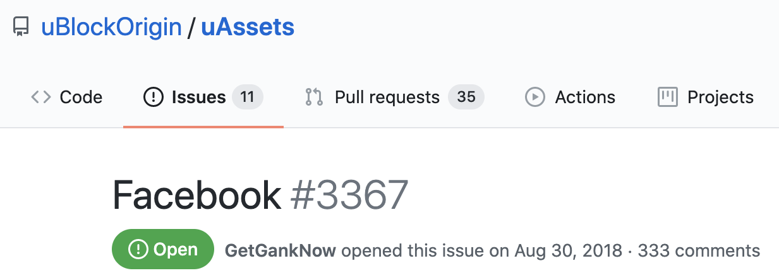
Why use CV for Ad-Blocking?
  Detecting ad-disclosures programmatically is hard!
Notes:
So you might still wonder then, why do we need computer vision for this. Why not just detect these ad-disclosures programmatically?
So first of all, many ads simply don’t have such visual disclosures, as there is no legal requirement to use them.
And when these ad disclosures are being used, publishers and ad networks aren’t going to make it easy for ad-blockers to detect the.
For example here on the left if a piece of HTML code that Facebook uses to generate its Sponsored tag.
It uses a bunch of HTML and CSS obfuscation techniques to make it hard to detect the tag when crawling through the page’s HTML.
If you look at FB now this might look different, because they dynamically change this between users and over time.
And for about a year now, the users of the uBlock origin ad blocker have been trying to come up with filters to block facebook ads. Judging by their github issue tracker, a new rule has to be deployed every couple of days. And the same holds for other ad disclosures.
But crucially, these obfuscation techniques are constrained by the fact that the human user should still see and recognize the ad disclosure.

Slide 7
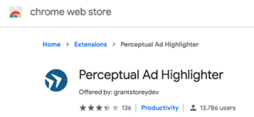

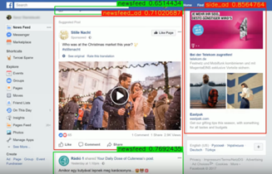
Perceptual Ad-Blocking
  Ad Highlighter [Storey et al., 2017]
    Traditional vision techniques
    (image hash, OCR)
  Sentinel by Adblock Plus [Paraska, 2018]
    Locates ads in screenshots using neural networks
  Percival by Brave [Din et al., 2019]
    CNN embedded in Chromium’s rendering pipeline
Notes:
And this insight is what prompted Storey and his co-authors at Princeton to propose Perceptual ad-blocking a few years ago.
Their main idea was to explicitly ignore all the features traditionally used by filter lists, and instead emulate the way in which humans recognize ads using computer vision techniques.
And since then, commercial players like Adblock Plus and Brave have taken this a step further and started looking into the possibility of integrating neural networks into their ad-blocking pipelines.

Slide 8
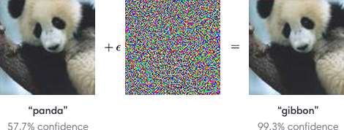
The Problem: Adversarial Examples
Biggio et al. 2014, Szegedy et al. 2014, Goodfellow et al. 2015, ...
Notes:
And this idea would be great, if not for a tiny issue with current computer vision systems: they quite simply don’t work in adversarial environments

Slide 9
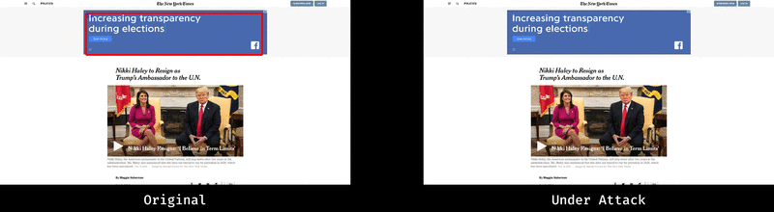
How Secure is Perceptual Ad-Blocking?
Notes:
And in our paper, we show that all proposed techniques for perceptual ad-blocking completely fail when attacked with adversarial examples

Slide 10


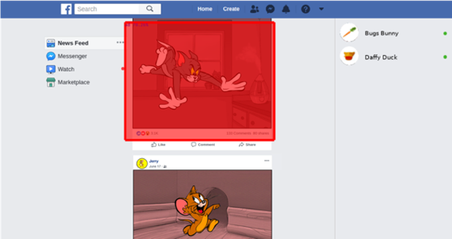
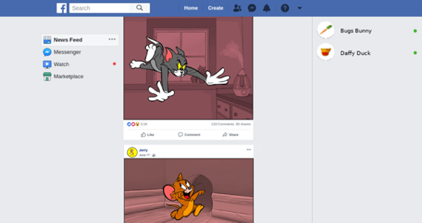
How (in)-Secure is Perceptual Ad-Blocking?
AD
AD
… so that Tom’s post gets blocked
Jerry uploads
malicious content
…
Notes:
And we further showed that naively integrating computer vision tools in a web context can cause security issues that go beyond just creating ads that evade detection.
For example, consider the ad-blocker design proposed by Adbloock Plus, which uses an off-the-shelf object detector trained on website screenshots.
We show an attack where one Facebook user, here Jerry, uploads a perturbed picture of themselves, that then causes the ad-blocker to recognize Tom’s post as an ad.
And this is of course pretty bad, because Jerry cannot actually alter Tom’s post, but since the object detector has no notion of web security boundaries, it just makes its predictions based on the full page screenshot.

Slide 11
Attacking Perceptual Ad-Blocking
How? Adversarial Examples (aka gradient descent)
    Nothing too special here
Why? Ad-blocking is the perfect threat model for adversarial examples
    This is the cool part!
Notes:
So as I mentioned earlier, these attacks are based on adversarial examples.
That is, we just perturb elements in the web page a little bit, so that ads go undetected.
I don’t want to focus on the technical details here, the attacks we use are quite standard.
Rather, I think that it is actually really cool to think about *why* perceptual ad-blockers are so easy to attack with adversarial examples.
And it turns out that ad-blocking nearly perfectly encapsulates the implicit threat model that adversarial examples capture.

Slide 12
The Adversarial Examples Threat Model
(There’s an adversary)
Adv. cannot change the distribution of inputs
    Otherwise, Adv could just use a “test-set attack” (Gilmer et al. 2018)
Adv. can only use “small” perturbations
    Otherwise, Adv could just change the class semantics
Adv. has access to model weights or query API
Notes:
Here’s what I mean by this.
Most of the literature on adversarial examples implicitly assumes a threat model defined like this:
First of course, there is an adversary. We’re not concerned with average-case performance here.
Second, and this is quite important, when studying adversarial examples we usually assume that there is some fixed distribution of inputs that the adversary cannot control. Note that if this weren’t the case, the adversary could just find one input that is misclassified and always use that one. This has been called a “test-set attack”. And so when we study adversarial examples, we usually make an implicit assumption that such a trivial attack doesn’t apply.
Third, we typically think of adversarial perturbations as being perceptually “small”. Again, without this restriction, attacking a model becomes somewhat trivial. So it’s important that this restriction actually makes sense in whatever domain we’re considering.
And then finally, most attacks in the literature, at least the strongest ones, assume that the adversary can somehow gain access to the model, either directly to the weights or at least to a direct query API.

Slide 13
The Adversarial Examples Threat Model
There’s an adversary
Adv. cannot change the distribution of inputs
Adv. can only use “small” perturbations
Adv. has access to model weights or query API
Challenge: find a setting where this threat model is realistic
Notes:
And I claim that it’s actually quite challenging to come up with a setting where this specific threat model is realistic.
And that in most cases, there isn’t a reason why the adversary should be constrained to making small perturbations to inputs from a fixed distribution.

Slide 14
The Ad-Blocking Threat Model
There’s an adversary
    Web publishers, ad-networks have financial incentive to evade ad-blocking
Adv. cannot change the distribution of inputs
    Ad campaigns are meticulously designed to maximize user engagement
Adv. can only use “small” perturbations
    Website users should be unaffected and still click on ads!
Adv. has access to model weights or query API
    Ad-blocker is run client-side so the model weights are public
New challenge: find a setting other than ad-blocking where this threat model is realistic
Notes:
And it turns out the perceptual ad-blocking perfectly fits this threat model, and it’s actually the only setting I know of that perfectly fits the threat model.
In other scenarios, at least one of the four above properties usually fails to hold.

Slide 15
Client-Side Web-Security is Hard
Near-impossible to resist dynamic/adaptive attacks
True beyond ad-blocking:
    Don’t do client-side visual anti-phishing!
True beyond computer vision:
    Don’t use client-side ML models to detect spam or malware
Notes:
So that’s basically why using computer vision for ad-blocking is really hard.
As long as adversarial examples are an issue, it will be near impossible to deploy a vision model that resists strong attacks.
And this true more broadly for client-side machine learning. For example, there’s also been some proposals for using CV to detect phishing websites.
And the exact same caveats apply here too.
Or beyond vision, you’d have the same problems if you tried to deploy a client-side machine learning model for detecting spam or malware

Slide 16

So What Can We Do?
Client-side black-lists:
    Signatures of known malware
    List of known phishing domains
    (e.g., Google safe browsing)
    Ad-blocking filter lists
Server-side ML:
    Real-time spam & malware detection
    Content takedown
    What about computer-vision?
Efficiency
More features
“Security by obscurity”
Notes:
So what do we do then, if we can’t use ML on the client.
Well current web security is mainly based on two axes:
The first is to use simple black-lists on the client. These are just lists of things that are known to be bad, such as known malware or phishing sites, or traditional ad-blocker filter lists
These aren’t perfect, they won’t catch zero-day attacks, but they’re a first line of defense
And if ML is used, it is done remotely, server-side. This is true for spam filtering in your Gmail account, most malware detection, content takedown on Youtube etc. And there are many advantages over running ML on the client: It’s more efficient, especially if the client is a low-resource device like a mobile phone. You can typically use more features, that cannot be shared with end-user devices, and tied to this, you get some amount of security from the fact that adversaries can no longer directly inspect what your ML pipeline is doing.
So what about running computer vision models server-side, say for ad-blocking or phishing detection?

Slide 17
Act II
Computer Vision In Server-Side Web Security:
A Privacy Nightmare
Notes:
And this brings us to the second part of our story, in which I argue that server-side computer vision is an even worse idea in most cases, because of the obvious privacy implications.

Slide 18
The Problem
Server-side ML
=
Server-side Data
Notes:
And this is really not rocket science. If we want to run our security ML models server-side, then we also need to have the data on the server

Slide 19
Privacy vs Security: Choose One
Does content-security warrant sharing our...
Emails?
    It seems so
Downloaded apps?
    Google / Apple / ... already know this anyway
Website screenshots for ad-blocking or anti-phishing?
    That seems excessive...
Notes:
So as users we ultimately often have to make a choice, between security and privacy. Namely, do we want to have all our data collected and aggregated so that we can get better security.
And email is maybe the data that best exemplifies this. You could of course run your own local email server, but a strong selling point of centralized email like Gmail is better spam filtering.
And in other cases, like mobile app downloads, the content already comes from a centralized repository anyways. In other words, Google or Apple already know which apps you’ve downloaded, so they might as well provide server-side malware detection with it.
But now, coming back to computer vision, ask yourself this: would you be okay with sharing screenshots from the websites you visit, if a remote service promised better ad-blocking or anti-phishing. To me, this gets into quite uncomfortable territory from a privacy perspective.

Slide 20
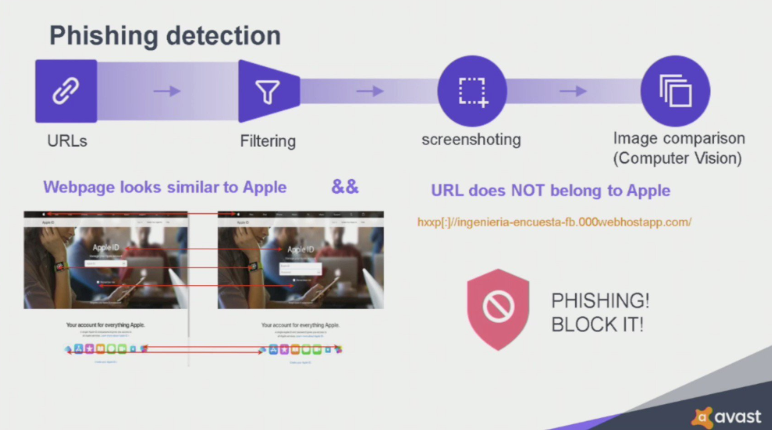
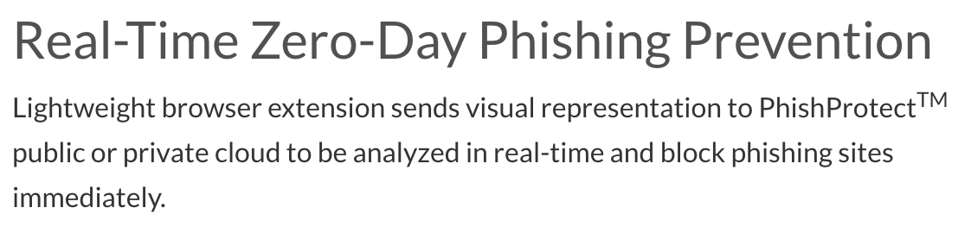
Screenshot Sharing For Security is a Thing!
source: https://www.phish.ai/
Notes:
And so I was quite surprised to find out that screenshot sharing is actually already a thing!
For instance, Avast’s antivirus phishing detection pipeline involves taking screenshots from pages you visit and sending these to the Avast servers.
There, some ML models will compare the screenshot to a database of screenshots from popular websites, to detect if you’re visitng a page that is masquerading as another.
And there’s a bunch of other companies, for example phish.ai, that propose a similar approach.

Slide 21
Some Research Questions
Is visual anti-phishing secure?
    Can computer vision achieve low-enough false positives?
    Do phishing websites have to look similar to legitimate websites?
    Automated black-box attacks?
Is it private?
    Can browser extensions be tricked into screenshotting sensitive data?
    Can this data be extracted from trained neural nets?
Notes:
And as a security and privacy researcher, this seems like a huge can of worms.
So before I conclude, I’ll leave you with some research questions that I find interesting in this space of visual anti-phishing.
Firstly, I wonder how well visual anti-phishing really works. Can modern computer vision actually achieve low enough error rates for this to work in practice? Beyond that, there’s interesting human studies about how good phishing websites have to look to actually fool users.
And then, assuming that visual anti-phishing does indeed work, well there’s the question on whether you could evade such a system using black-box attack techniques
And then of course there’s this annoying privacy aspect. So it would be very cool to understand how risky this approach of sharing website screenshots really is, what type of sensitive data could get exfiltrated this way. Given what we know about unintended memorization in neural networks, it’s even possible that data from these sensitive screenshots could then be extracted by interacting with a trained model.

Slide 22

Conclusion
Don’t Use Computer Vision
Machine Learning
For Client-Side Web Security
Don’t collect screenshots from my browser!
Don’t Use Computer Vision For Web Security
“In fact, it’s better if you don’t use ML at all”
Questions? tramer@cs.stanford.edu
Notes:
This brings me to the end of my talk.
I hope I’ll have convinced you that running computer vision models, or really any machine learning models, on user devices is a bad idea for web security, because these models are so easy to fool.
And on the flip side, moving these security-sensitive computer vision models to the cloud just trades one problem for another, since now you’re introducing a really nasty privacy leak.
And this is why I believe that currently, computer vision just doesn’t have a place in modern web security.

