Slide 1
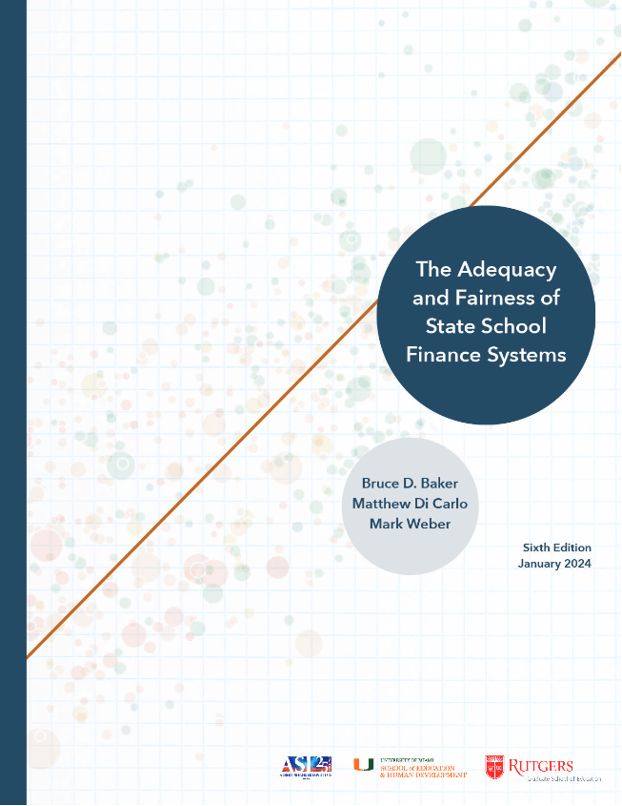
The State of Florida’s Schools
Bruce D. Baker
School Finance Indicators Database
University of Miami

Slide 2
Outline
Money Matters (New Literature on an Old Question)
Goals of State School Finance Systems
School Funding in Florida
  Effort
  Consequences of Low Effort
  Revenues & Volatility
  Adequacy & Outcomes
Choosing Choice over Adequacy & Equity
District level deeper dives (focus on Miami)
Better (more equitable & efficient) uses of the voucher dollars

Slide 3
Background

Slide 4

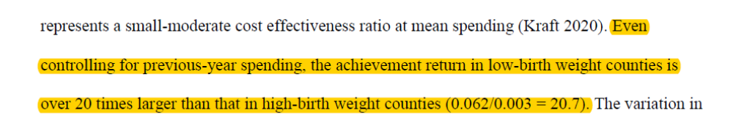
Money matters
Money matters
  Whether derived from
    Court order/school finance reforms
    Economic fluctuations
    Local referenda
    Formula discontinuities
    Pandemic federal stimulus
  Whether spent on
    Annual operations (usually leading to increased staffing and/or increase wages)
    Capital infrastructure
Money spent on children from low income contexts or areas where prior spending was lower yields greater return on outcomes
  Achievement
  Attainment
  Mortality
  Crime
Rauscher, E., & Shen, Y. (2022). Variation in the relationship between school spending and achievement: Progressive spending is efficient. American Journal of Sociology, 128(1), 189-223.

Slide 5
1971
1989
1992
2007
2019
School Funding Context
Wealth Equalization
r*
Targeted Increases
(Progressiveness)
Great Recession
J&M, 2023
JR&DS, 2022
ER&YS, 2022
J&W, 2021
JWX, 2021
1966
Coleman
Card & Payne, 2002
JJP, 2014&15
C&S, 2019
Hanushek, 1986
Meta-Wars
EAH v. HLG
Regression-based
Production Functions
National
JL, JR &DS, 2018
Research & Eval
State (or Policy) Specific
Guryan, 2001
Mass (’93)
Deke, 2003
KS (’92)
Hyman, 2017
Mich (’95)
CCD&T, 2024 (MS)
BHV, 2024 (MI)
Barron, 2022 (WI)
Abbott, 2020 (7)
Rauscher, 2020 (KS)
Kreisman, 2019 (TX)
Gigliotti, 2018 (NY)
Johnson, 2018 (CA)
Downes, 2004
VT (’98)
Roy, 2011
Mich (’95)
Chaudhary, 2009
Mich (’95)
Cost Modeling, 1994 →

Slide 6
Pathways to Education Production and determinants of cost
Production Analysis
Staffing Wages
Current Operations
Program Organization & Delivery
Staffing Quantities
Student Engagement
Student Attendance
Spending*
MS&E &Other
Labor Market / Workforce Effects
Student Academic Achievement
Long Term outcomes
Facilities Improvements
Capital Investment
Quality of Indoor & Outdoor Spaces
Student Health
New Facilities
Cost Analysis

Slide 7

Goals of School Finance Systems
The goal of school finance systems is to provide all children, regardless of where they live or attend school, equal opportunity to achieve common, adequate outcome goals
  Providing equal educational opportunity toward common goals costs different amounts in different settings, and across children (individually and collectively) by needs and contexts
    State accountability systems (for what they’re worth) set common goals - rate, rank and evaluate schools (and children) on whether they meet those goals
    A fair system requires funding sufficient to provide equal opportunity to meet these goals (which are often used for articulating constitutional rights).
14 Conceptions of Equity and Adequacy in School Finance
16 Measurement of Cost Differentials
Notes:
State school finance systems should be designed to enable local public schools to provide the programs and services needed for all children – whatever their backgrounds – wherever they attend school – to have equal opportunity to achieve adequate educational outcomes!
That unified framing can and should serve as a substitute for older conceptions of things like “horizontal” and “vertical” equity, which are problematic in a number of ways – especially when attempting to frame legal arguments.
The treatment, per se, is the expectation for all children that they have equitable access to outcome goals. Ideally, those outcome goals are adequate – though equal opportunity can be maintained even if the outcomes are not adequate.
Under this framework, all children are similarly situated (with respect to outcome expectations), but require different resources to have equal opportunity to succeed.
Failing to calibrate state school finance systems to provide equal opportunity to succeed on outcome standards set by the state is inherently unfair.
Recall when pundits were arguing that schools/districts with fewer resources just needed to be like the Oakland Athletics in the film/book Moneyball. They always failed to mention the book’s subtitle: The art of winning an unfair game.
It’s fine for baseball to be unfair, but not our children’s education.

Slide 8

Basic Principles of “Costs” & “Equal Opportunity”
It costs more to achieve higher than lower outcomes
  All else equal, the per pupil spending required to achieve higher, and broader outcome goals is higher than the per pupil spending required to achieve narrower and/or lower goals
It costs more to achieve the same outcomes…
  With some children than others
    Collective, social context effects (poverty)
    Specific student needs (ELL, Disability)
  In some settings than others
    Economies of Scale – Small, sparsely populated remote school districts
    Regional variations in the competitiveness of wages (labor market effects)
16 Measurement of Cost Differentials
8
Performance Standards and Educational Cost Indexes: You Can't Have One Without the Other

Slide 9
Florida School Funding Effort
Race to the Bottom
(or Chasing Arizona)

Slide 10
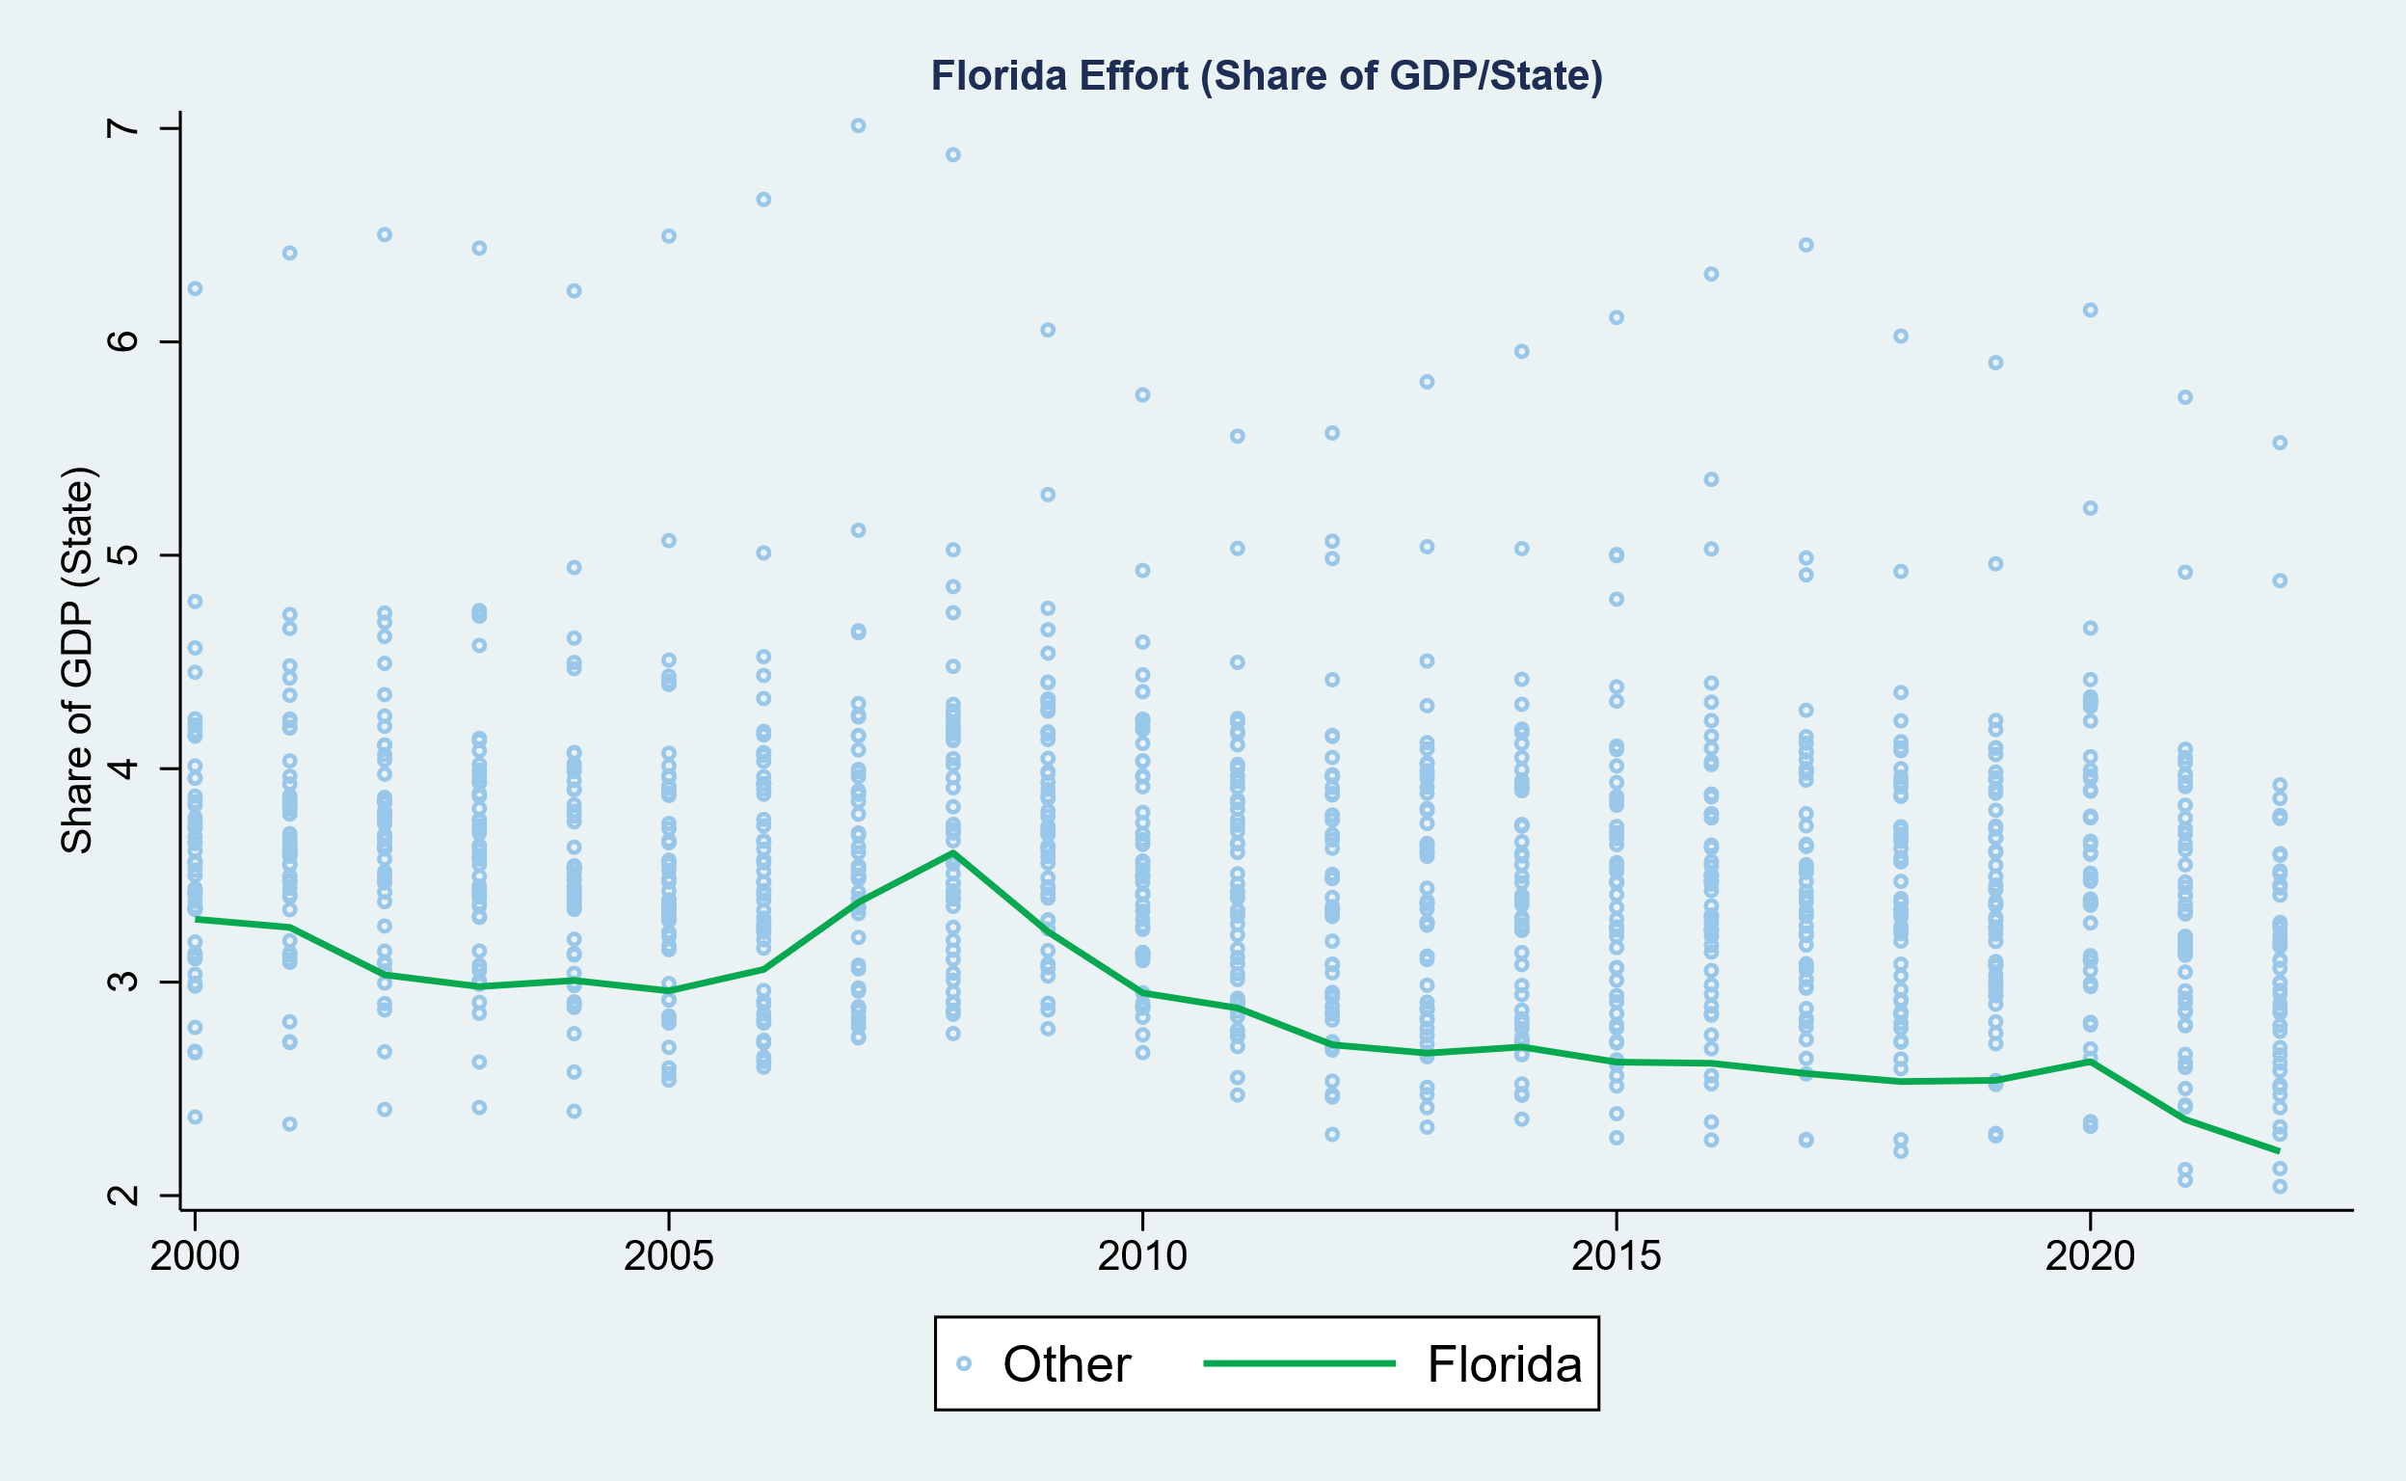

How Hard is Florida Trying?
Public School Spending as a Share of Economic Capacity

Slide 11
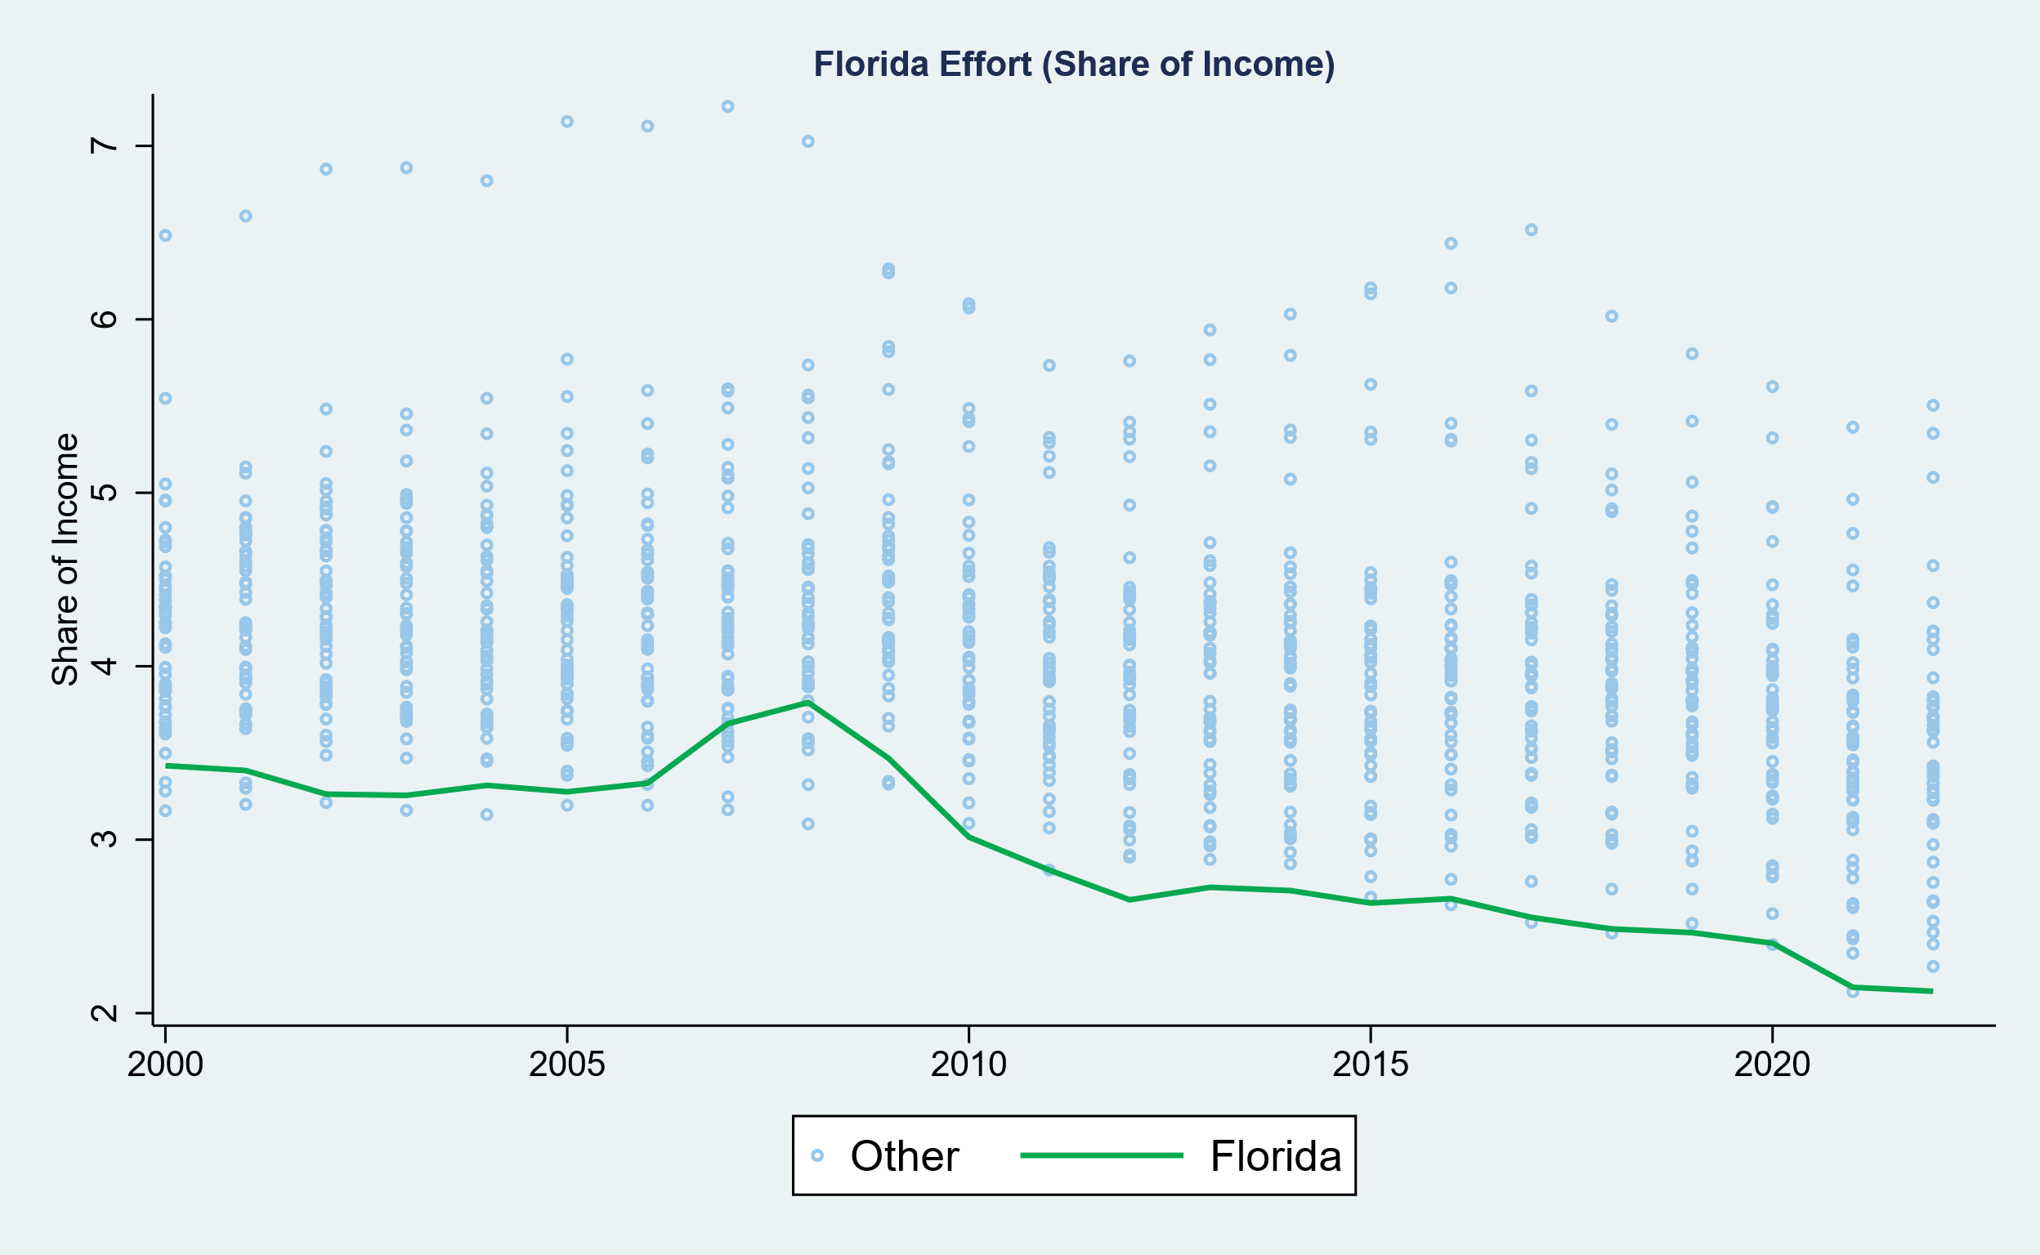
How Hard is Florida Trying?
Public School Spending as a Share of Economic Capacity

Slide 12
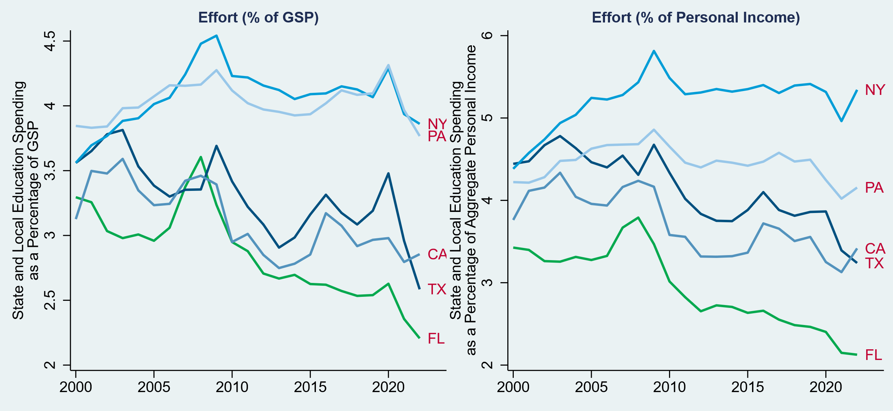
How Hard is Florida Trying?
Comparison to other Large States

Slide 13
Consequences of Low & Declining Effort

Slide 14
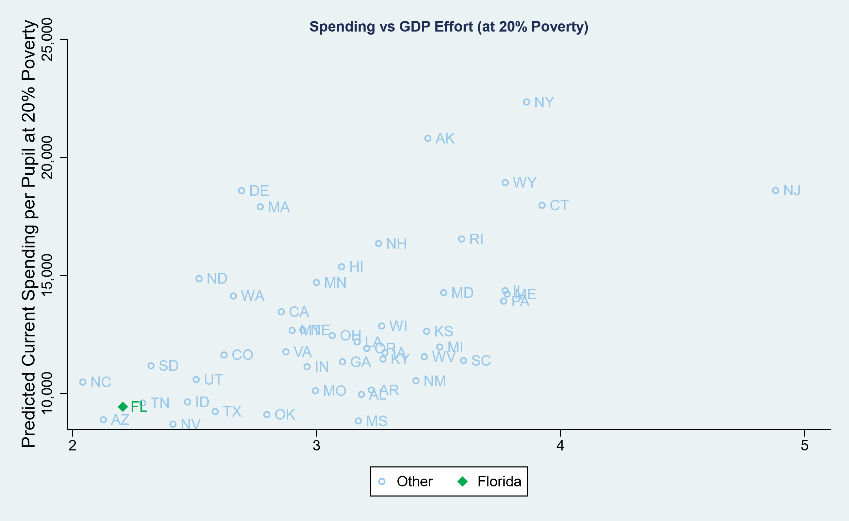
Consequences of Low Effort
Effort & Spending

Slide 15
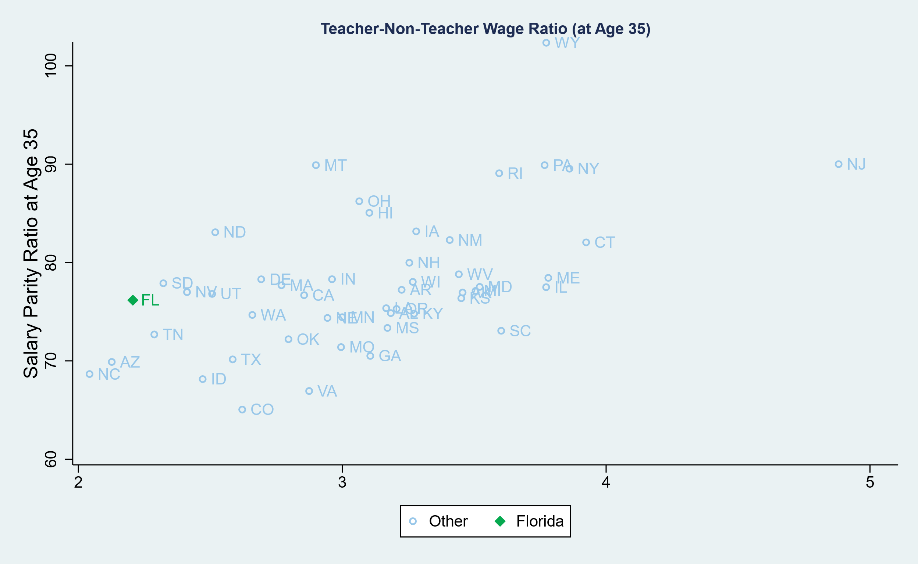
Consequences of Low Effort
Effort & Teacher Wage Competitiveness

Slide 16
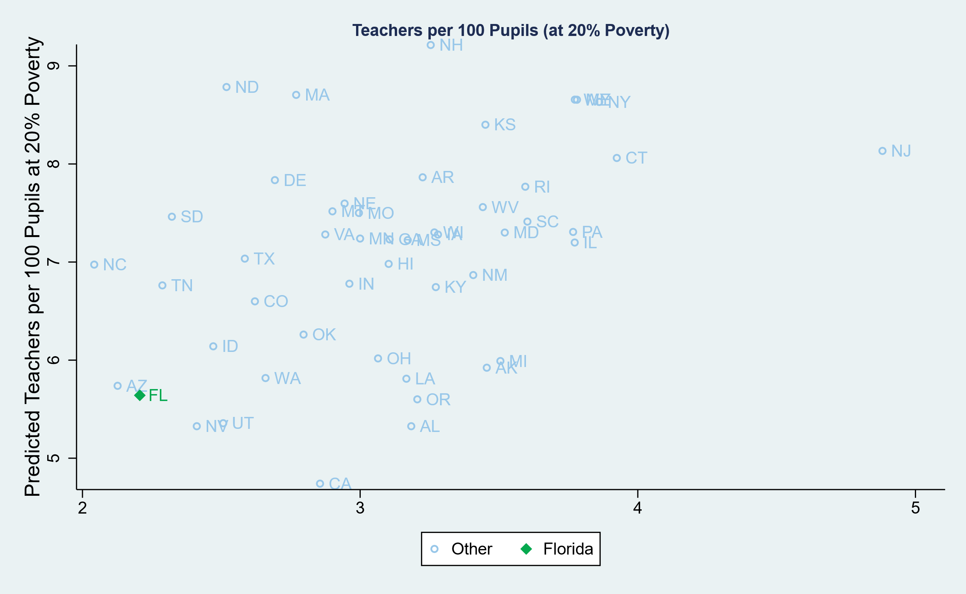
Consequences of Low Effort
Effort & Staffing Ratios

Slide 17
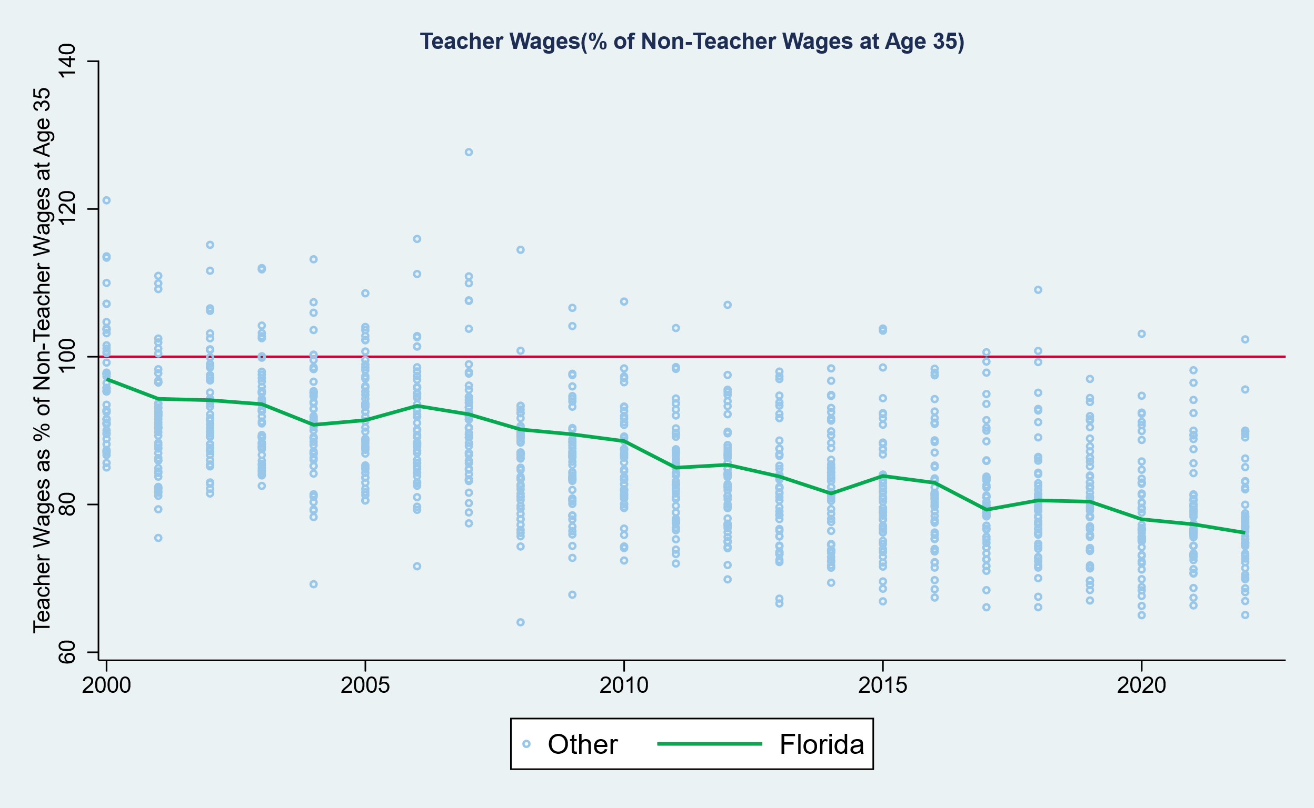
Trends in Teacher Wage Competitiveness
Controlling for age, degree level (2yr to Masters included), hours per week, weeks per year

Slide 18
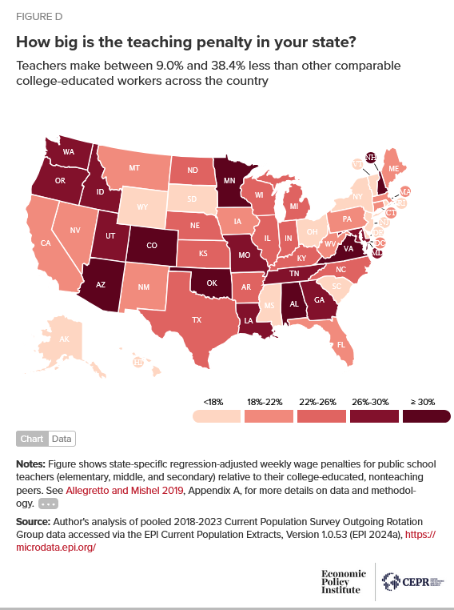
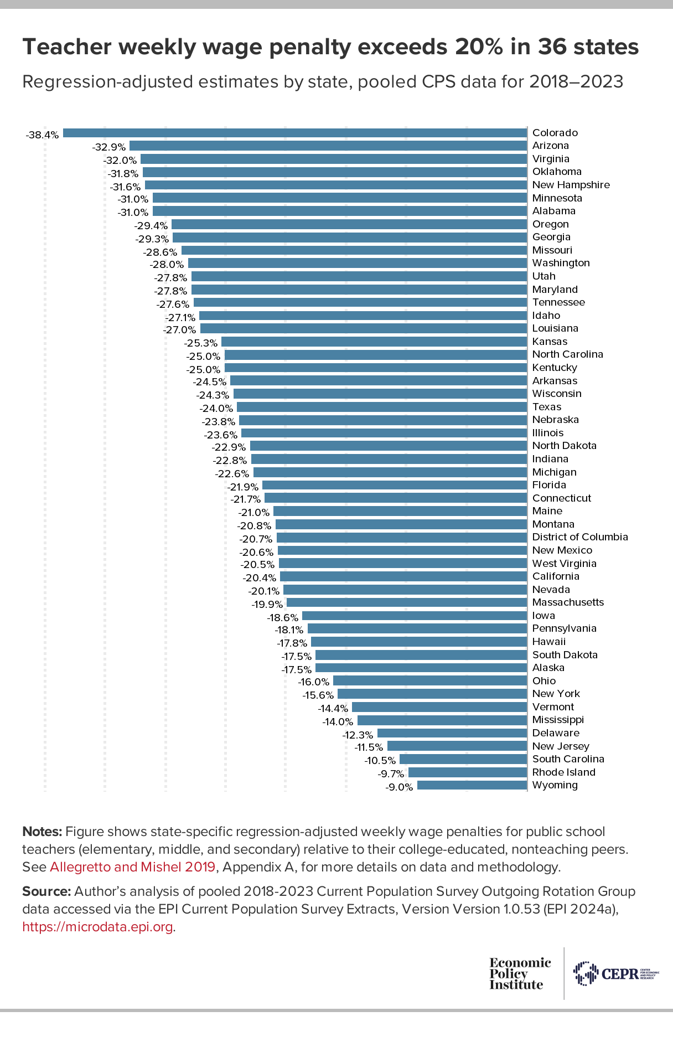

Slide 19
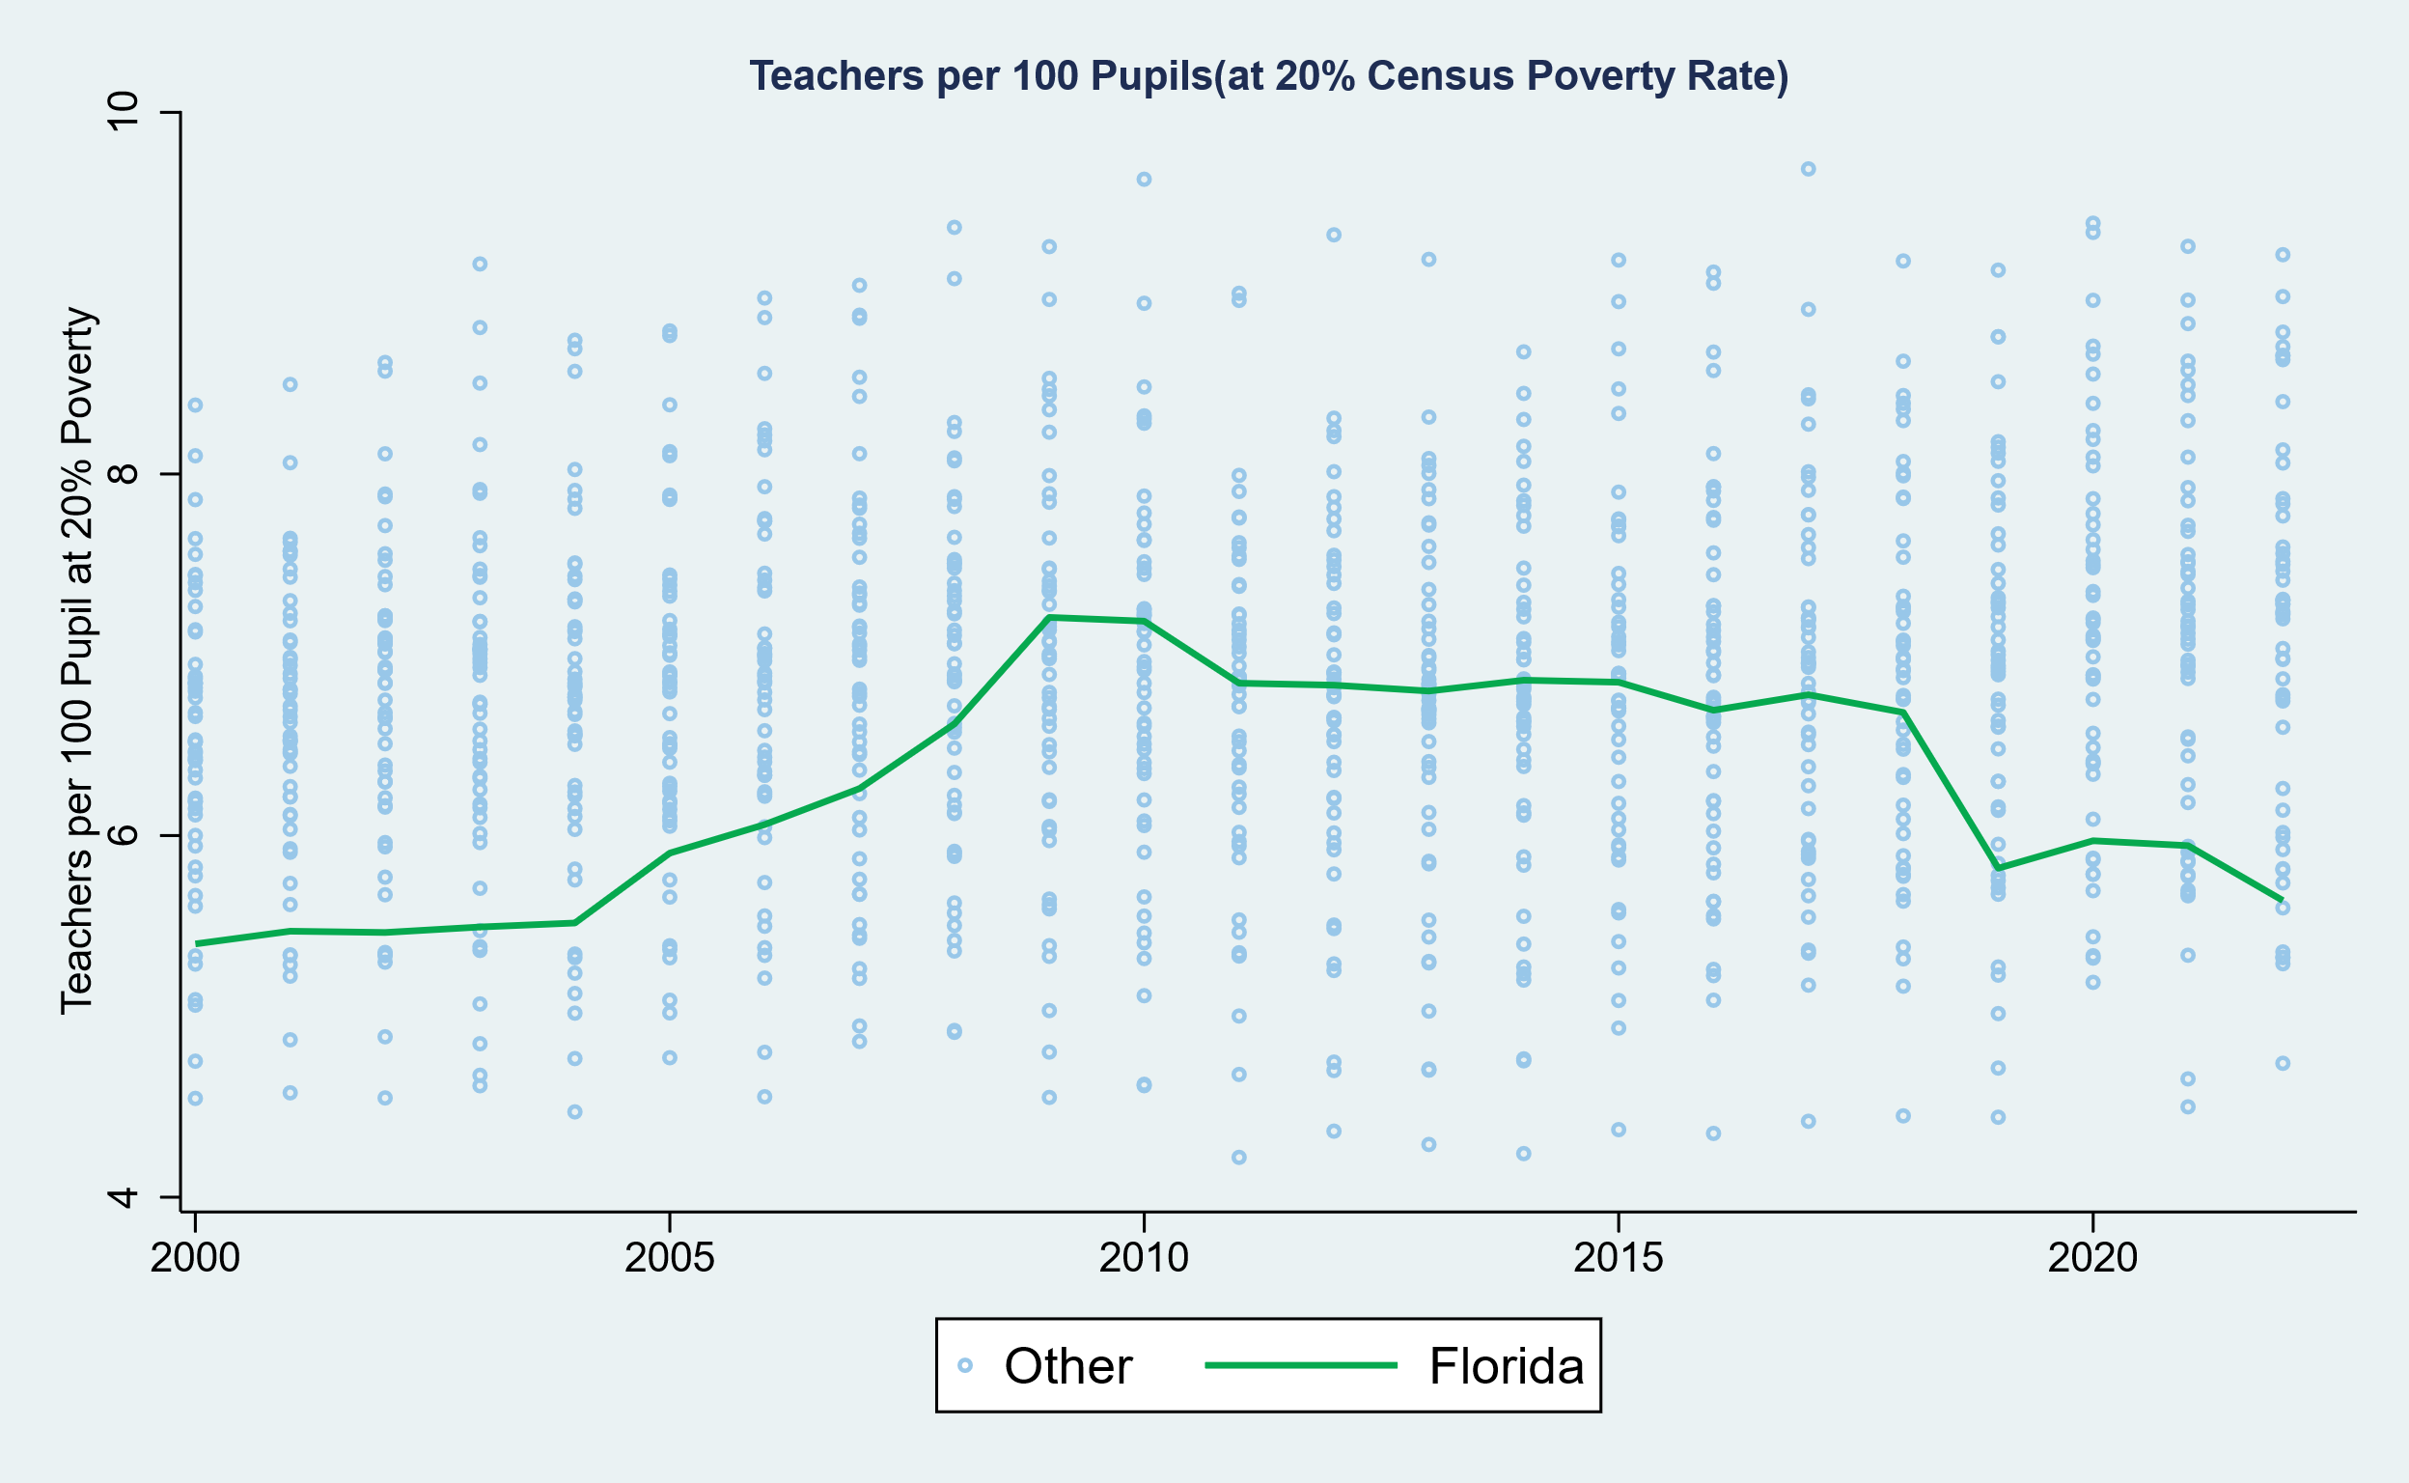
Trends in Staffing Ratios

Slide 20
A Look at Revenues by Source
Theme: Heavy Dependence on Federal Aid & Declining role of State Support

Slide 21
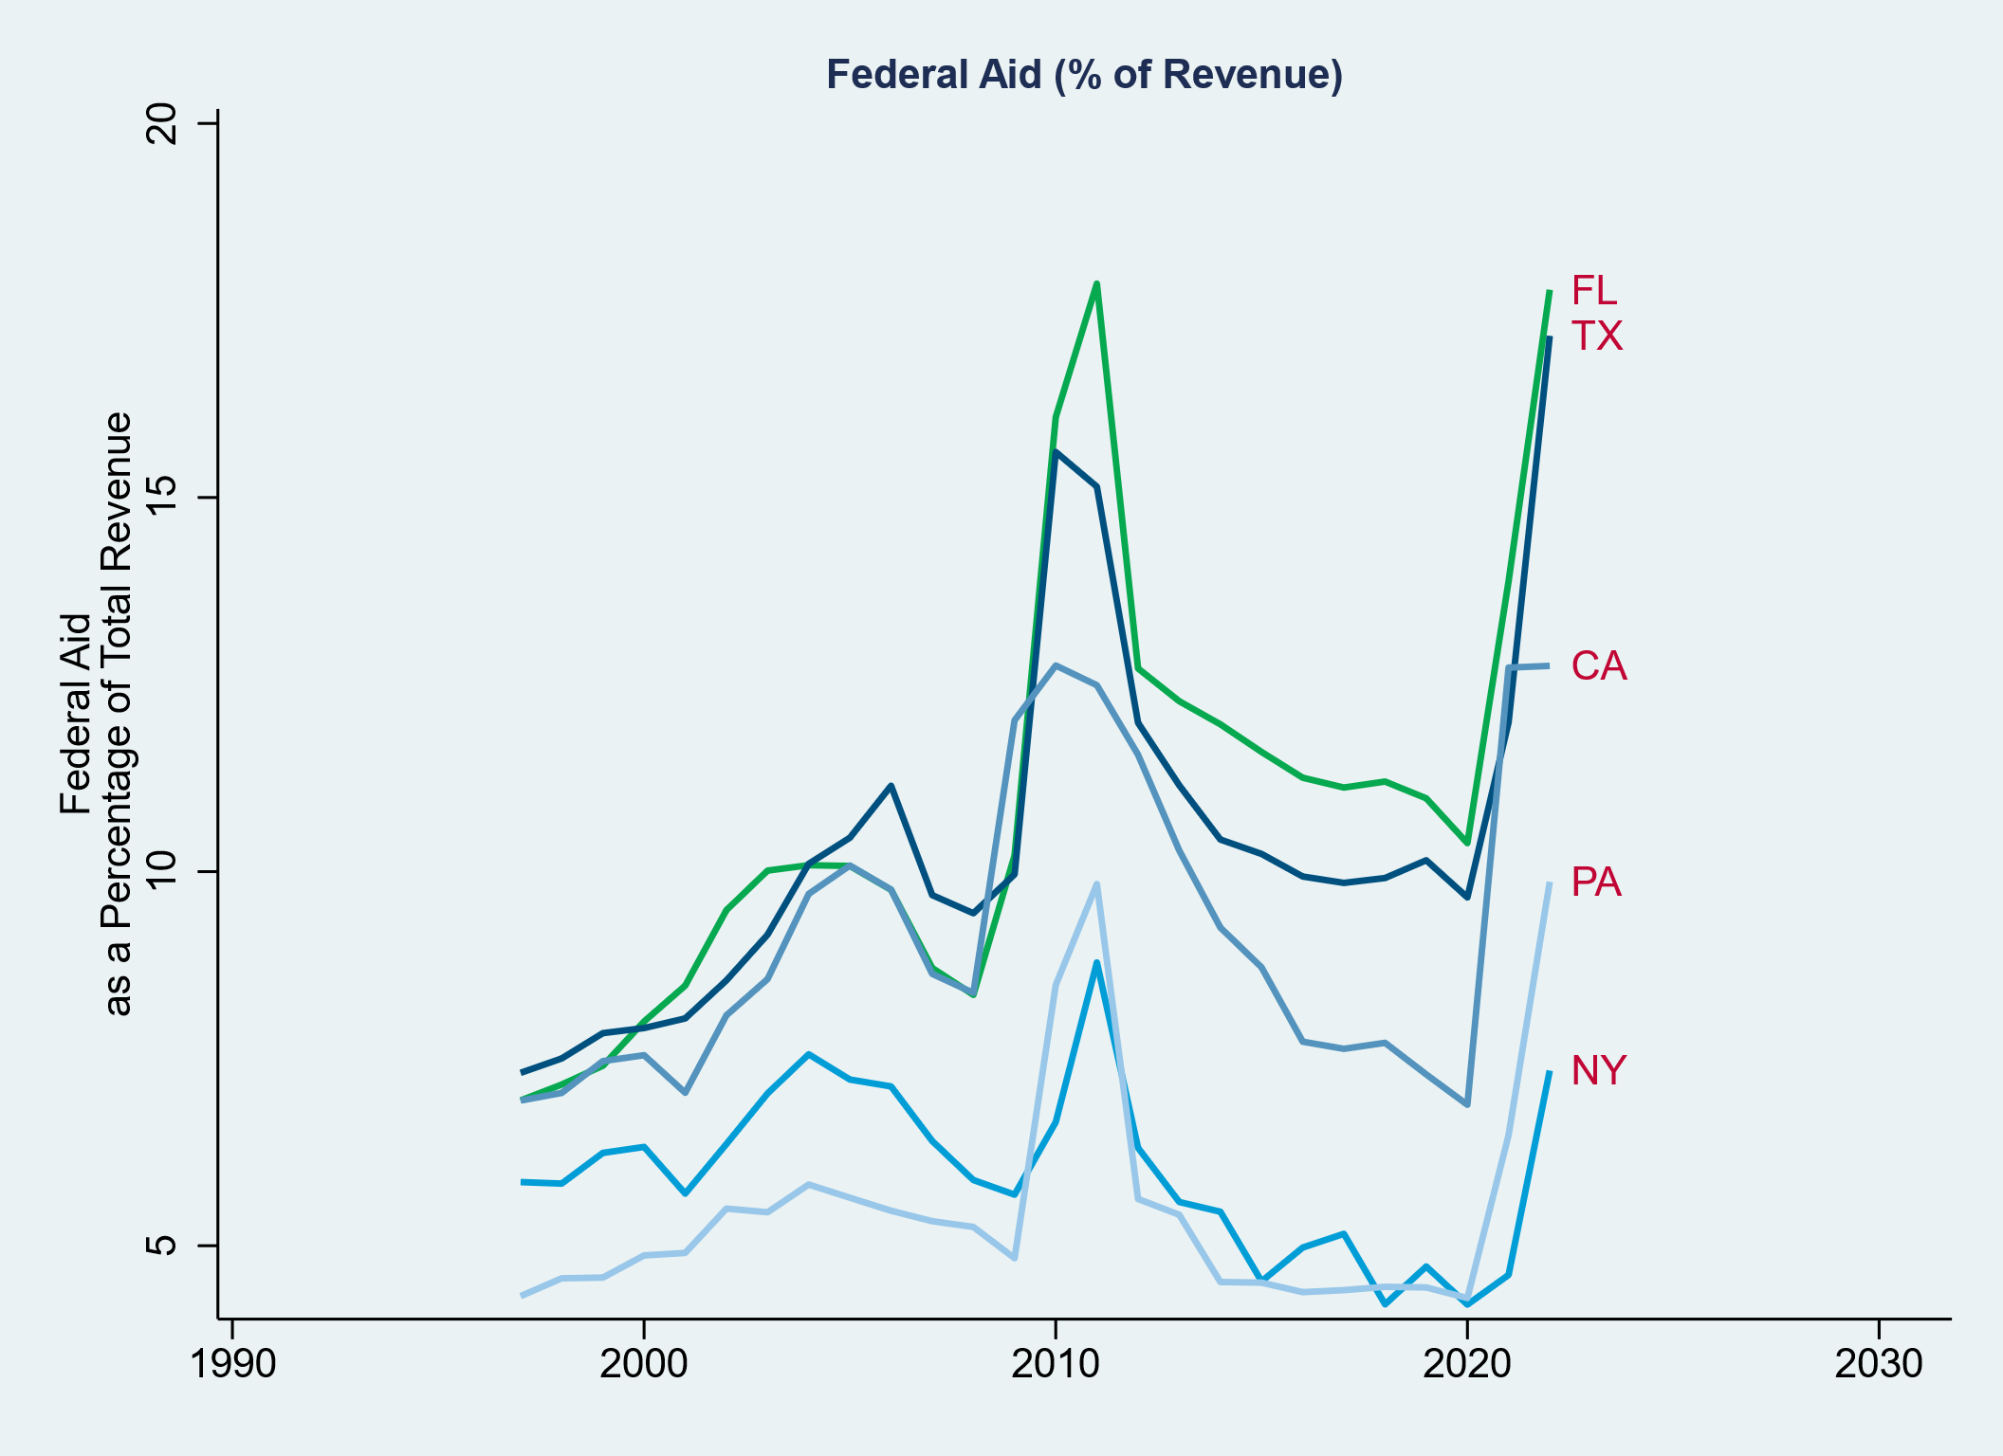
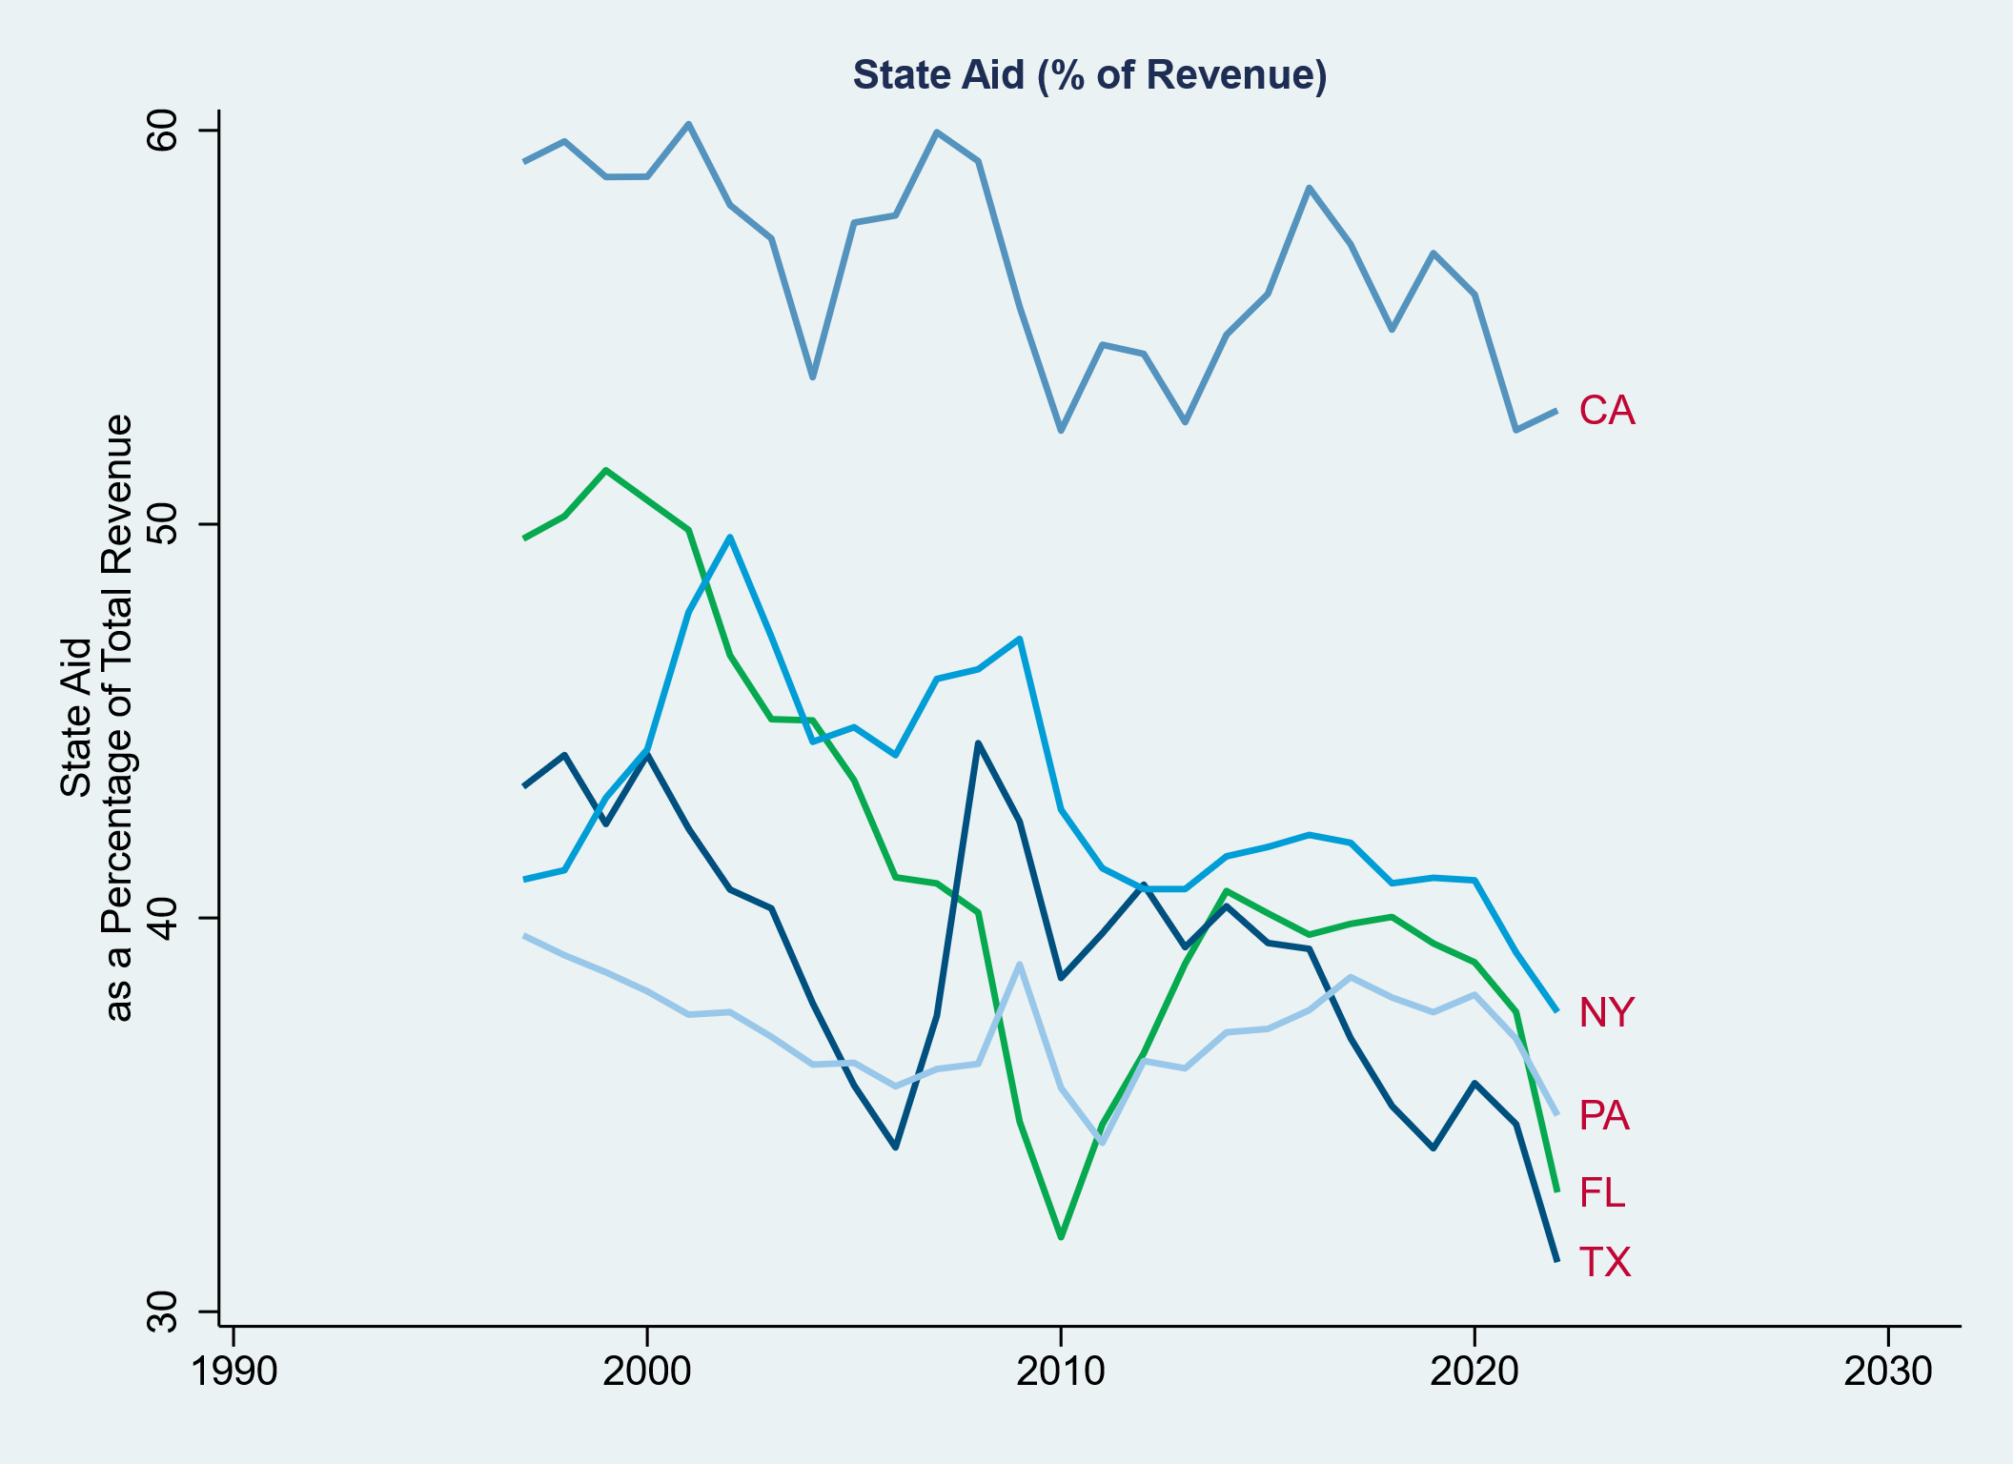
Dependence on Federal Aid
Compared to other Large States

Slide 22
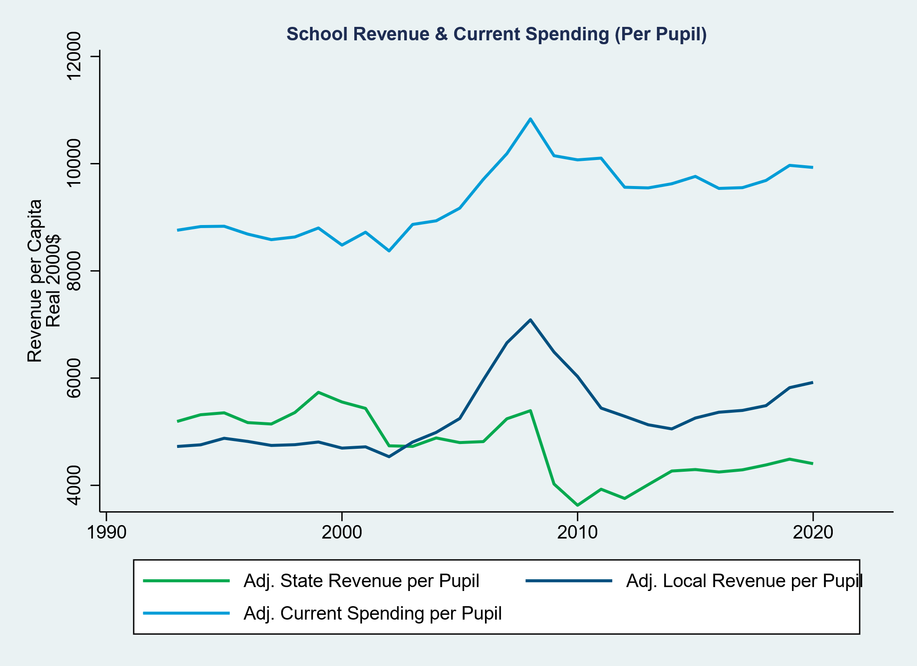
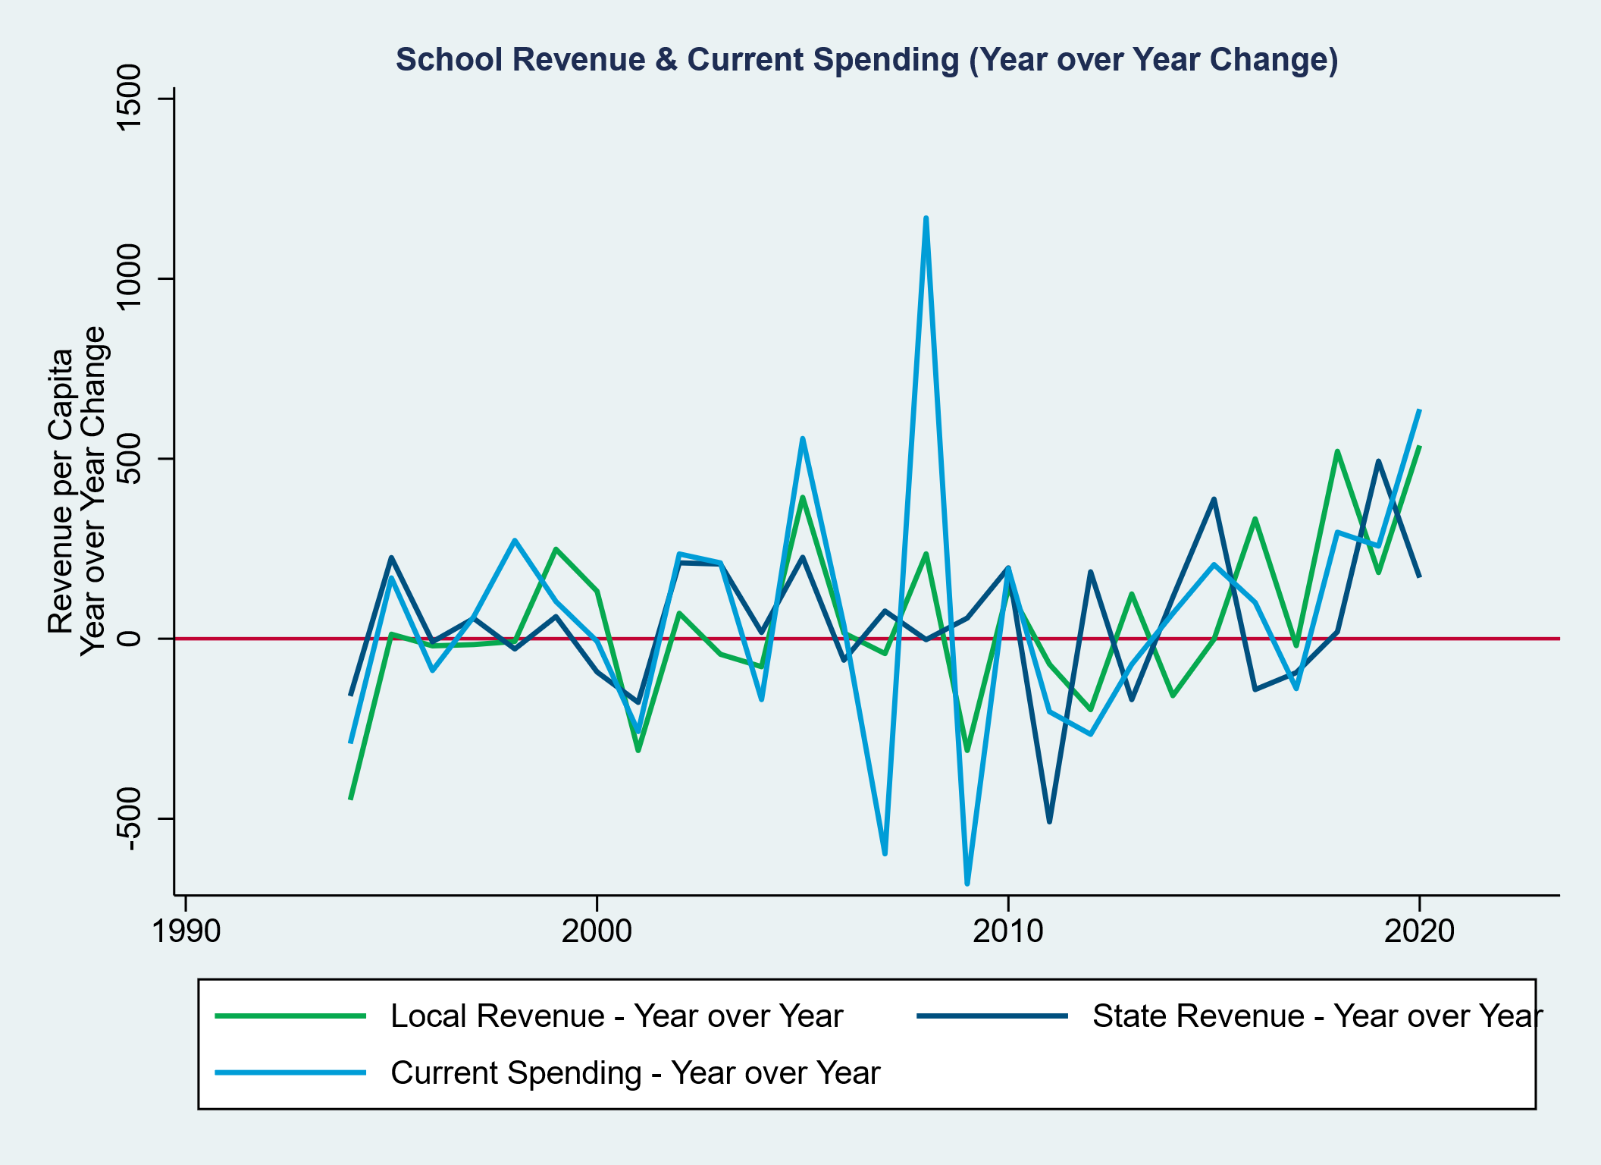
Fluctuations in Revenues by Source & Current Spending

Slide 23
Adequacy, Costs & Outcomes

Slide 24
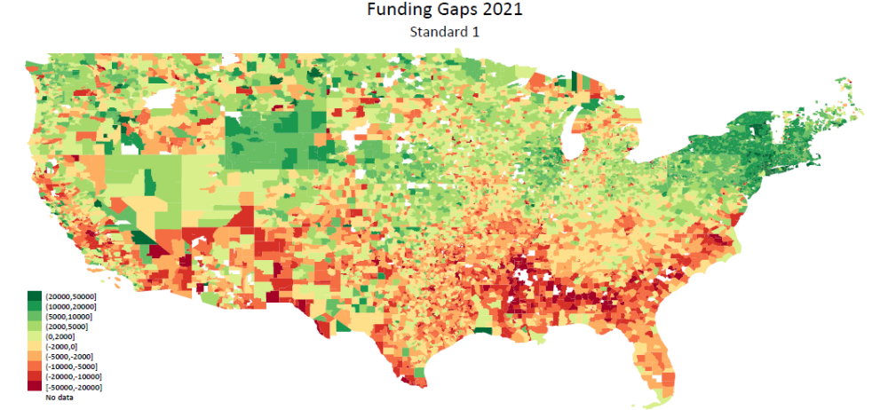
Current spending compared to spending needed to achieve national mean outcomes

Slide 25
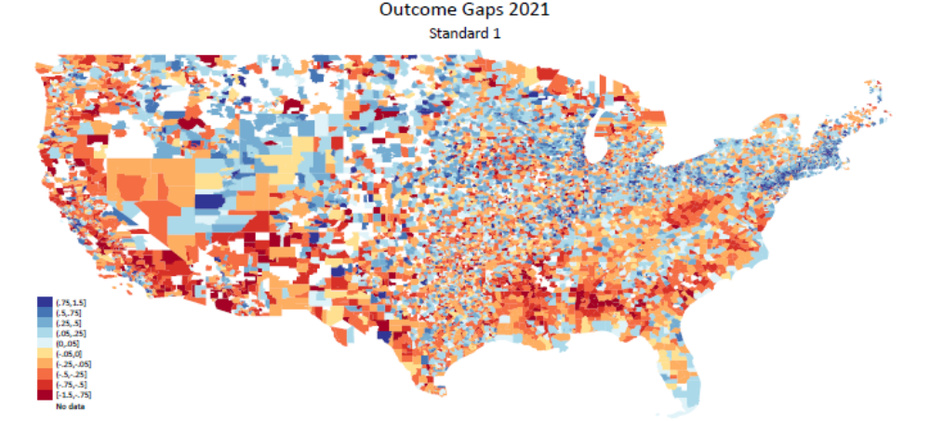
Outcome Gaps to National Mean

Slide 26
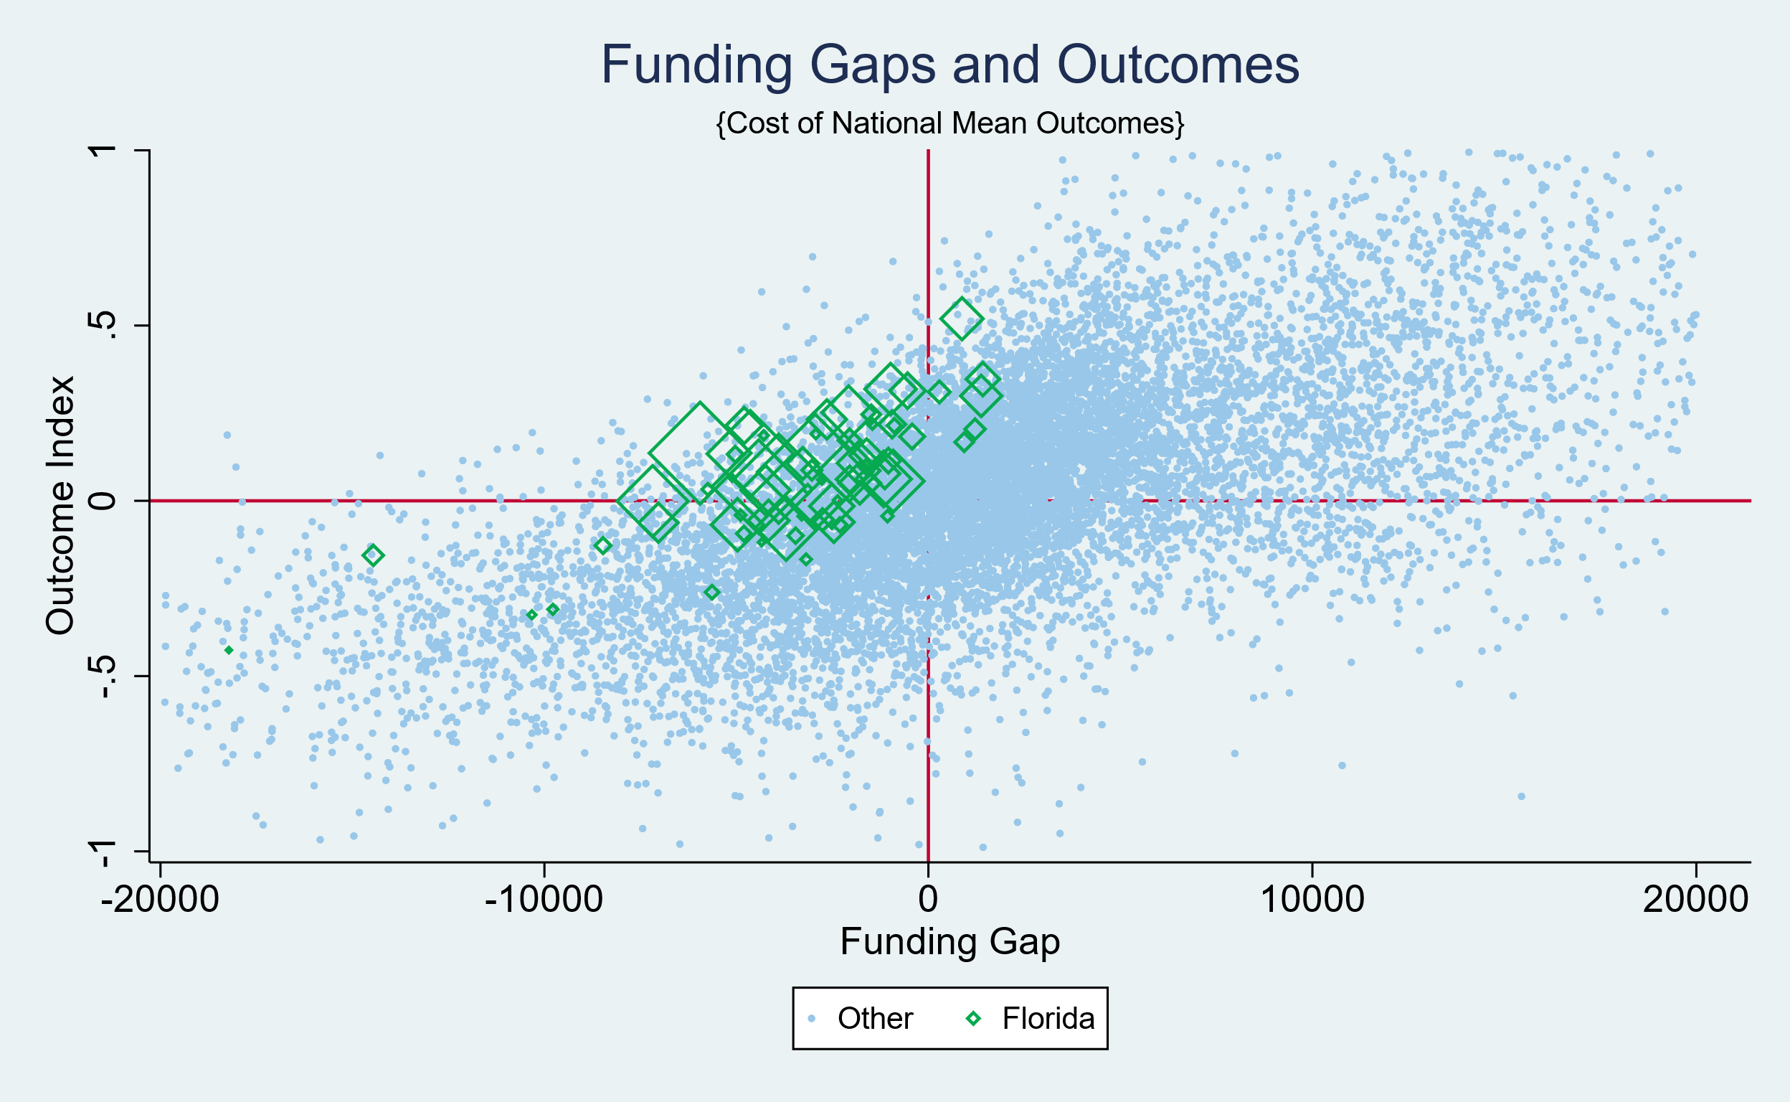
Funding Adequacy & Outcomes
Compared to National Averages (2021)

Slide 27
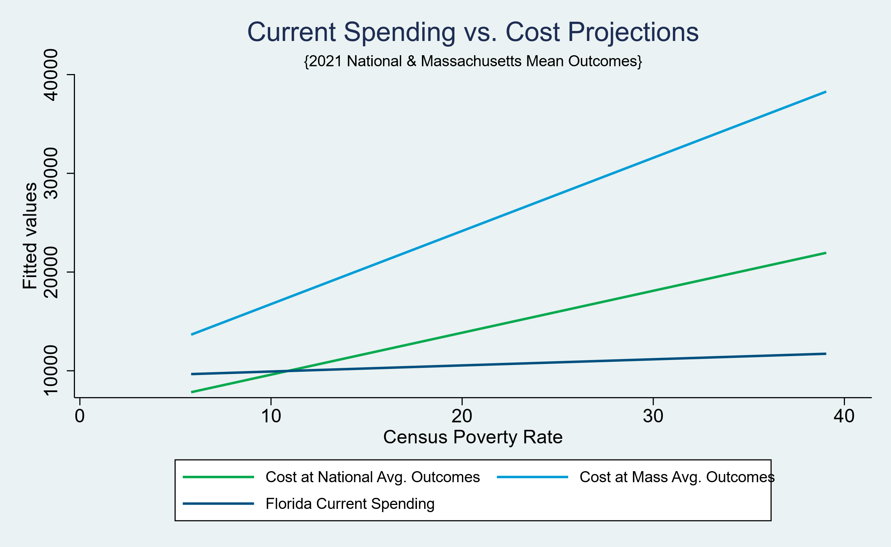
Current Spending vs. Costs of Equal Opportunity
(by Poverty)

Slide 28
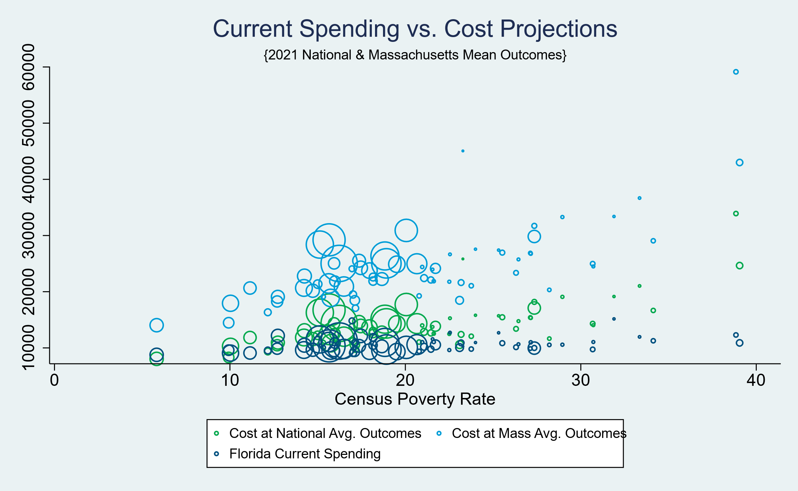
Current Spending vs. Costs of Equal Opportunity
(by Poverty)

Slide 29
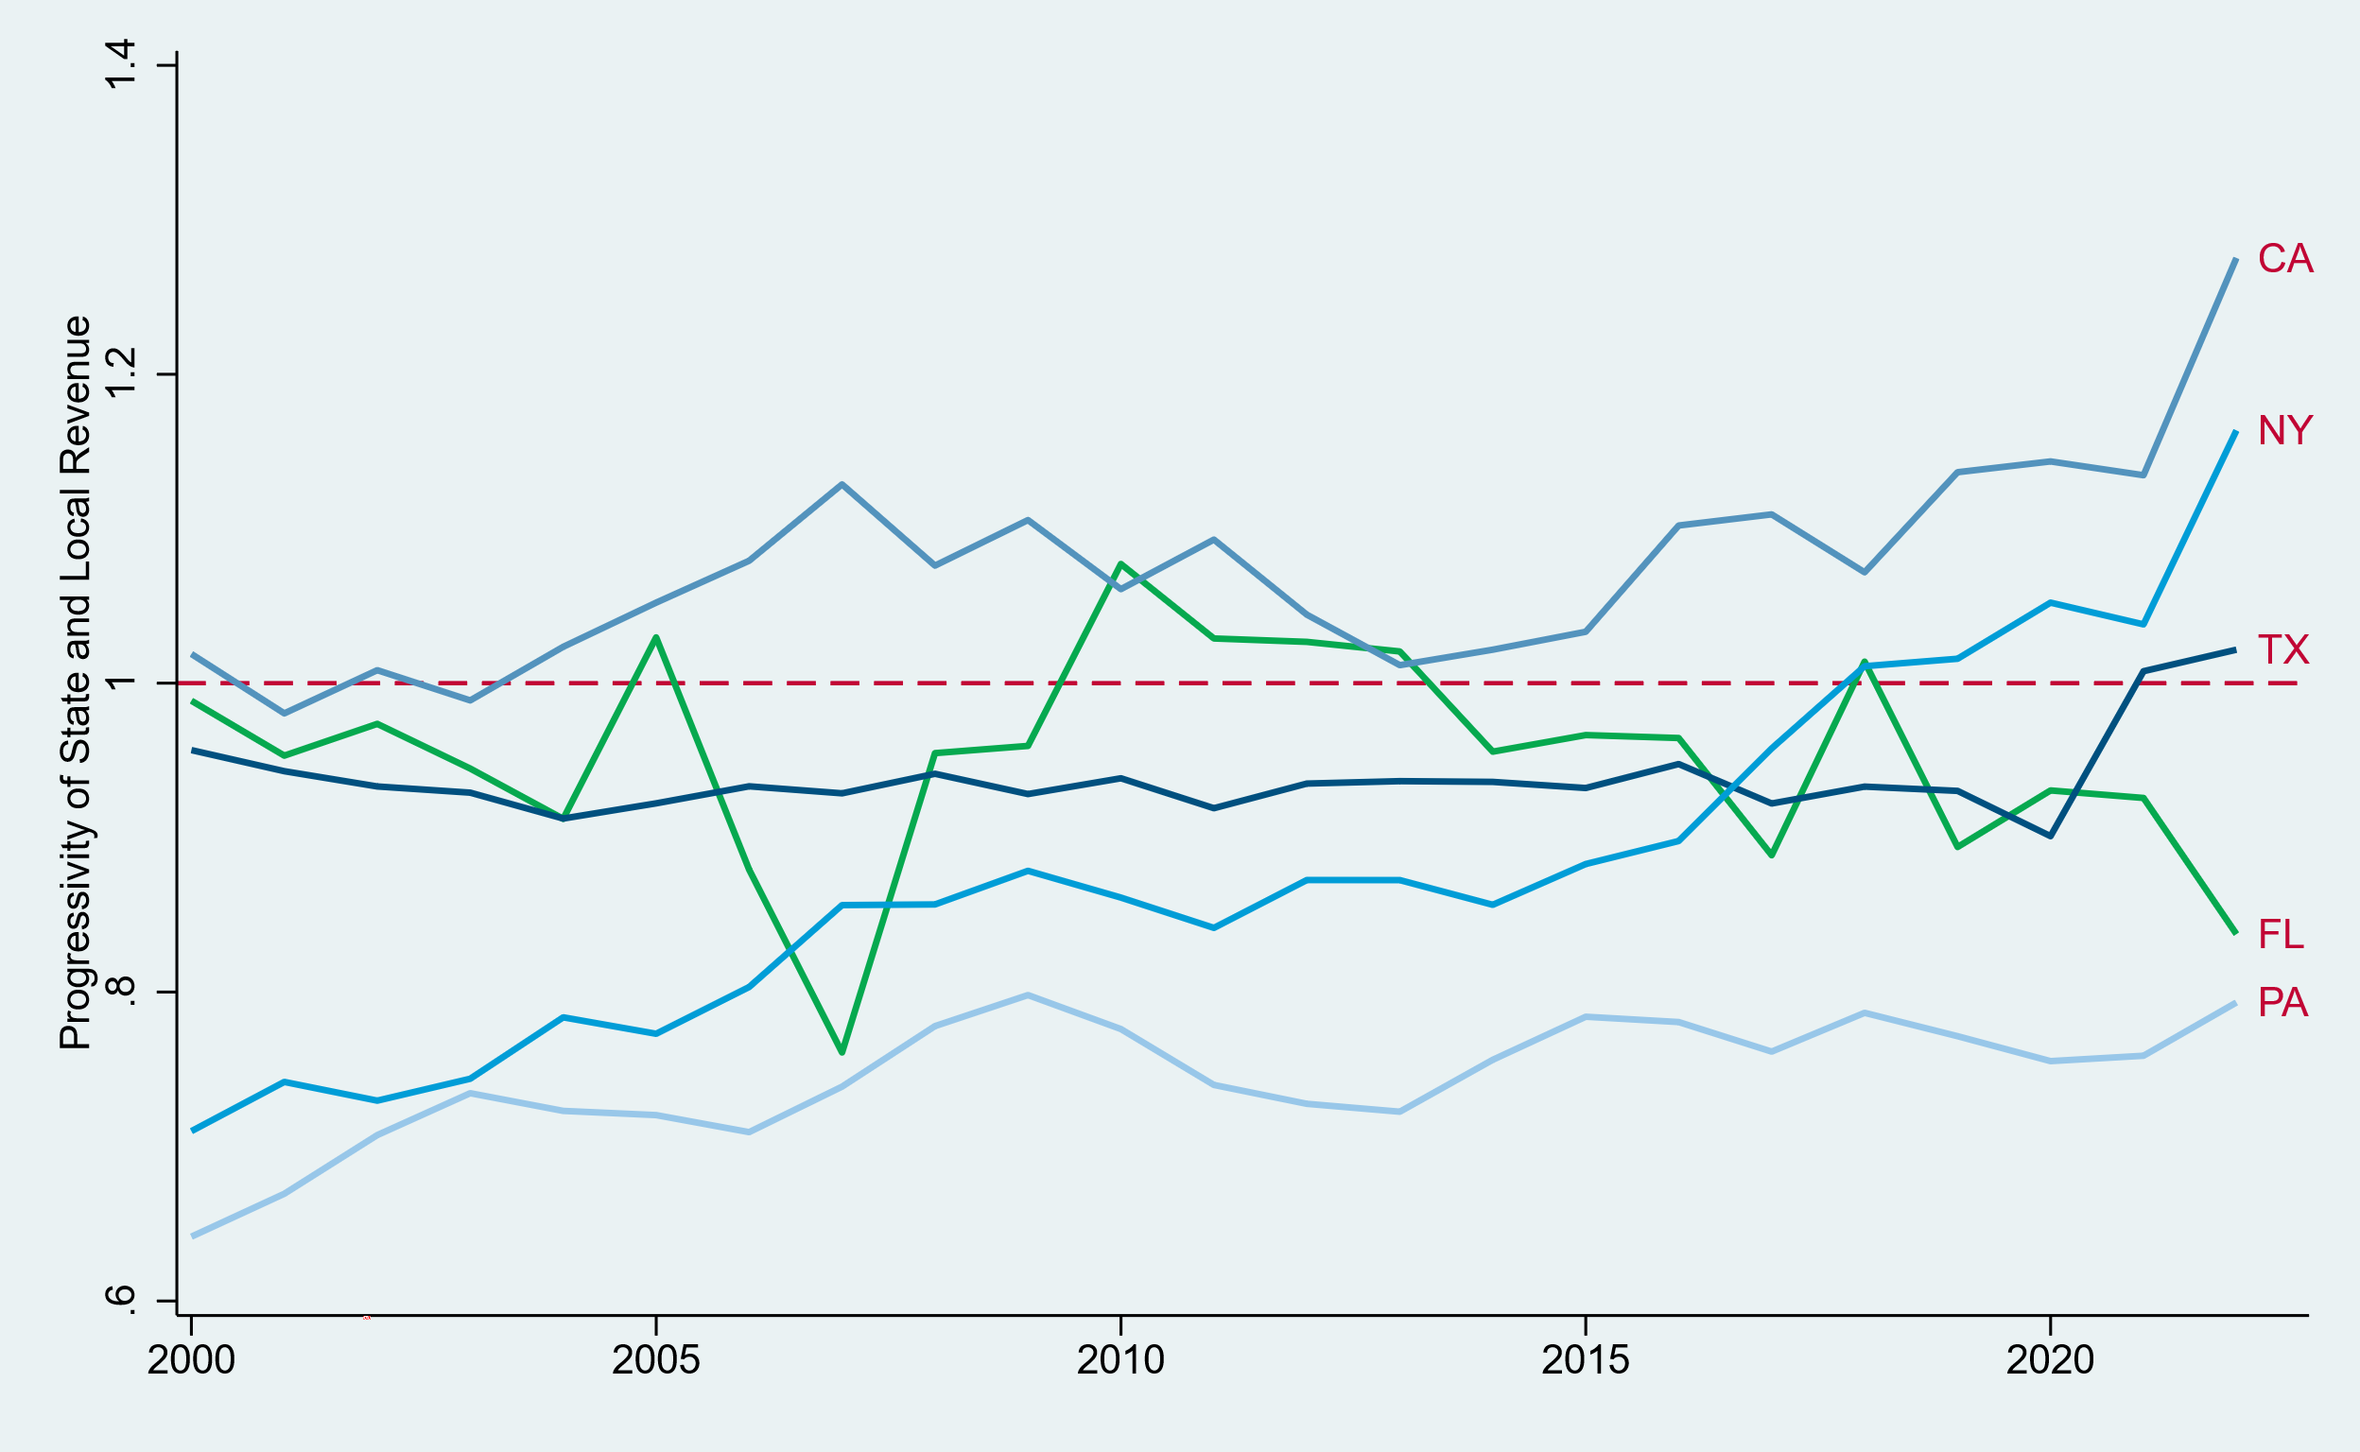
Progressiveness of State & Local Funding with respect to child poverty

Slide 30
Florida Outcomes

Slide 31
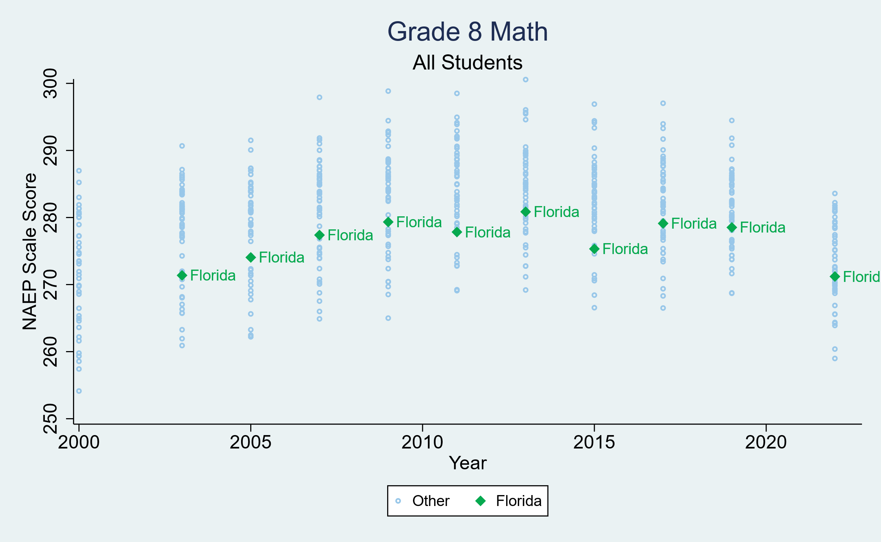
Math Outcomes
Compared to All Other States

Slide 32
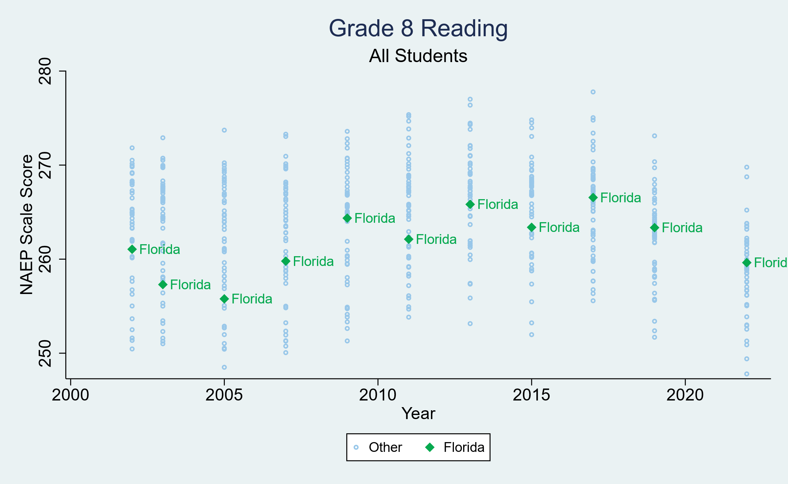
Reading Outcomes
Compared to All Other States

Slide 33
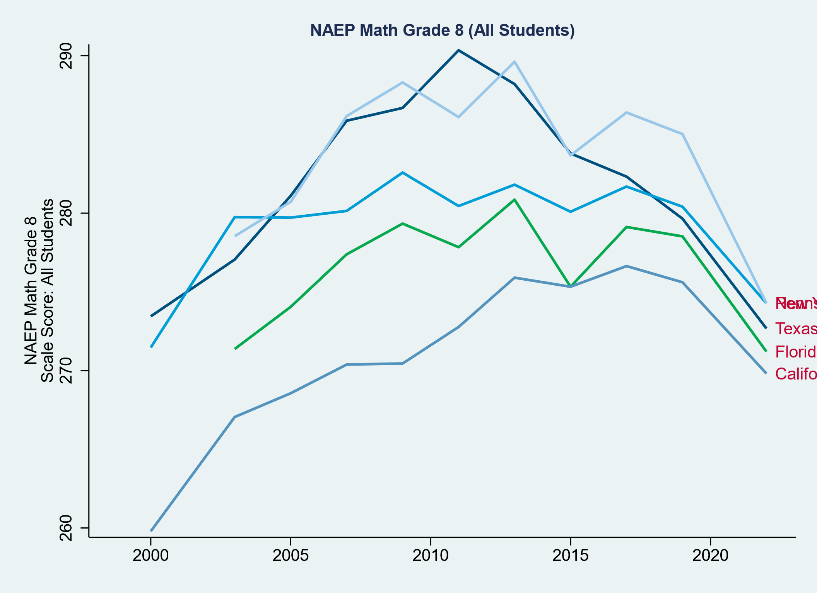
Math & Reading Outcomes
Compared to other Large States

Slide 34
Charters & Non-Public Schooling
Chasing Arizona

Slide 35
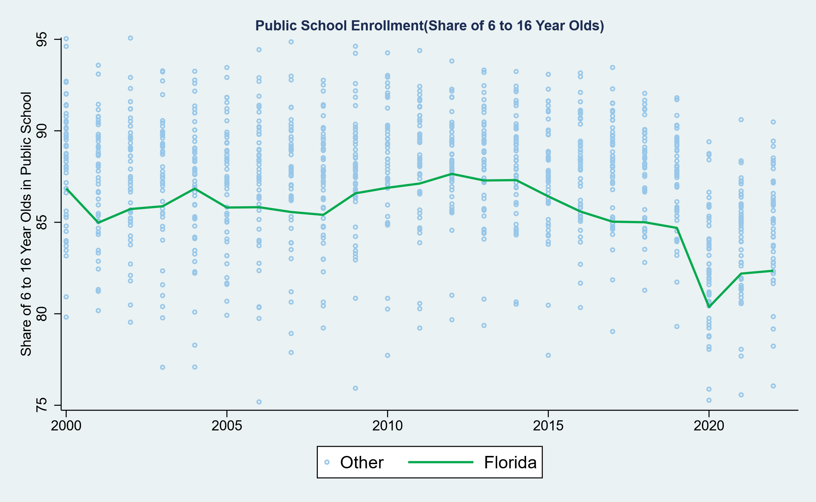
Public Schooled Enrollment Shares
Share of 6 to 16 Year Olds

Slide 36
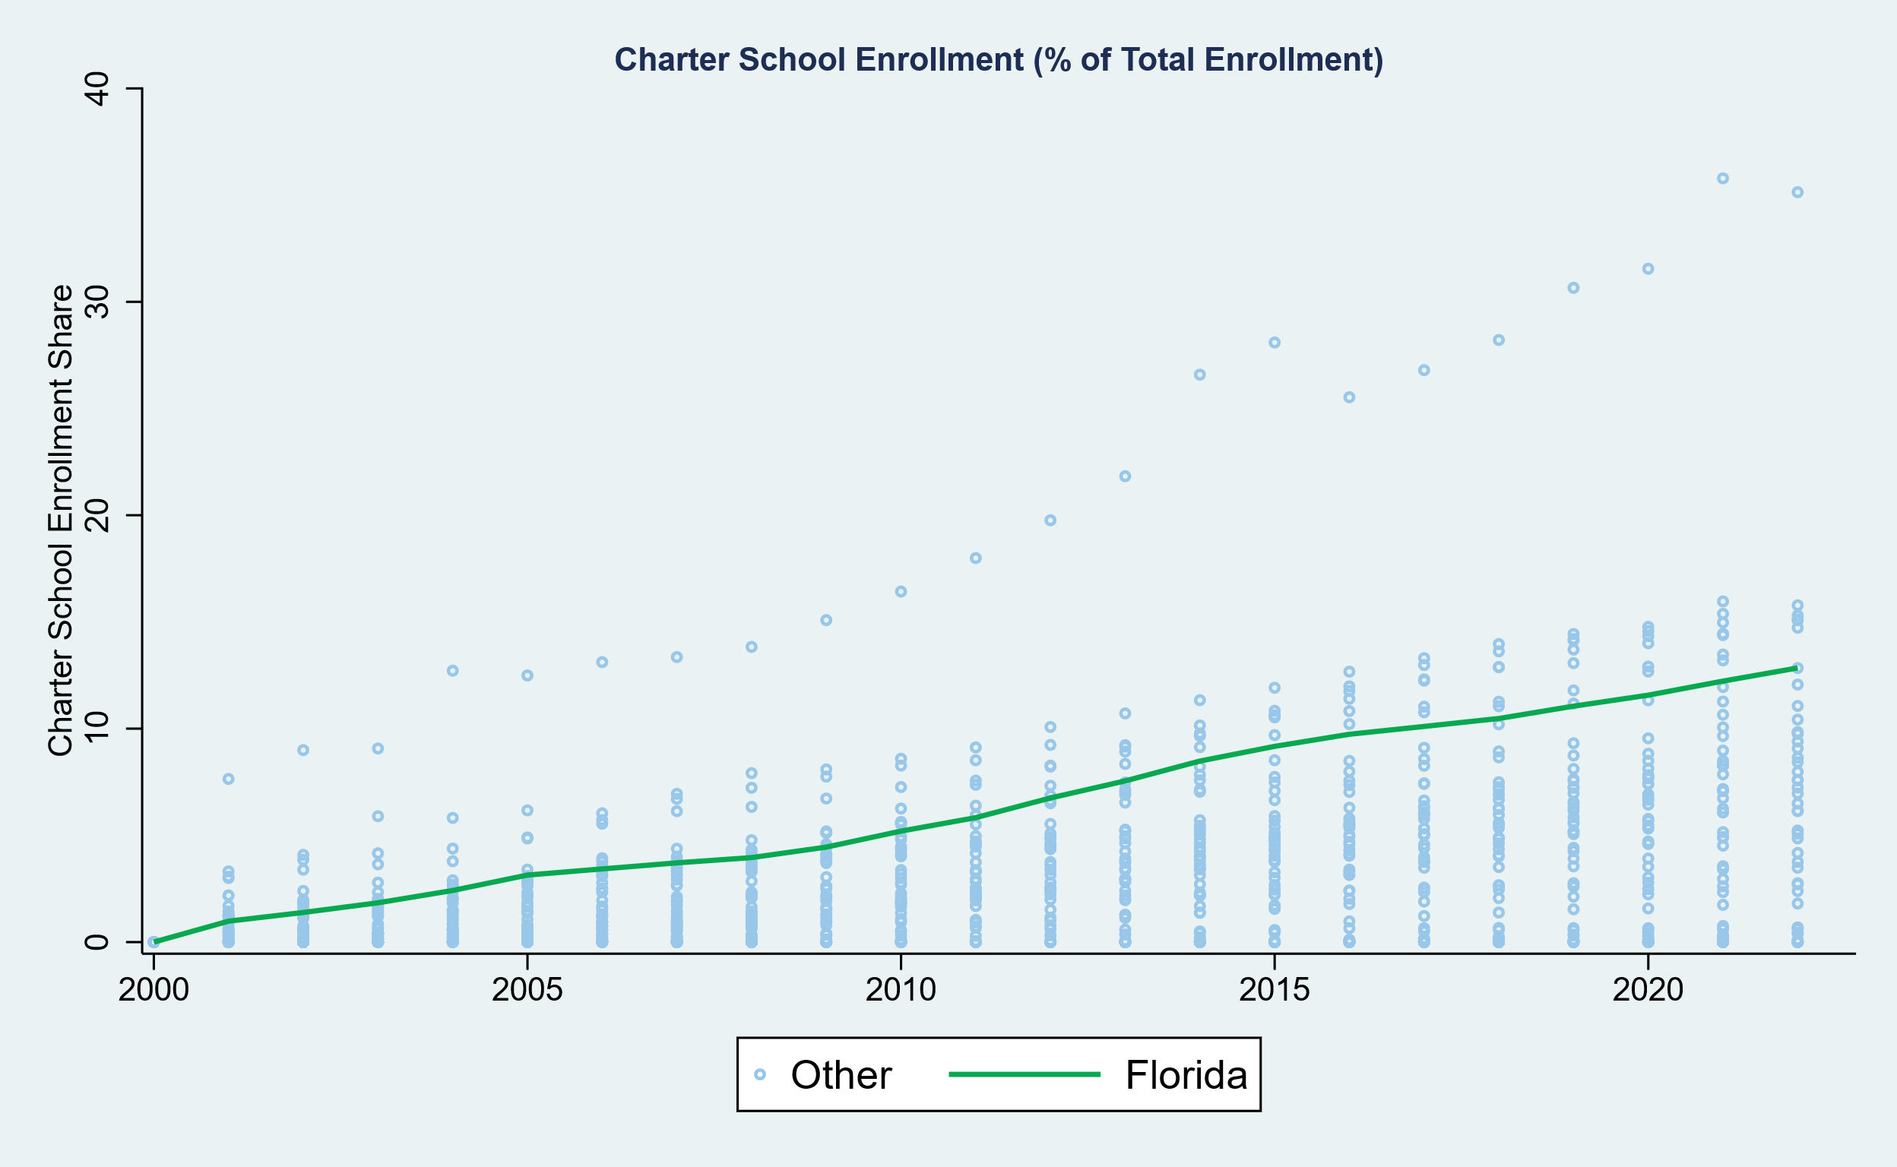
Charter School Enrollment Shares

Slide 37
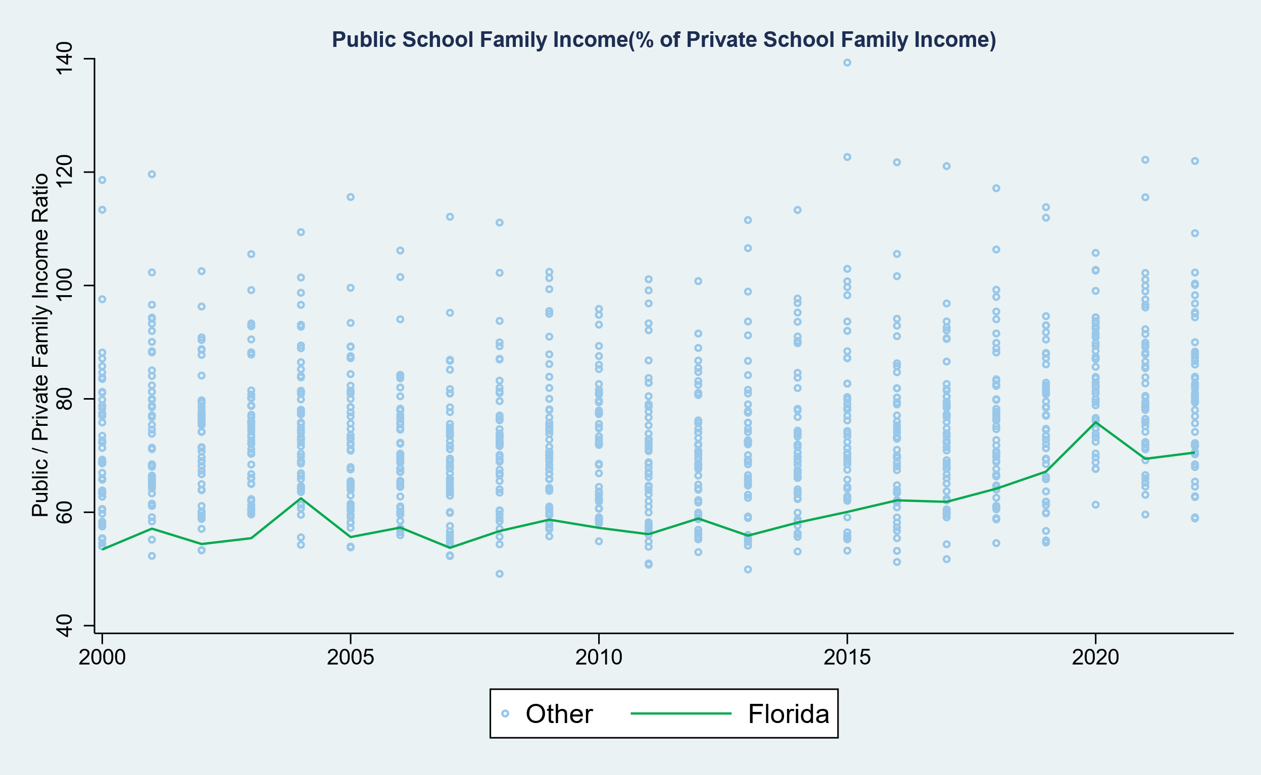
Public School Family Income relative to Private School Family Income

Slide 38
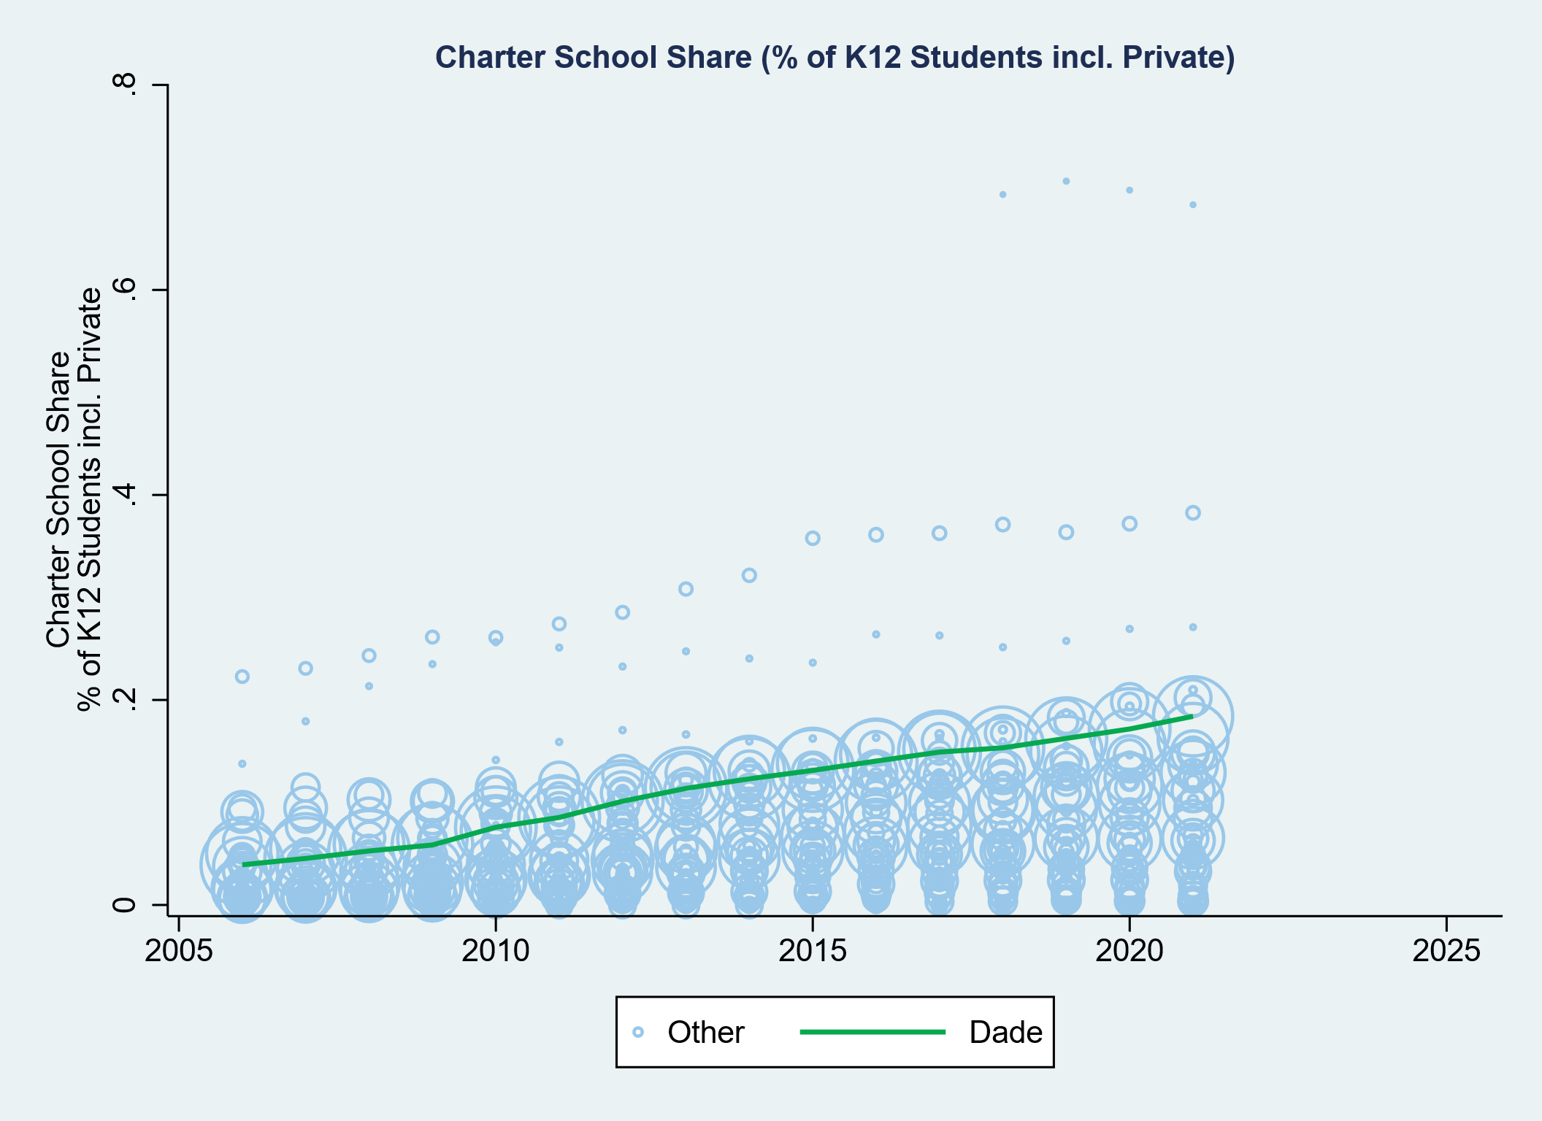
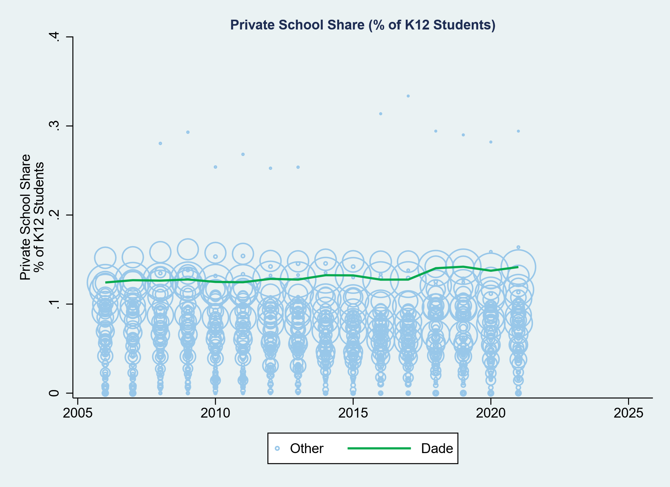
Florida District Charter & Private School Enrollment Shares

Slide 39
Revenue & Spending in Florida

Slide 40
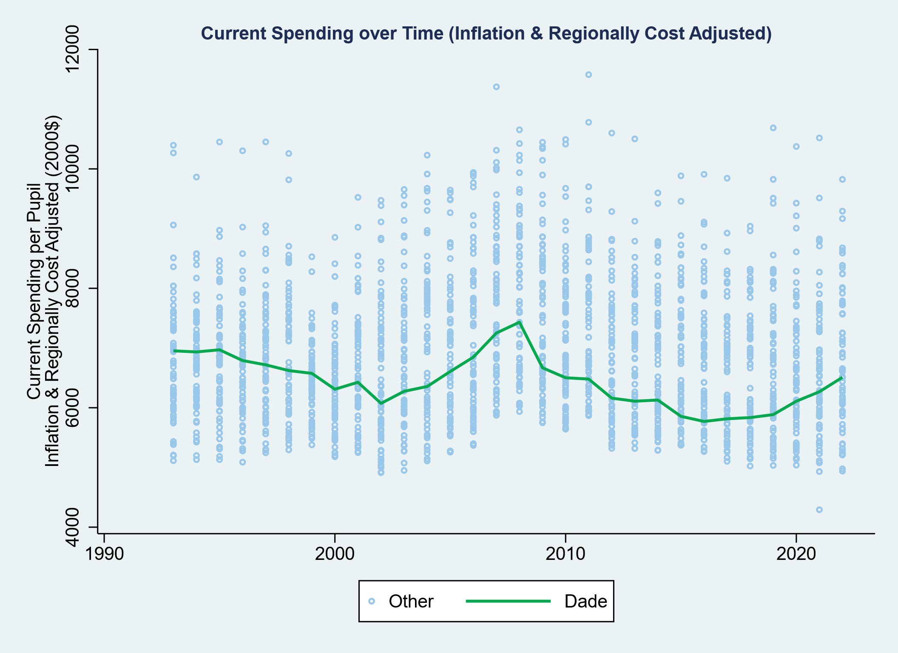
MDCPS Spending Down Since 1993
Adjusted for regional wage variation & employment costs over time (2000$)

Slide 41
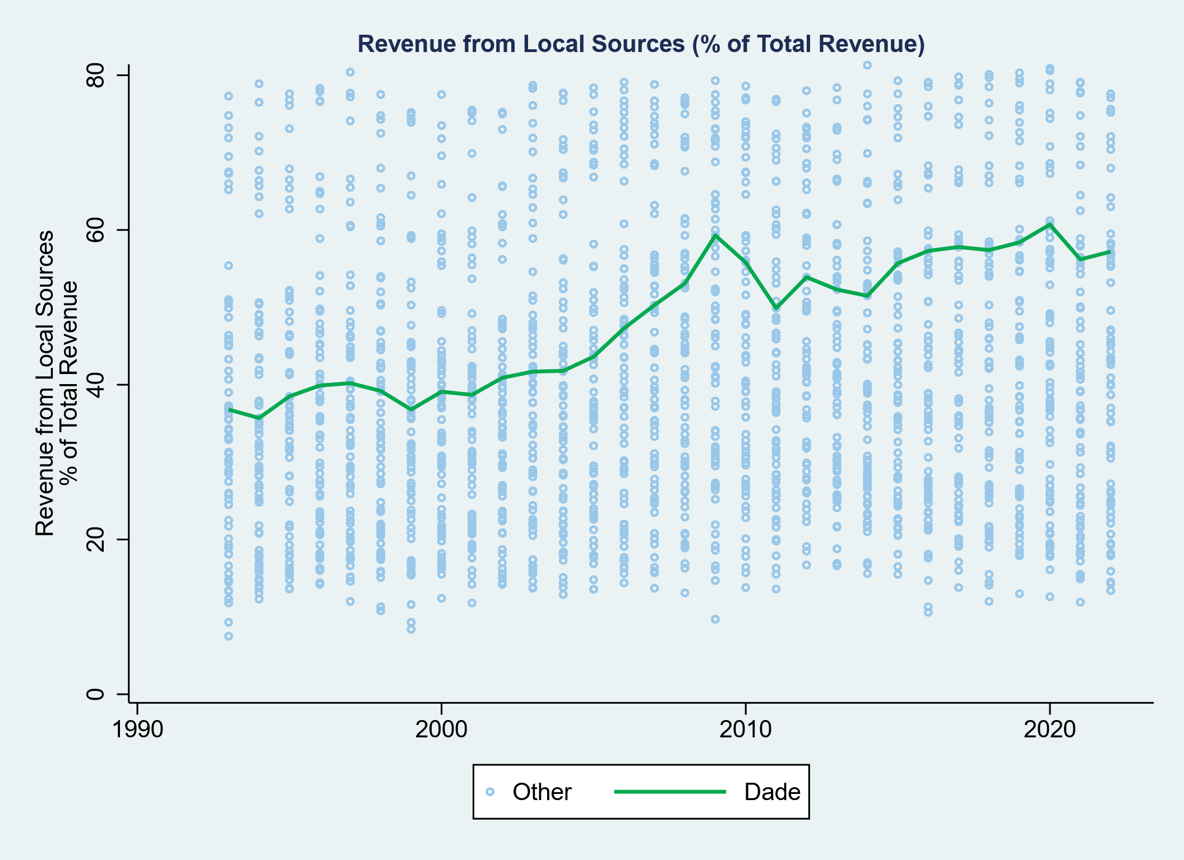
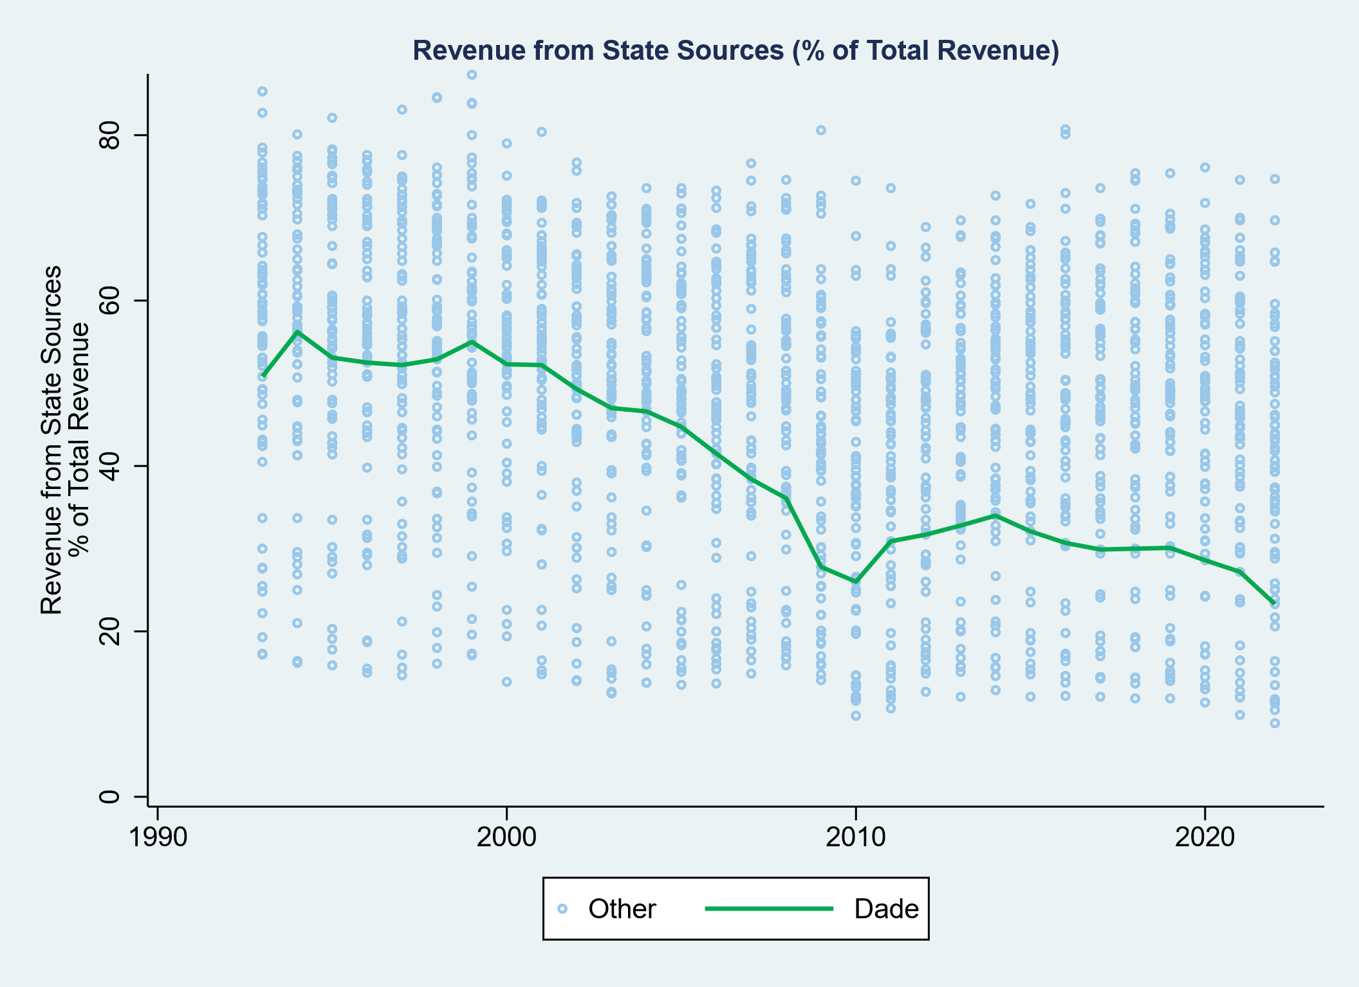
MDCPS Increased Dependence on Local Revenues

Slide 42
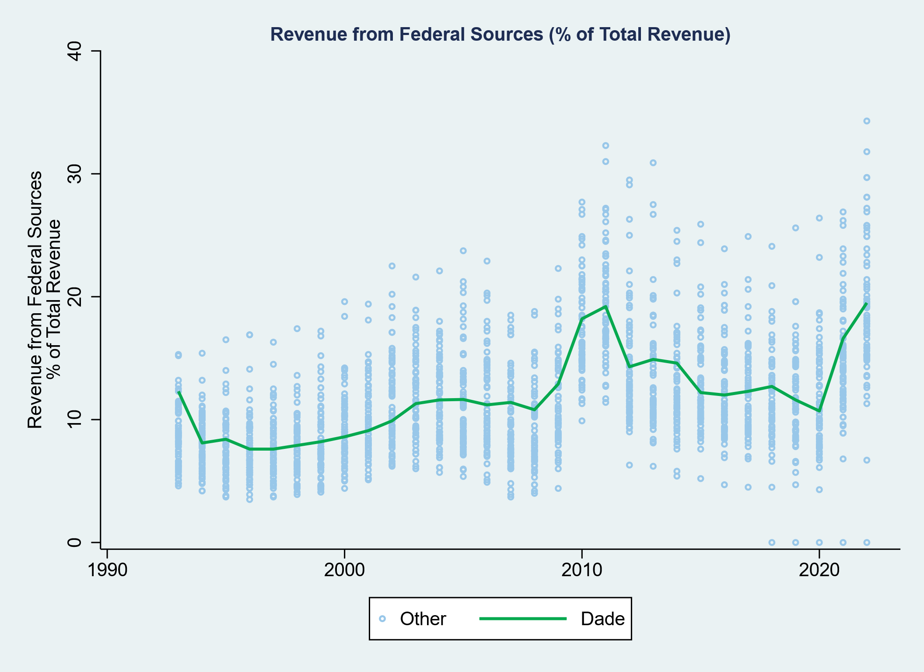
MDCPS Federal Revenue Fluctuations & Spending Fluctuations

Slide 43
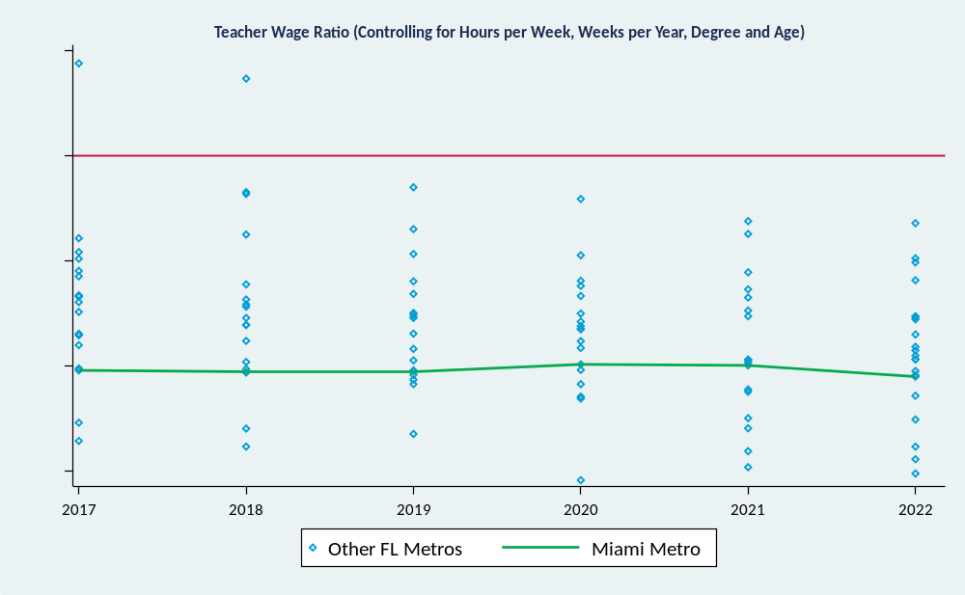
Teacher / Non-Teacher Wage Ratios in Florida
Controlling for age, degree level (2yr to Masters included), hours per week, weeks per year
Modeled with ACS 5-year panels at metro area level

Slide 44
Cost-Benefits of Reallocating Voucher Program Funding

Slide 45
How to spend a few billion (or more) dollars of new investment in k12 schooling
Decision should be guided by:
  Equity
  Efficiency
  Accountability
Option 1: Universal Vouchers
  60% end up supporting students already in private schools
  Those tend to be higher income families
  Recent studies of universal voucher programs show particularly poor outcomes, especially in math;
    Achievement declines more severe than COVID learning loss or Hurricane Katrina.
Option 2: State aid to high poverty schools/districts
  Substantial body of new literature finds that funding targeted to high poverty districts yields significant positive return on investment
  That return on investment is greater (several times) than the return on spending similarly in lower poverty, previously higher spending settings.

Slide 46
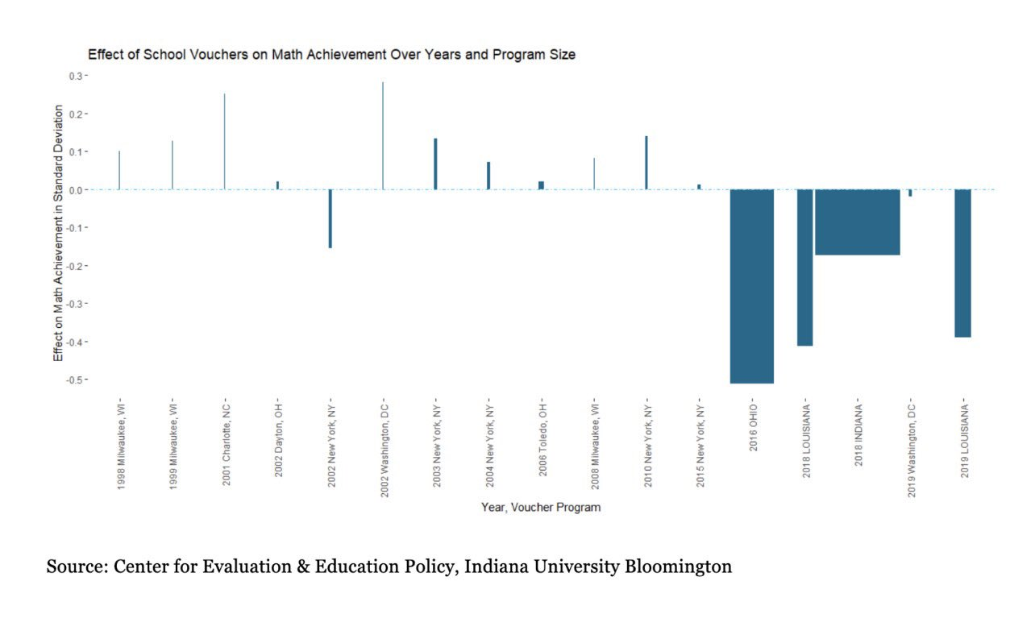
Outcomes of Universal Voucher Programs

Slide 47
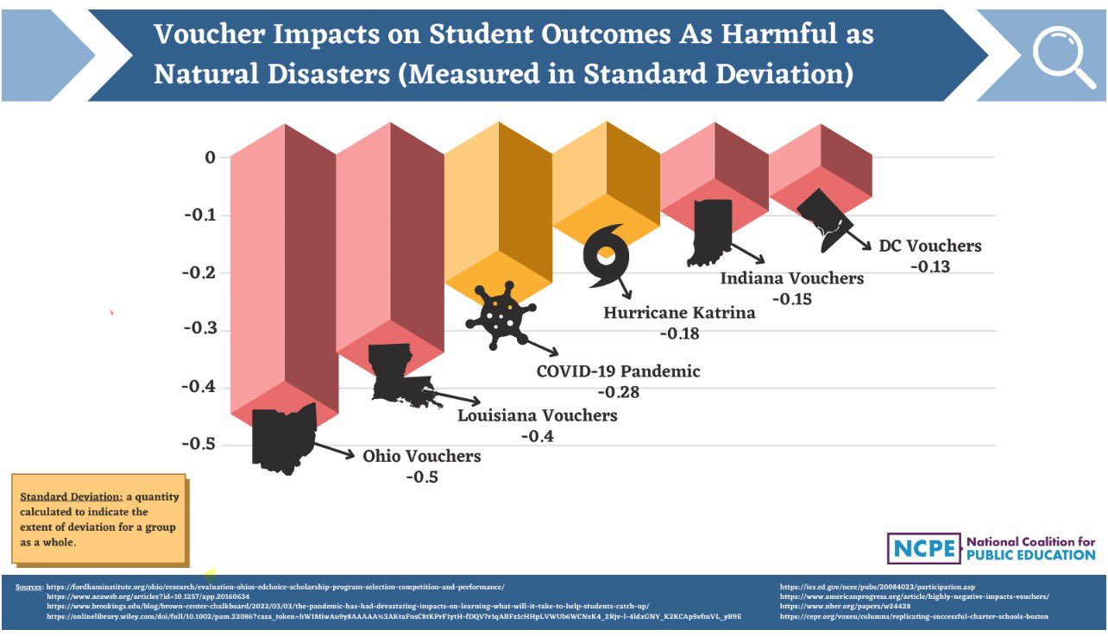

Slide 48
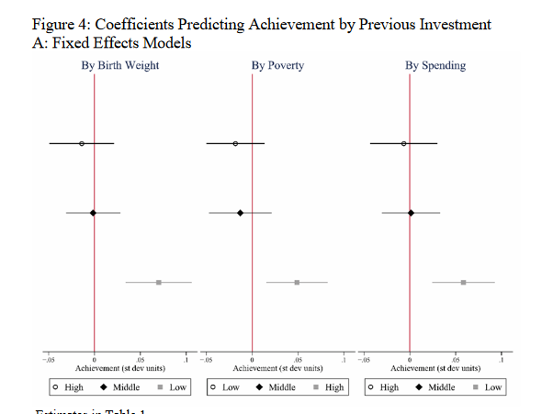
Return on Investment by Need & Prior Spending
(Rauscher & Shen, 2023)
https://sociologyofdevelopment.com/wp-content/uploads/2022/10/rauscher-and-shen-2022-no-3.pdf

Slide 49
Return on Investment by Need & Prior Spending
(Rauscher & Shen, 2023)
Low Birth Weight
High Poverty
Low Prior Spending
https://sociologyofdevelopment.com/wp-content/uploads/2022/10/rauscher-and-shen-2022-no-3.pdf

Slide 50
Re-allocating inequitable, inefficient (& unaccountable) voucher funding for greater return on investment

Slide 51
Summary

